Slide 1



Integrating Cost of Care Conversations
A Workflow Guide
Support for this work was provided by the New York State Health Foundation (NYSHealth). The mission of NYSHealth is to expand health insurance coverage, increase access to high-quality health care services, and improve public and community health. The views presented here are those of the authors and not necessarily those of the New York State Health Foundation or its directors, officers, and staff.

Slide 2

Instructions for this Course
In order to ensure that learners are able to fully interact with this course module, please:
Play this as a slide show by clicking the slideshow icon
Turn the computer sound on
Use the green arrows to advance through the slides

Slide 3
Learners will:
OBJECTIVES
Integrate Cost of Care conversations into patient care and encounters.

Slide 4

Knowledge Check
What cost conversations are already occurring?
Before we begin, take a moment to think about the out-of-pocket cost conversations that are already happening in your daily routine. If cost conversations aren’t occurring with patients, what other things are you doing now that will help support these conversations?
Click Next to see common practices that form a solid foundation for supporting out-of-pocket cost conversations in the workflow.
NEXT

Slide 5
Knowledge Check
Common Practices:
Team Huddles
Providing Patient Education Materials
Knowing which labs are in network
Having the Medication Formulary turned on in the EHR
Finding more affordable medications
What cost conversations are already occurring?
Before we begin, take a moment to think about the out-of-pocket cost conversations that are already happening in your daily routine. If cost conversations aren’t occurring with patients, what other things are you doing now that will help support these conversations?
Click Next to see common practices that form a solid foundation for supporting out-of-pocket cost conversations in the workflow.
NEXT

Slide 6


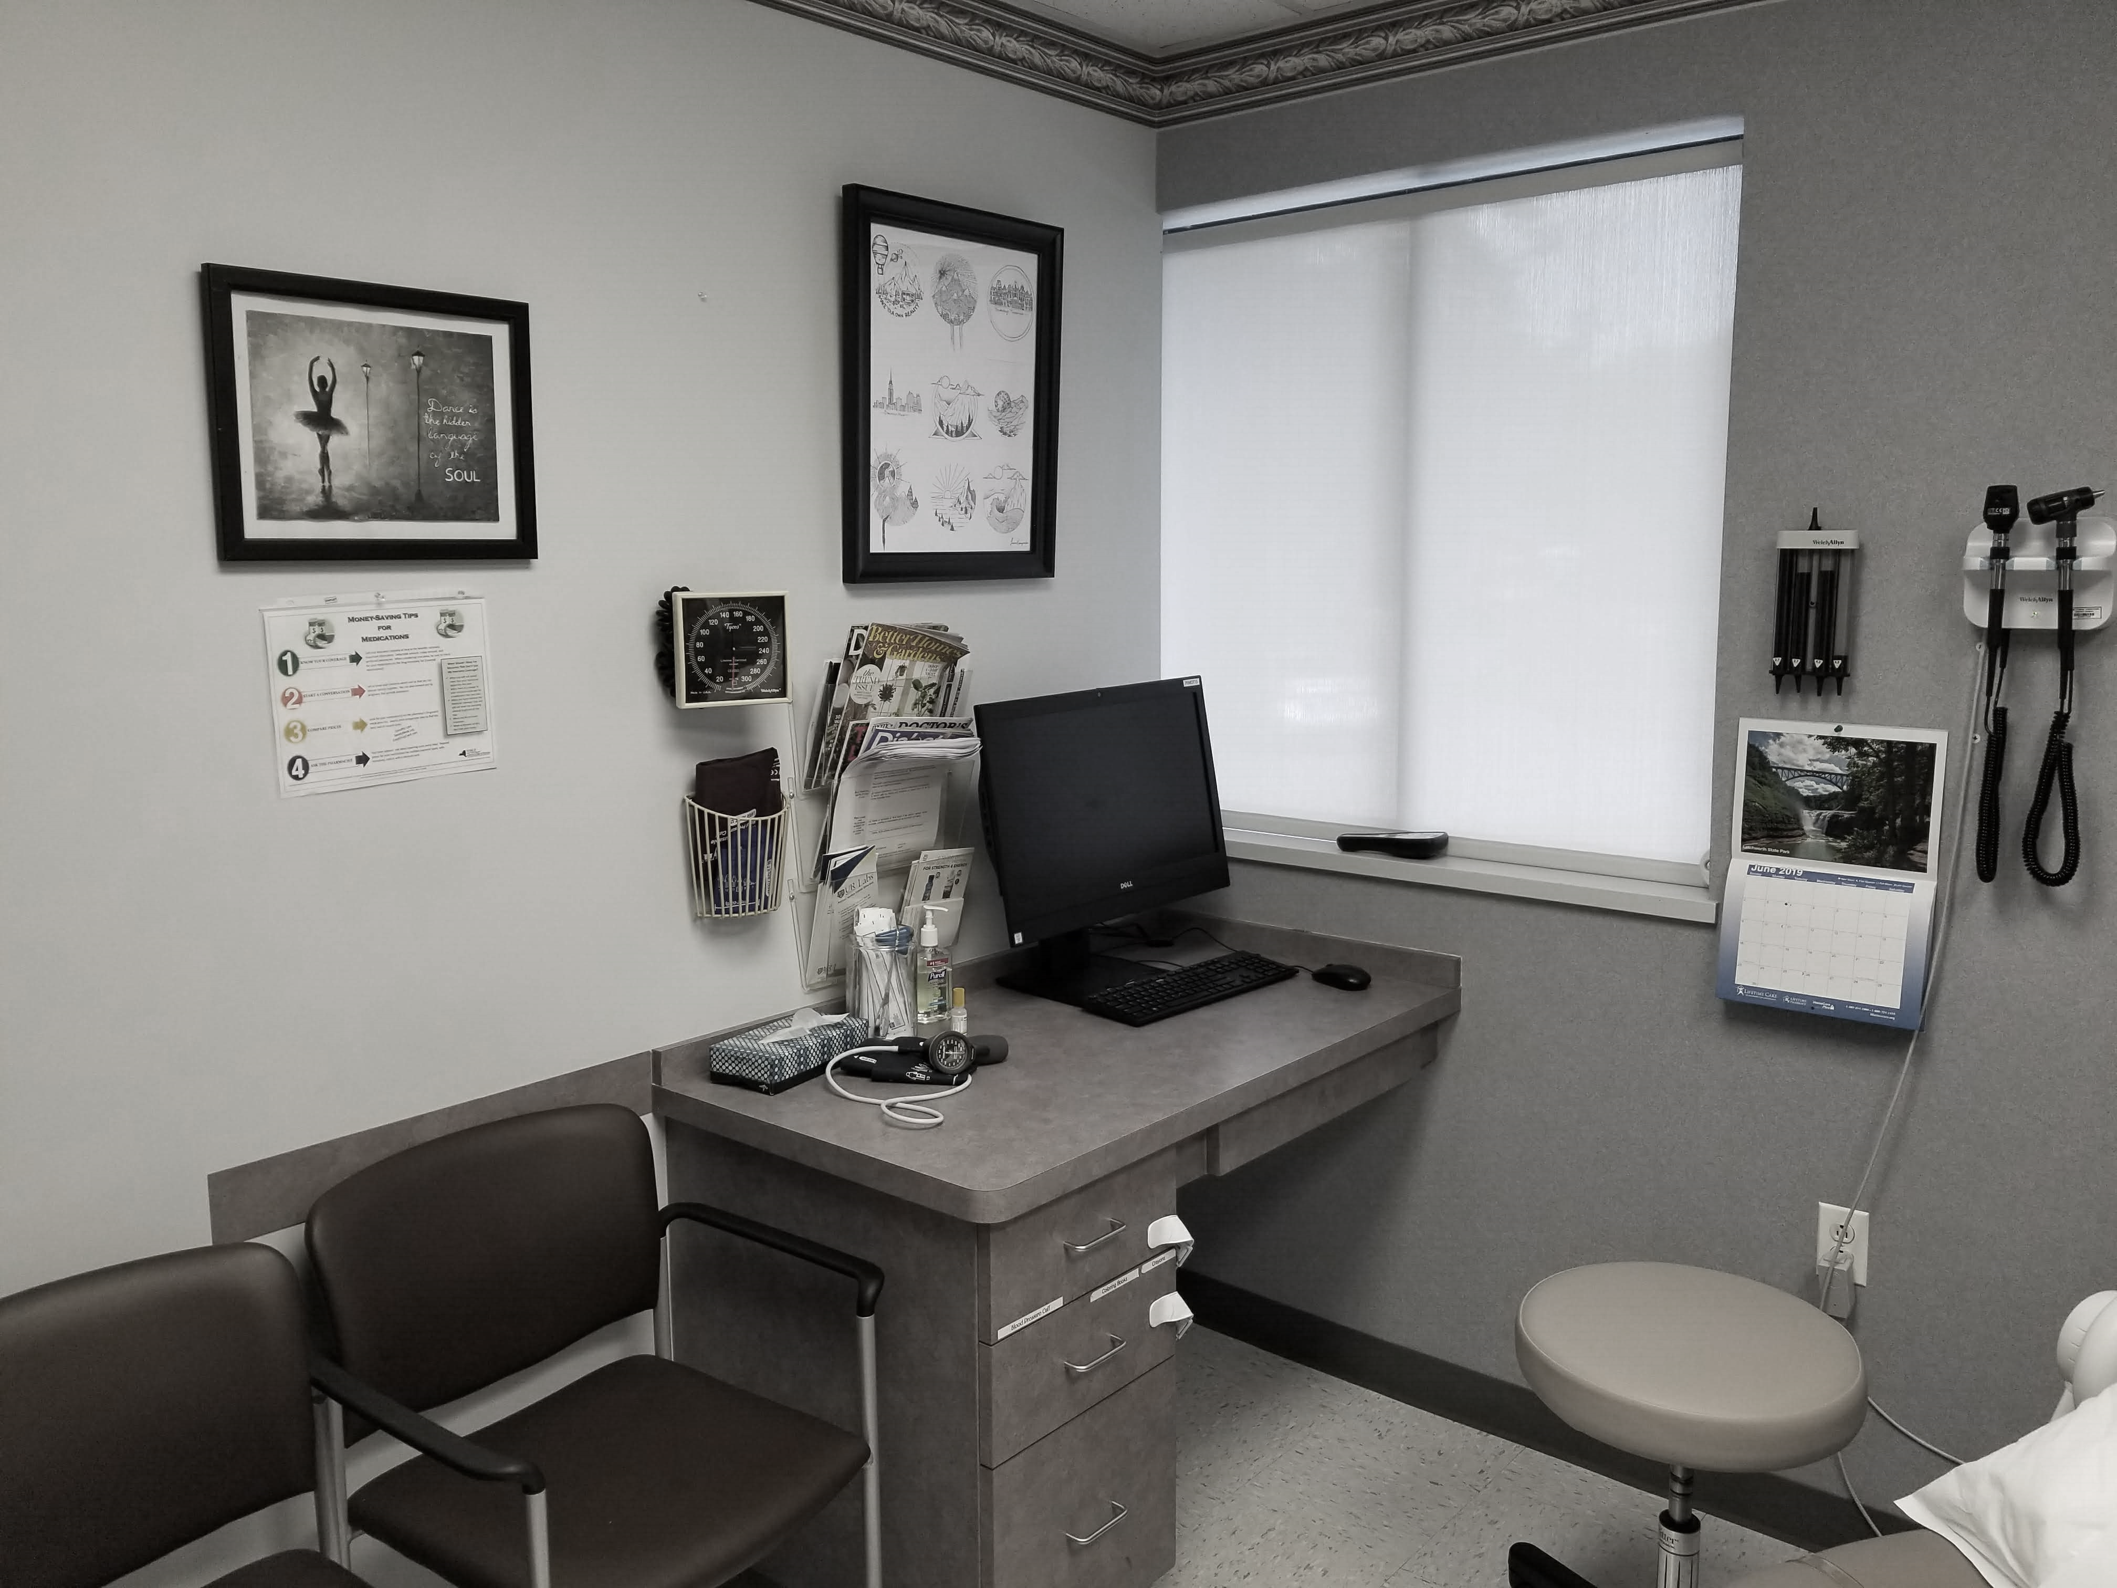



Workflow Guide
Cost of Care conversations are easier to incorporate into the workflow than you may think! Every staff member can play a small role in supporting the conversation, building relationships and affecting outcomes. This guide provides tips and tactics for each step in the workflow of an ambulatory care office.
PRE-VISIT
CHECK IN
EXAM ROOM
This Photo by Unknown Author is licensed under CC BY-SA
This Photo by Unknown Author is licensed under CC BY
POST VISIT
ADMINISTRATIVE
This Photo by Unknown Author is licensed under CC BY-SA
This Photo by Unknown Author is licensed under CC BY-ND

Slide 7
Cost of Care
Before the Visit
PRE-VISIT
Who: Scheduling, New Patient Registration, Care Team
Confirm network status based on the patient’s insurance. Notify the patient if they are out of network.
Identify missing labs/tests/images/referral reports – this could be a red flag. They may skip these due to cost.
Identify if there are unimproved outcomes – this could be a red flag. They may not be adherent due to cost.

Slide 8


Knowledge Check
Laura just moved to the area and wants to make a new patient appointment. How should she be helped?
Click on the icon to for feedback!
Hi! I’d like to make an appointment with Dr. Smith.
“Going out of network can mean higher costs for you, so let’s verify that Dr. Smith is in your network first. Do you have your insurance card handy?”
“Welcome to town! Let’s get you scheduled.”
“I’m not able to verify that Dr. Smith is in network for your insurance plan. Let me provide you with a phone number to call your insurance and Dr. Smith’s NPI number. Your insurance will have the most up to date information. Since going out of network can mean higher costs for you, I anted to let you know before we go ahead and book. Would you like to make an appointment or check with your insurance first?”

Slide 9
Knowledge Check
Laura just moved to the area and wants to make a new patient appointment. How should she be helped?
Click on the icon to for feedback!
Hi! I’d like to make an appointment with Dr. Smith.
“Going out of network can mean higher costs for you, so let’s verify that Dr. Smith is in your network first. Do you have your insurance card handy?”
A simple way to let the patient know you care! It also allows staff to gather information up front, which makes for better flow on the day of the appointment. Use the insurance website to verify network status.
More information should be gathered up front in order to normalize the conversation, help expedite things on the day of the appointment and prevent billing questions later.
“Welcome to town! Let’s get you scheduled.”
“I’m not able to verify that Dr. Smith is in network for your insurance plan. Let me provide you with a phone number to call your insurance and Dr. Smith’s NPI number. Your insurance will have the most up to date information. Since going out of network can mean higher costs for you, I anted to let you know before we go ahead and book. Would you like to make an appointment or check with your insurance first?”
While this may be lengthy, it has some great pieces to it: it let’s Laura know you care, normalizes cost conversation, provides Laura with helpful information and allows her to make a choice.

Slide 10


Knowledge Check
It’s Thursday morning and you just heard this information at team huddle. Which ones relate to cost of care?
Click on the icon to for feedback!
“Miles Carr is coming in today and his lab results weren’t in his chart. I called the lab and confirmed that they do not have results for him. “
“Marietta Jain is on the schedule for her 3 month follow up today. She has rescheduled this appointment 3 times so we need to follow up if she doesn’t come.”
This Photo by Unknown Author is licensed under CC BY-SA
“A patient brought in a bill for Shingrix the other day and was really upset about the high cost. Our office manager did some digging and found it at a reduced cost at the pharmacy with Part B coverage.”
10

Slide 11
Knowledge Check
It’s Thursday morning and you just heard this information at team huddle. Which ones relate to cost of care?
Click on the icon to for feedback!
“Miles Carr is coming in today and his lab results weren’t in his chart. I called the lab and confirmed that they do not have results for him. “
Consider that adherence issues may be due to cost. Perhaps last time Mr. Carr went to an out of network lab and received a large bill. He may be spread thin and has chosen to forego testing until he has more funds available.
“Marietta Jain is on the schedule for her 3 month follow up today. She has rescheduled this appointment 3 times so we need to follow up if she doesn’t come.”
Consider that cost can be a reason for missed appointment. Perhaps Ms. Jain is having trouble taking off of work, affording childcare or simply paying her copay.
This Photo by Unknown Author is licensed under CC BY-SA
Yes! Cost is mentioned directly. This shows how quickly and easily information can be shared using the “people” tool for communication!
“A patient brought in a bill for Shingrix the other day and was really upset about the high cost. Our office manager did some digging and found it at a reduced cost at the pharmacy with Part B coverage.”
11

Slide 12
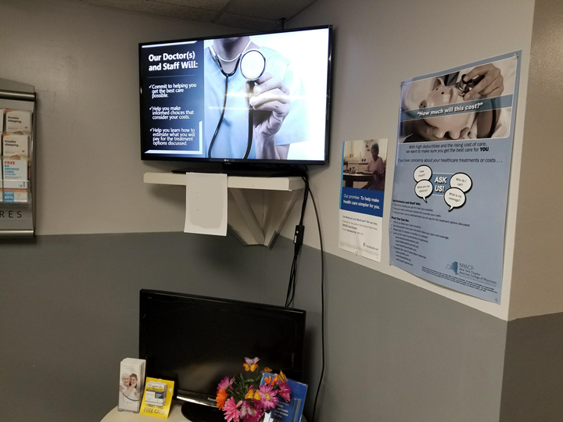
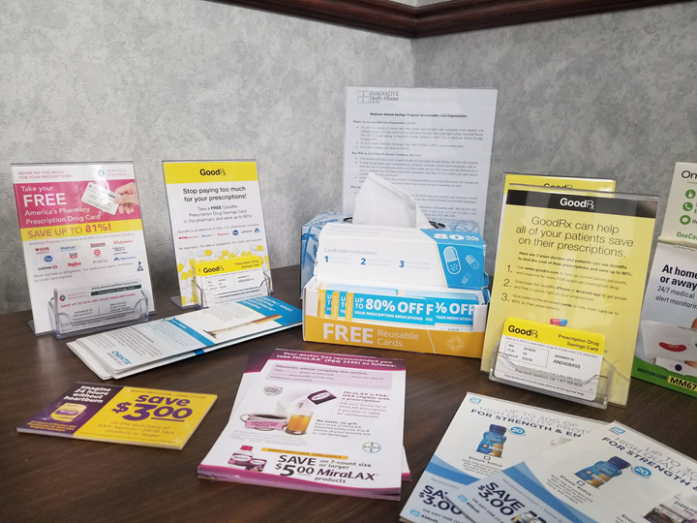
Cost of Care
When the Patient Arrives
CHECK IN
Who: Front Desk Staff
Use the Patient Insurance Literacy handout to assist with answering any insurance questions
Provide financial screening questions with registration form
Enter any cost concerns or special billing information into the EHR.
Place posters and informational slides in the waiting room to normalize the topic.
Place coupons, discount cards and patient assistance programs in the waiting room.

Slide 13

Cost of Care in the Exam Room
EXAM ROOM
Who: Nurses, Medical Assistants, Clinicians
Ask open ended questions about medication adherence and affordability
Follow up on positive financial screening done at the front desk or initiate financial screening. Use bookmarked tools on the computer to assist.
Listen for patient triggers about cost
Let the patient know that cost concerns are important to you for all patients
Provide Handouts
Know your needs and understand your patient’s needs. When necessary, it’s ok to follow up on questions after the visit!

Slide 14
Cost of Care
Conversation Starters
There is no perfect formula for out-of-pocket cost conversations. The key is to start and let patients know that you care. Here are some ideas that other Physicians have used to get started!
“How often are you taking your meds?”
“Call me if you can’t do it” (meaning cover the cost)
“Are you affording...?” “ Would you like resources?”
“This could be expensive with a high deductible plan.”
“Is there anything we can do to make it easier for you to take care of your health?”
“Are you able to afford this?”
“Do you have any problems affording your medications?”

Slide 15


Knowledge Check
Mary and Dr. Smith are discussing a treatment plan. She looks concerned and has asked about missing work and if she needs to “do this now.” How can Dr. Smith assist Mary?
Click on the icon to for feedback!
Provide handouts about insurance coverage.
Provide a list of price transparency tools to help her estimate costs.
Provide information about patient advocates and patient assistance programs.
Ask Mary about her concerns. (Is it time, cost, work restrictions?) And discuss options that address these concerns.
This Photo by Unknown Author is licensed under CC BY-NC-ND

Slide 16
Knowledge Check
Mary and Dr. Smith are discussing a treatment plan. She looks concerned and has asked about missing work and if she needs to “do this now.” How can Dr. Smith assist Mary?
Click on the icon to for feedback!
Handouts are helpful for patients with questions about how insurance works or to find out more about their plan. In this case, it most likely will not address Mary’s concerns.
Provide handouts about insurance coverage.
Provide a list of price transparency tools to help her estimate costs.
It’s great to have a list of these tools on hand to help patients plan. This may be helpful as Mary’s treatment plan is finalized to help her plan for costs.
Mary’s concerns about missing work have tipped you off that there could be indirect cost constraints affecting her ability to follow the treatment plan! Putting her in contact with someone who can help with transportation costs or other patient assistance programs would help ease concern.
Provide information about patient advocates and patient assistance programs.
Sometimes letting the patient know this is important to you can help open the conversation. Perhaps there are options to consolidate visits or even another clinically equivalent option that may help address her concerns.
Ask Mary about her concerns. (Is it time, cost, work restrictions?) And discuss options that address these concerns.
This Photo by Unknown Author is licensed under CC BY-NC-ND

Slide 17


Knowledge Check
Dr. Little sees that, despite changes, Mr. Flower’s outcomes haven’t improved. She is wondering about his medications and if she should adjust them. Before she does, how can Dr. Little use her out-of-pocket cost knowledge to help Mr. Flower?
Click on the icon to for feedback!
Connect Mr. Flower with Prescription assistance programs.
Use knowledge of price ranges and discount cards to help Mr. Flower save on medication costs.
Ask more open ended questions about taking medications.
This Photo by Unknown Author is licensed under CC BY-SA

Slide 18
Knowledge Check
Dr. Little sees that, despite changes, Mr. Flower’s outcomes haven’t improved. She is wondering about his medications and if she should adjust them. Before she does, how can Dr. Little use her out-of-pocket cost knowledge to help Mr. Flower?
Click on the icon to for feedback!
This is great knowledge to have! Dr. Little is familiar with options and contacts to help Mr. Flower if cost is indeed the issue.
Connect Mr. Flower with Prescription assistance programs.
Use knowledge of price ranges and discount cards to help Mr. Flower save on medication costs.
This is great knowledge to have! Dr. Little is familiar with the tools and options to help Mr. Flower if cost is indeed the issue.
Dr. Little should definitely consider that cost could be preventing adherence. Mr. Flower could be skipping doses, cutting pills, or even stopping medications to save money. Asking more open ended questions is a great start to uncovering this!
Ask more open ended questions about taking medications.
This Photo by Unknown Author is licensed under CC BY-SA

Slide 19
Cost of Care
After the Visit
POST VISIT
Who: Staff, Nurses/MA's, Medical Records, Billing, Clinicians
Use covermymeds to assist with the pre-authorization process
Close the loop on referrals/labs/tests/imaging. Missed appointments could be due to cost concerns. This will prep for the next visit.
Billing staff can assist with questions that patients have about their insurance

Slide 20
Cost of Care
Administrative Tasks
ADMINISTRATIVE
Who: Everyone
Staff Meetings for continuing staff education
Gather Information from local facilities
Analyze Information to identify where patient outcomes can be affected by cost and improved.

Slide 21

Additional Resources
ACP
Practice Level Approach to Addressing health Care Cost Distress
NYACP
Sample Workflow
Poster
Financial Screening Questions
Webinar – Lessons From the Field
Avalere Practice Briefs
How to Talk to Your Patients About the Costs of Their Care
How to Integrate Cost-of-Care Conversations into Workflow
Considerations for Facilitating Cost-of-Care Conversations with Vulnerable Patients
This Photo by Unknown Author is licensed under CC BY-SA

