Slide 1

Million Dollar Claims
A Closer Look

Slide 2

Continuing Medical Education
CME Accreditation and Designation Statement
MLMIC is accredited by the Medical Society of the State of New York (MSSNY) to provide CME for physicians.
MLMIC designates this live educational activity for a maximum of 2.0 AMA PRA Category 1 Credits™. Physicians should claim only the credit commensurate with the extent of their participation in the activity.

Slide 3
Continuing Medical Education
Disclosure Policy Statement
MLMIC relies upon planners and faculty participants in its CME activities to provide educational information that is objective and free of bias. In this spirit and in accordance with the guidelines of MSSNY and the ACCME, all speakers and planners for CME activities must disclose any relevant financial relationships with commercial interests whose products, devices or services may be discussed in the content of a CME activity, that might be perceived as a real or apparent conflict of interest. Any discussion of investigational or unlabeled uses of a product will be identified.
The material presented in this program is intended for educational purposes only and does not constitute legal advice.
In cases of specific legal questions, always contact an attorney.
©2019 MLMIC Insurance Company. All rights reserved.

Slide 4
Disclosure Information
  The attorney from Fager Amsler Keller & Schoppmann, LLP, the MLMIC Risk Management Consultant, and the MLMIC Claims Representative have no relevant financial relationships to disclose.

Slide 5
Million Dollar Claims
A Closer Look
MLMIC Insurance Company prepared this analysis of claims that closed during 2013 through 2017 and resulted in payments of one million dollars or more.
Our goal was to determine the issues and commonalities of those losses in order to proactively mitigate high exposure risks for our insureds.

Slide 6
Million Dollar Claims
A Closer Look
Each closed claim reviewed in this report is derived from MLMIC’s database of losses within the State of New York.
As the leading liability carrier for healthcare professionals and facilities in New York, only MLMIC has the experience, knowledge and expertise to provide such a detailed overview of New York’s medical professional liability environment.

Slide 7
Objectives:
At the end of this presentation, the participant will be able to:
  identify the leading causes of loss in million-dollar claims;
  analyze the key factors leading to significant payments in these claims;
  recognize the chief medical factors identified in these files; and
  implement risk management strategies to lessen the risks of high-exposure professional liability claims within your organization.

Slide 8
By the Numbers…
29,063
  Professional liability claims processed by MLMIC between 2013—2017
459
  Professional liability claims analyzed for the purpose of this report where the indemnity payment totaled one million dollars or more
$1,332,040
  The average indemnity payment among the claims reviewed for this report, the highest of which was $2.35 million

Slide 9
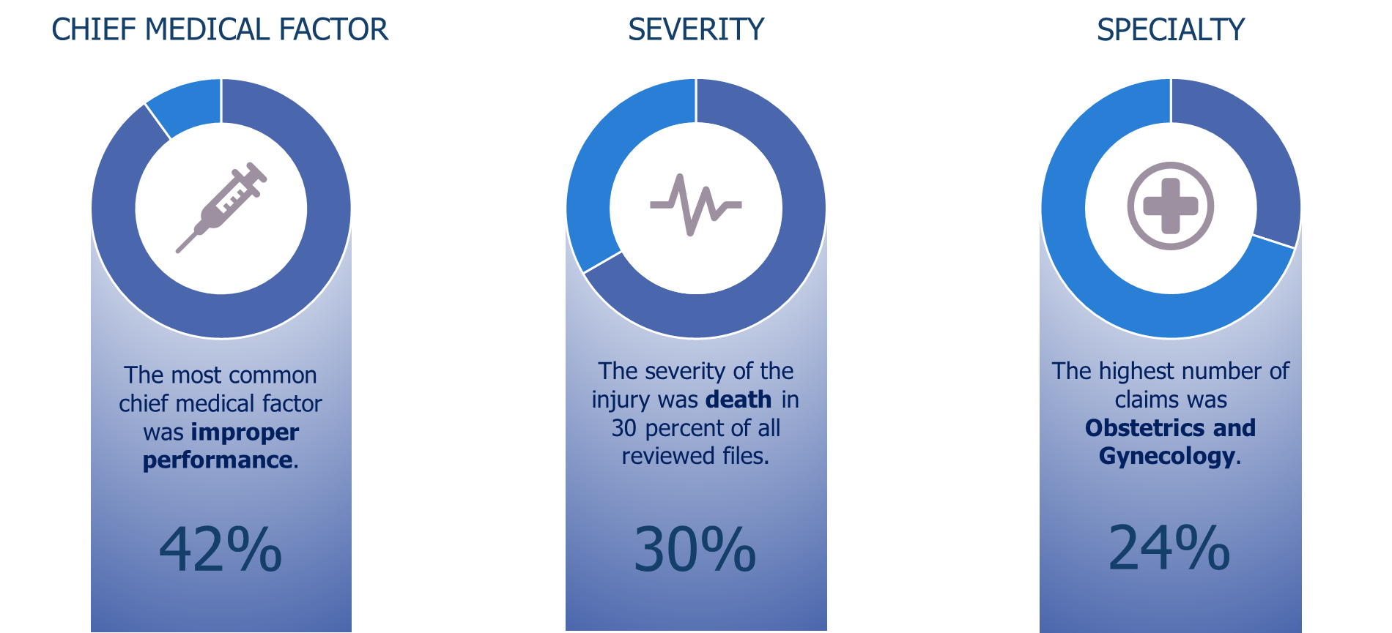
Top Findings by Category
Notes:
Above is a preview of some of the findings we will discuss within this report. We will also present case studies that demonstrate some of the chief medical factors identified in these files. Additionally, we will offer resources and strategies to lessen the risks of high exposure professional liability claims in the future.

Slide 10
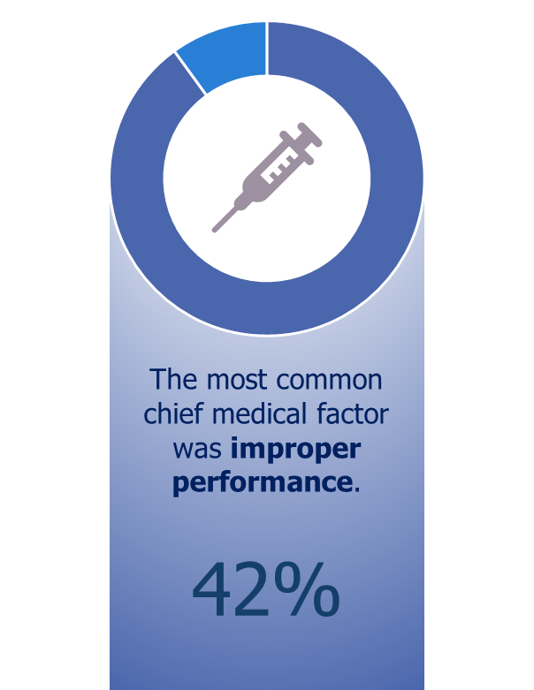
Chief Medical Factor
Chief medical factor is formerly known as medical misadventure.
It is defined as an act or omission by a healthcare provider that falls below the accepted standards of medical care, triggering a claim for medical and/or legal damages.
(Medical Professional Liability Association [MPL Association] Data Sharing Project Reference Manual, 2018)

Slide 11
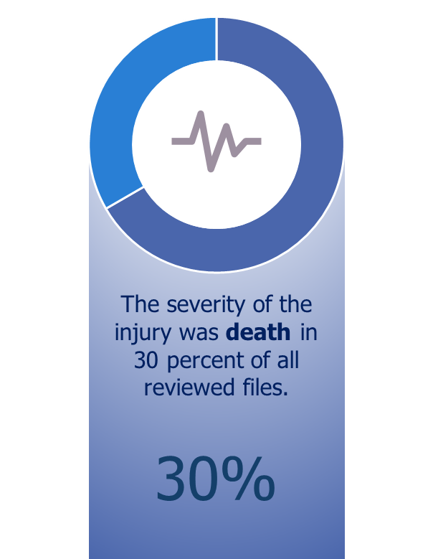
Severity
According to the MPL Association, severity is defined as the degree of injury of the patient which is most related to the outcome.
Severity can range anywhere from no injury to a major temporary injury to death.

Slide 12
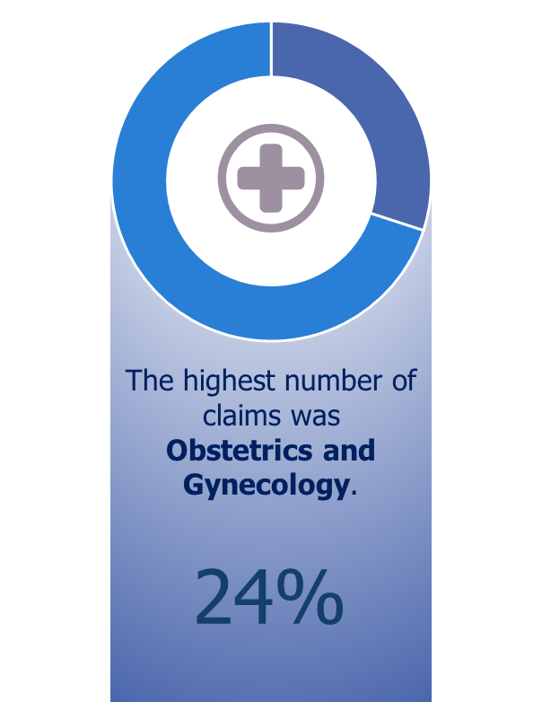
Specialty
Certain areas can be identified as high risk, for example: Surgery, Ob/Gyn and Radiology.
Systems and processes can then be reviewed and augmented to decrease the likelihood of a similar outcome in the future.

Slide 13
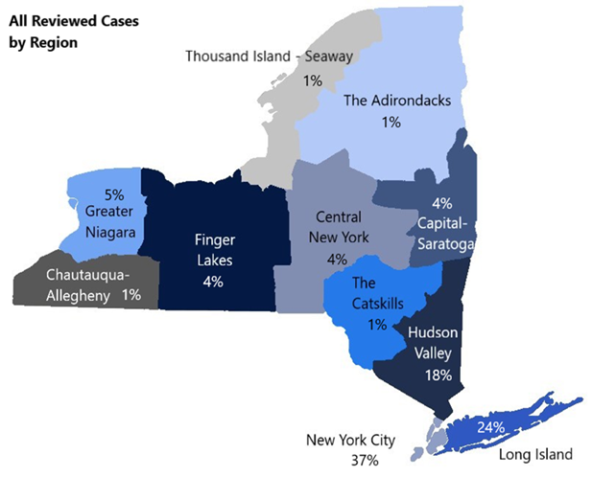
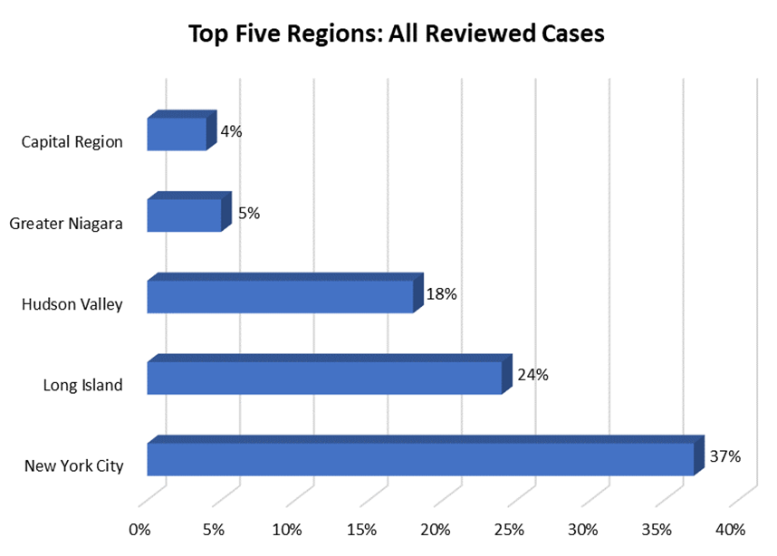
Regional Distribution
Notes:
More than 1 in 3 of these claims originated in the southern most part of NYS.
According to the U.S. Census Bureau’s estimates, roughly 57% of the population of New York resides within the five boroughs and on Long Island. This percentage directly correlates with our findings shown in the bar graph below which illustrates where the cases we reviewed were venued.

Slide 14
Regional Distribution
When comparing U.S. Census data to MLMIC’s claims experience:
  57% of NY’s population resides in NYC and on Long Island.
  This area accounts for 61% of MLMIC’s million-dollar claims.

Slide 15

Regional Distribution
43% of the State’s total population resides in Manhattan, Queens, Kings, Richmond and the Bronx.
37% of MLMIC’s million dollar claims occurred in NYC.

Slide 16
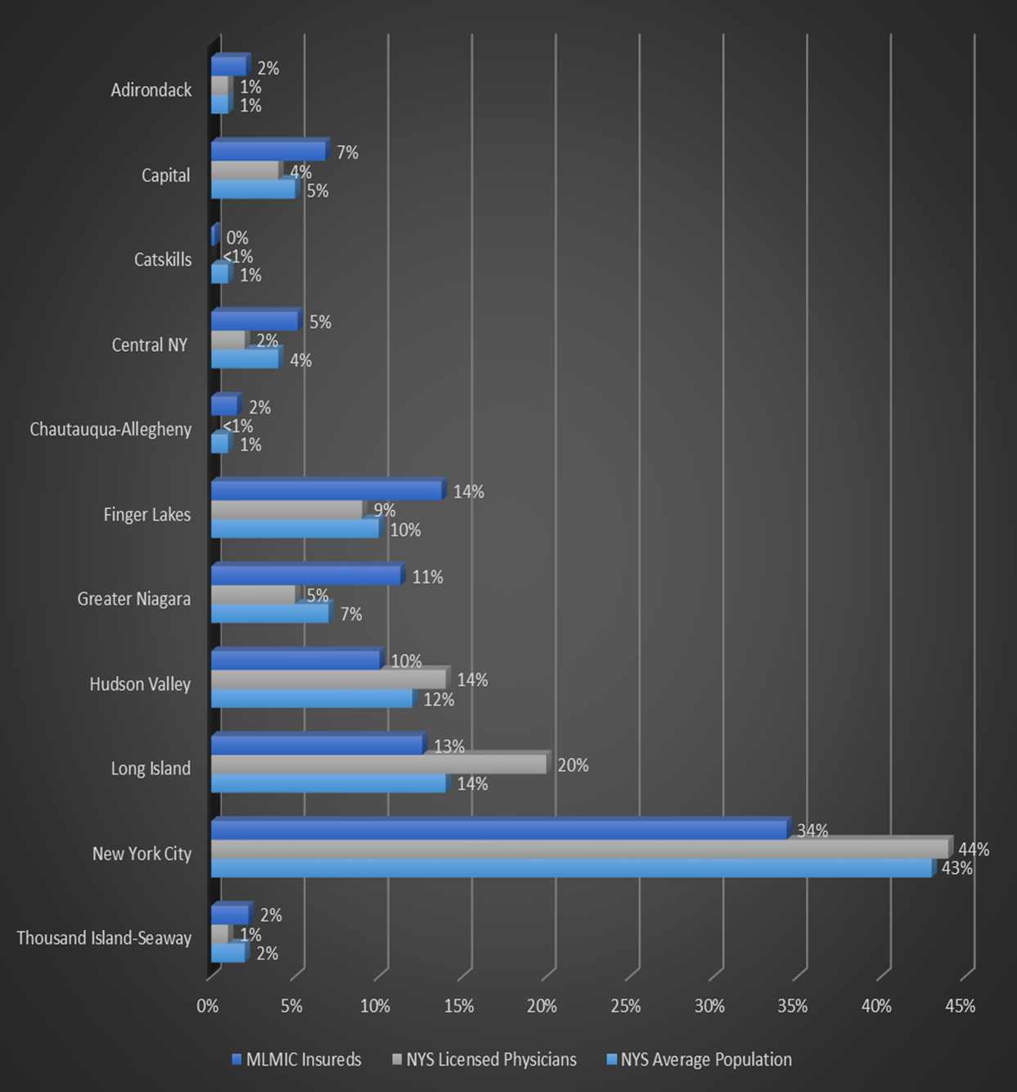
By County, Population and Licensure

Slide 17
By County, Population and Licensure
The concentration of claims found within our data correlates to the State’s population density.
The more people you have requiring services in an area, the more interactions with physicians and healthcare providers:
  In terms of liability, each patient encounter is an opportunity for an event to occur.
In other areas of the State, the population is less concentrated:
  Hence, the impact of volume on interactions is less dense, resulting in a more widespread distribution of million-dollar lawsuits.

Slide 18
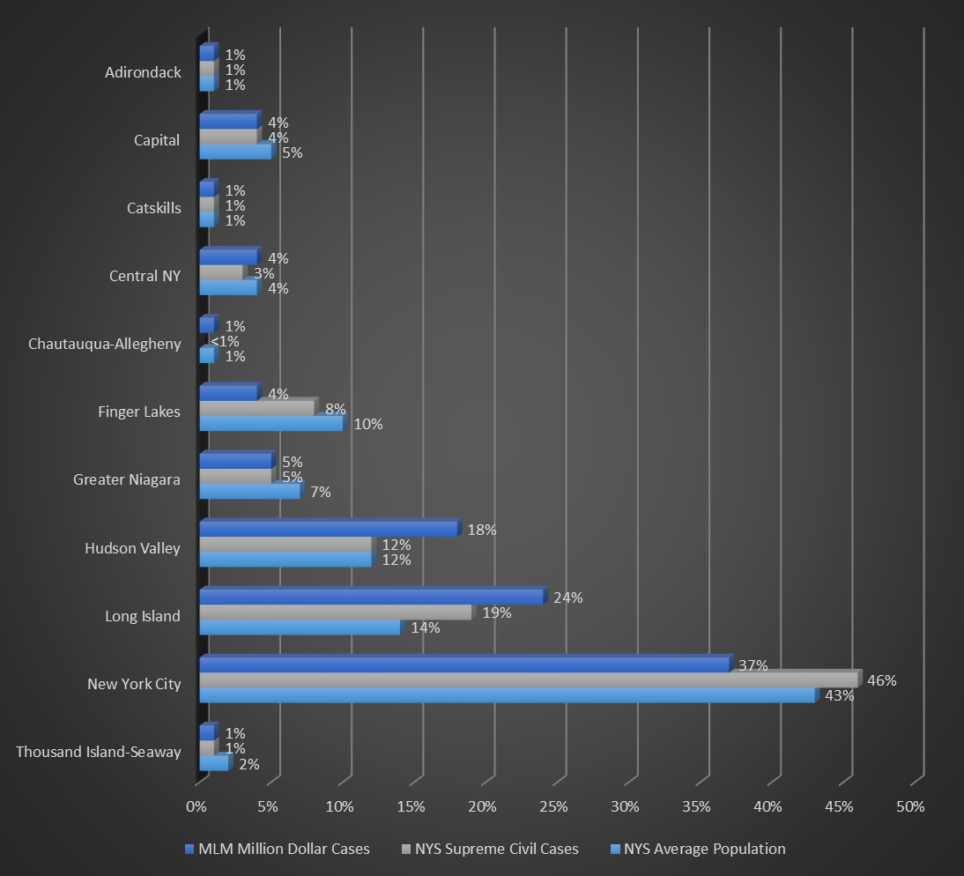
By County, Population and Court Activity

Slide 19
By County, Population and Court Activity
As expected, physicians in New York City and the surrounding communities have the highest incidence of claims resulting in payments of one million dollars or greater.
When you overlay the data: population, number of physicians in the area, volume of court filings and MLMIC cases resulting in million-dollar payments, you see that from a population perspective, all physicians in NYS have a strong chance of experiencing a substantial professional liability claim over the course of their career.

Slide 20
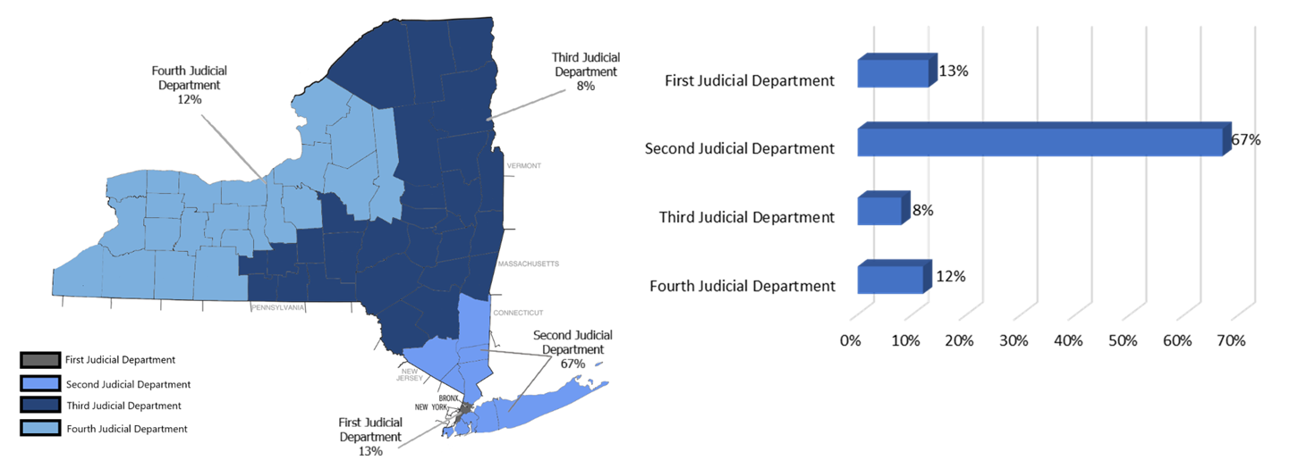
Judicial Department Distribution

Slide 21
Judicial Department Distribution
Most medical malpractice lawsuits are litigated in one of the New York State Supreme Courts which are in each county of the State. These courts are known as trial courts.
If there is a challenge being made to a determination at the trial court level, such as a verdict, the case will proceed to the Appellate Division of the New York State Supreme Court.

Slide 22
Judicial Department Distribution
There are four Appellate Divisions across the State, one in each of the four Judicial Departments.
One of the functions of the Appellate Court is to determine whether there is legal basis to substantiate a verdict rendered in the trial court:
  This appellate review can have an impact on the value of the case resulting in a lower verdict or foster settlement negotiations to bring the case to final resolution.

Slide 23
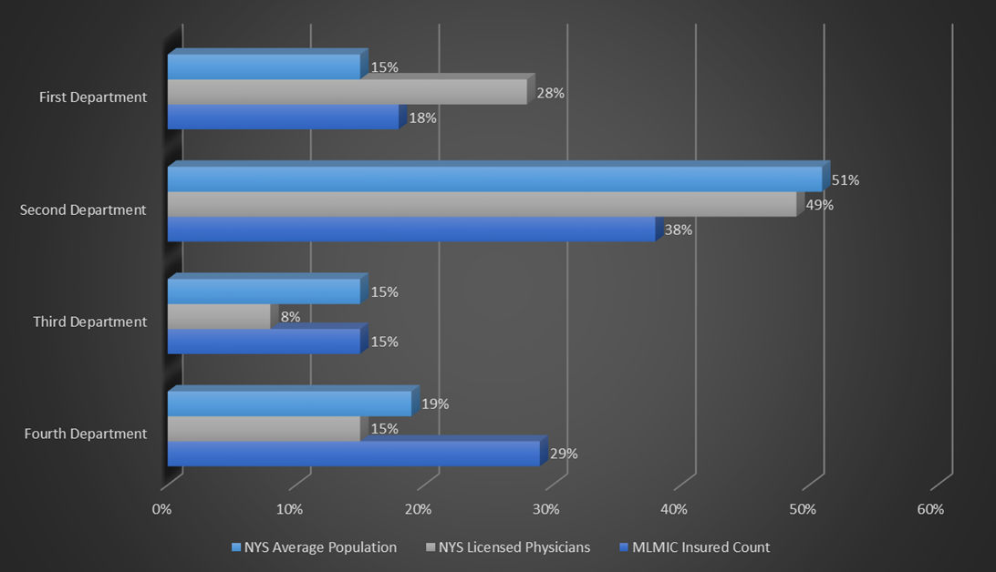
Judicial Department Distribution

Slide 24
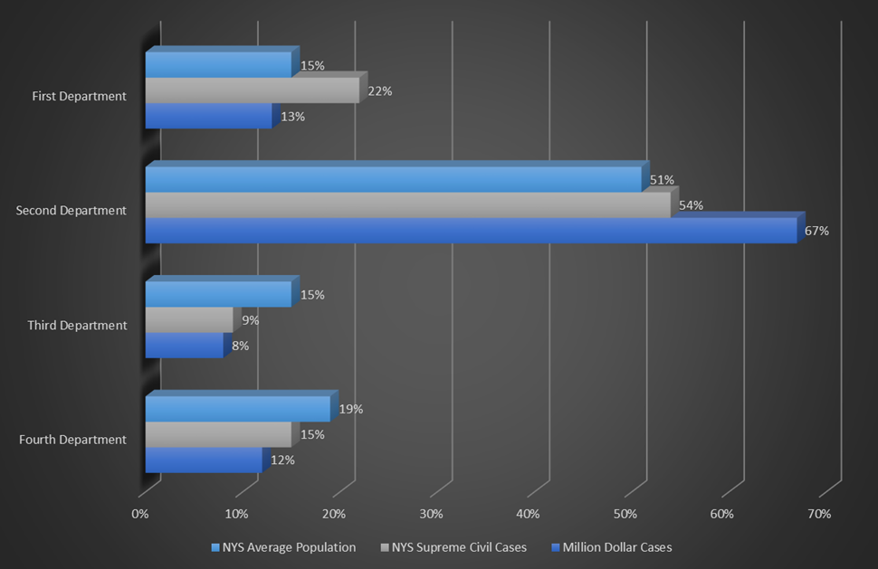
Judicial Department Distribution

Slide 25
Judicial Department Distribution
For example, the Second Judicial Department:
  includes Dutchess, Kings, Nassau, Orange, Putnam, Queens, Richmond, Rockland, Suffolk and Westchester counties,
  accounts for 51% of the State’s population, and
  encompasses 67% of all claims reviewed for this report.
MLMIC insures nearly 4 in 10 of every licensed professional in this department at 38%.

Slide 26
Judicial Department Distribution
Taking a closer look at the number of court filings by department from a consistency perspective, the distribution of population and million dollar filings are relatively the same.
No matter where you are within the State, you have a relatively strong chance of being involved in a million dollar lawsuit.
Notes:
Regardless of how you look at the data, by county or judicial department, the result is the same and there still is a chance of being involved in a million dollar lawsuit.

Slide 27
The Five D’s of a PCE
A potentially compensatory event (PCE) can arise from treatment that results in an adverse outcome. However, this does not always result in malpractice.
MLMIC Insurance Company has a high rate of success in defending our insured healthcare professionals at trial.
Duty
Defend
Dollars
Deviation
Damages

Slide 28
The Five D’s of a PCE
The process begins when a call comes in from an insured related to a PCE.
Our claims examiners use their expertise and experience to determine whether an event has merit and identifies the appropriate direction for the file.
Duty
Defend
Dollars
Deviation
Damages

Slide 29
The Five D’s of a PCE
Duty
Defend
Dollars
Deviation
Damages
Duty
Did the physician hold a duty to provide care to the patient?
Defend
Deviation
Did the provider deviate from acceptable standards of care?
Dollars
If “Yes" to all, then settlement is likely the best plan of action.
Damages
Did this deviation directly cause harm to the patient?
then defending the matter is likely the best plan of action.
If “No” to any,
Notes:
We can defend if any of the first three are missing. If they are all there, then compensable malpractice occurred.

Slide 30
The Five D’s of a PCE
The Five D’s will begin to formulate a defense strategy.
There are other factors which will need to be considered to determine the value and merit of a claim:
  allegation(s) made,
  outcome for the patient,
  impact of the outcome on the family,
  location,
  specialty involved,
  quality of the documentation,
  record’s ability to tell the story, and
  the potential liability of other providers involved in the patient’s care.

Slide 31


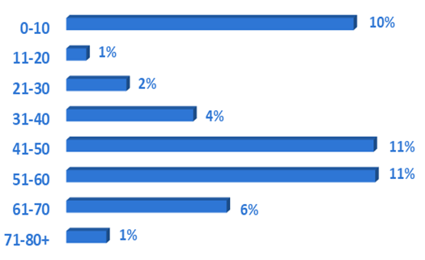
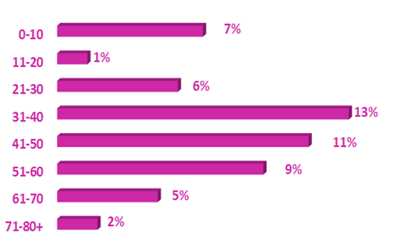



The Claimant Profile
Male
Female
46% of claimants reviewed are male.
54% of all claimants reviewed are female.
Ages
Ages
1 in 5
claims with the chief medical factor of diagnostic error involved a cancer diagnosis.
88%
of male claimants noted in the 0-10 age range involve
birth-related claims.
34%
of claims involving women ages 25-45 related to care provided before, during or immediately after labor and delivery.
3 in 5
claims with the chief medical factor of diagnostic error involved a cancer diagnosis.

Slide 32
Claimant Profile
We had a larger number of female claimants than males at 54%.
Our files also revealed that females became claimants at a younger age than males.
This aligns with the fact that a large number of claims reviewed involved breast cancer and obstetrics, both of which impact younger, female claimants.

Slide 33
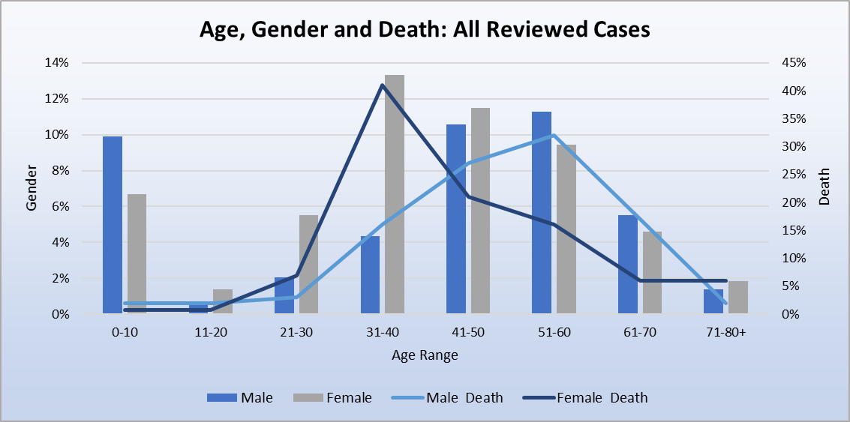
Claimant Profile
Notes:
Of all the cases involving death, 48% were male and 52% were female.

Slide 34
Claimant Profile
Our analysis of professional liability claims resulting in death revealed female claimants died more frequently and at a younger age than male claimants:
  A female of childbearing age (21—45 years of age), was identified as a claimant almost twice as often as a male in that same group (30% and 17%, respectively).
  In review of the same age range, the incidence of death for men decreased to less than 1 in 4 (23%).
Notes:
Childbearing stats

Slide 35
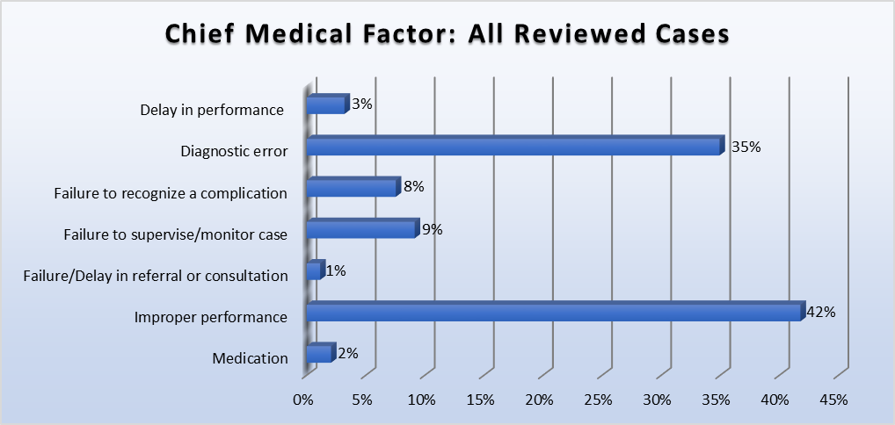
Chief Medical Factor

Slide 36
Chief Medical Factor
Improper Performance
Improper Performance was alleged in 2 of every 5 files reviewed at 42%.
Occurs when the insured performs a procedure that was not done correctly:
  For example: the claimant alleges the insured performed a laparoscopic cholecystectomy and lacerated the common bile duct.
  This broad claim is alleged any time a medical procedure/treatment outcome does not meet the expectations of the patient (and/or family).
Notes:
Formerly known as medical misadventure
Act or omission by a healthcare provider that falls below the accepted standards of medical care, triggering a claim for medical and/or legal damages (PIAA Data Sharing Project Reference Manual, 2018).
PIAA – Physicians Insurers Association of America
Simply stated: any time the goals of care do not meet expectations, someone (healthcare team member) did not perform their role/actions properly.
An example of a test/procedure not meeting expectations is seen many times in Obstetrics. Moms will have their idea of a birthing plan----and if things do not unfold and occur exactly as they thought it would , they will equate that with the healthcare team not performing properly. (Cesarean sections are done: allege labor was not managed properly and the section should have occurred sooner than it did……)

Slide 37
Chief Medical Factor
Improper Performance
This is seen most frequently in care delivered by a surgical specialty and in obstetrics where the expectation of the mother-to-be may not have been the experience she envisioned.
Our million dollar files analysis reveals:
  Top specialties:
    Ob/Gyn at #1
    General Surgery at #4
Notes:
Improper Performance is an outcomes driven misadventure. If those outcomes are not as expected—even if what happens is a risk of the procedure—this allegation may be made.
It is never more true than when you are talking about childbirth and surgery. With L and D: we will have a healthy, bouncing baby girl or boy. With surgery: the problem will be fixed. This is why the Informed Consent process is so critical. And shaping expectations of outcomes.

Slide 38
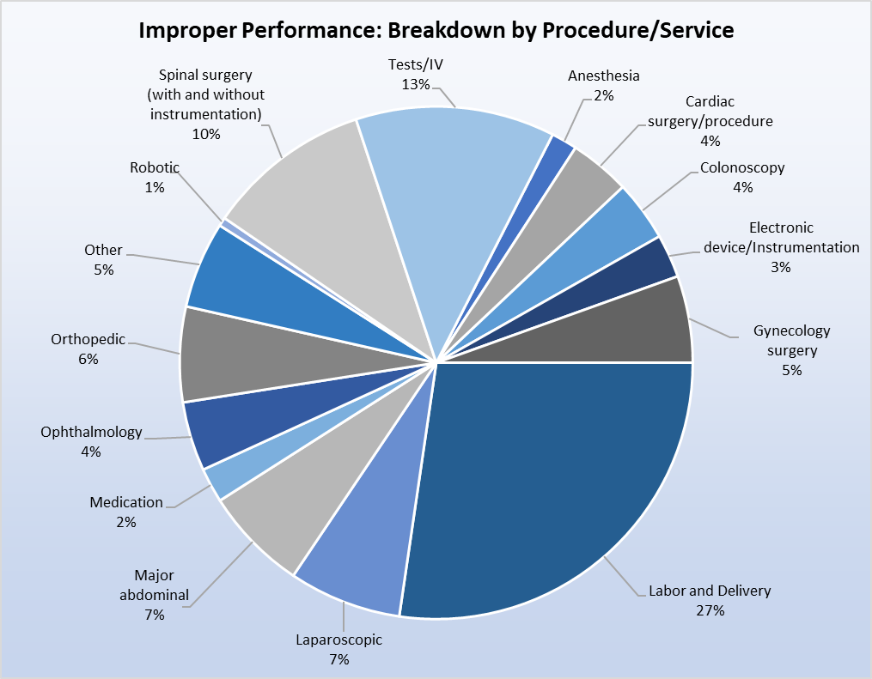
Chief Medical Factor
Improper Performance

Slide 39
Chief Medical Factor
Improper Performance
A closer look shows that multiple specialties are involved, and different types of procedures have triggered claims. For example, in a surgical specialty it can be alleged as a result of:
  the operative consultation,
  the operative procedure itself,
  the management of a patient in the Post Anesthesia Care Unit (PACU) immediately after surgery, and/or
  the care rendered prior to discharge.
Nearly 4 in 10 (39%) of our files reviewed involved a surgical procedure.
Notes:
Improper performance in the department of surgery can occur at any point during the surgical process, up to an including discharge.

Slide 40
Category | Percentage of files | Example of allegation
Obstetrics: Labor and Delivery management Normal vaginal delivery Cesarean section | 27% 66% 34% | Management of labor Delay in deciding on doing the C-section (now emergent) Fetal monitor tracing management Use of maneuvers
Tests and IVs | 13% | Insertion of central lines and catheters Diagnostic bronchoscopy Colonoscopy with perforation ERCP
Spinal surgery (with or without instrumentation) | 10% | Laminectomy with a dural tear Spinal fusion with nerve compression
Major abdominal procedures | 7% | Exploratory for small bowel obstruction with perforation Total abdominal hysterectomy with a bowel perforation
Laparoscopic procedures | 7% | Laparoscopic cholecystectomy with a common bile duct laceration
Notes:
Chief Medical Factor
In our review of closed claims, the specialty most often associated with an improper performance was Obstetrics, which was cited in almost one-third of all files reviewed (27%). The most common associated factor was labor and delivery. For example, an allegation of improper performance was made if a physician had to use maneuvers during a vaginal delivery for which the patient was not prepared; or if complications arose during the performance of a Cesarean section, exposing both mother and baby to a higher level of risk for injury.
At 13%, tests and intravenous therapy was the second largest category of claims in improper performance. These tests and therapies include such things as: the insertion of a central venous line for monitoring in an intensive care unit; or a Broviac catheter for the administration of long-term therapies, such as chemotherapy; or a diagnostic bronchoscopy. In these cases, there was an expectation for each test or intravenous placement, which was not met. This leads to allegations involving the informed consent process and lack of documentation in the medical record.

Slide 41
Chief Medical Factor
Informed Consent
When filing a claim or suit, a plaintiff attorney may also allege a lack of informed consent.
In certain instances, consent between the doctor and patient is implied. For example:
  during a routine physical, or
  in a medical emergency where the delay in life-saving care will cause harm.
For invasive tests and surgical procedures, informed consent must be obtained.

Slide 42
Chief Medical Factor
Informed Consent
Informed consent is a non-delegable duty that rests with the physician who will be performing the test or procedure.
The discussion must include:
  risks and benefits of the test/procedure,
  alternatives to the proposed treatment/procedure,
  risk of the alternative options,
  option of no treatment,
  time for questions and answers, and
  consent to proceed with the proposed therapy.

Slide 43
Chief Medical Factor
Informed Consent
While there is a specific form to be completed and signed after an informed consent discussion between the doctor and the patient, there must also be reasonable documentation in the medical record which provides an accounting of the discussion.
Notes:
It is a process, not only a form to sign.

Slide 44
Chief Medical Factor
Diagnostic Error
Diagnostic error was alleged in more than 1 in 3 files reviewed at 35%.
Occurs when a diagnosis is delayed, missed or incorrectly identified.
Diagnostic error has been cited by:
  the MPL Association as one of the top five allegations made in the medical liability industry, and
  the ECRI Institute, as one of the top concerns of patient safety experts.
Diagnostic error was first identified as a healthcare issue in the groundbreaking report To Err is Human in 1999.
Notes:
ECRI – formerly known as Emergency Care Research Institute.
An independent non-profit organization authority on the medical practices and products that provide the safest most effective care. It was

Slide 45
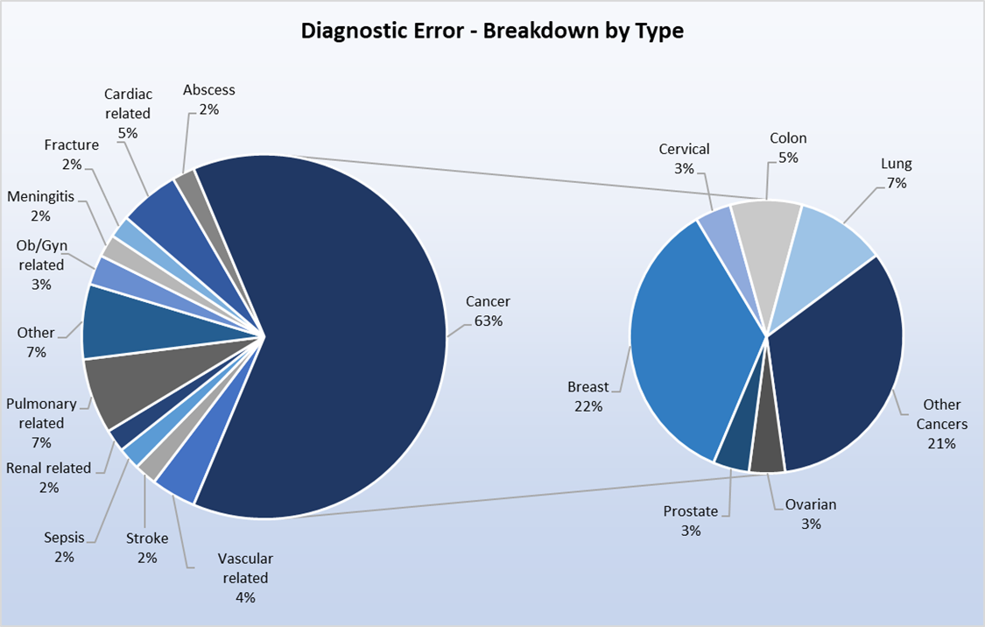
Chief Medical Factor
Diagnostic Error

Slide 46
Chief Medical Factor
Diagnostic Error
The allegation of diagnostic error can occur in any medical specialty.
The MPL Association data identified:
  Radiology as the top specialty associated with diagnostic error; and
  a missed or delayed cancer diagnosis (primarily lung, breast and colorectal) was the most common allegation made.

Slide 47
Chief Medical Factor
Diagnostic Error
Our review of claims supports this finding as a cancer diagnosis was missed, delayed or misidentified in more than 6 in 10 files (63%).
Diagnostic errors were also noted, to a lesser extent at a combined 33%, in other body systems.
For example:
  pulmonary system: pulmonary emboli or pneumonia;
  cardiac system: endocarditis or cardiomyopathy;
  vascular system: thoracic dissecting aneurysm or arterial thrombosis; and
  gastrointestinal system: intra-abdominal hemorrhage.

Slide 48
Chief Medical Factor
Diagnostic Error
Category | Percentage of files | Missed diagnosis allegation
Cancer | 63% | Breast (22%) Lung (7%) Colon (5%) Other (21%): Liposarcoma Glioblastoma Cervical spine Nasopharyngeal Renal
Pulmonary related | 7% | Hemopneumothorax Pneumonia Aspiration pneumonia in a newborn Deep Vein Thrombosis (DVT)/ Pulmonary Embolus (PE)
Notes:
Diagnostic errors were also noted, to a lesser extent at a combined 33%, in other body systems

Slide 49
Chief Medical Factor
Diagnostic Error
Category | Percentage of files | Missed diagnosis allegation
Cardiac related | 5% | Coronary Artery Disease (CAD) Endocarditis Cardiomyopathy: Heart failure
Vascular related | 4% | Thoracic dissection Arterial thrombosis
Other | 7% | Gastric hemorrhage Hydrocephalus Acoustic neuroma Hypertensive encephalopathy
Notes:
Diagnostic errors were also noted, to a lesser extent at a combined 33%, in other body systems

Slide 50
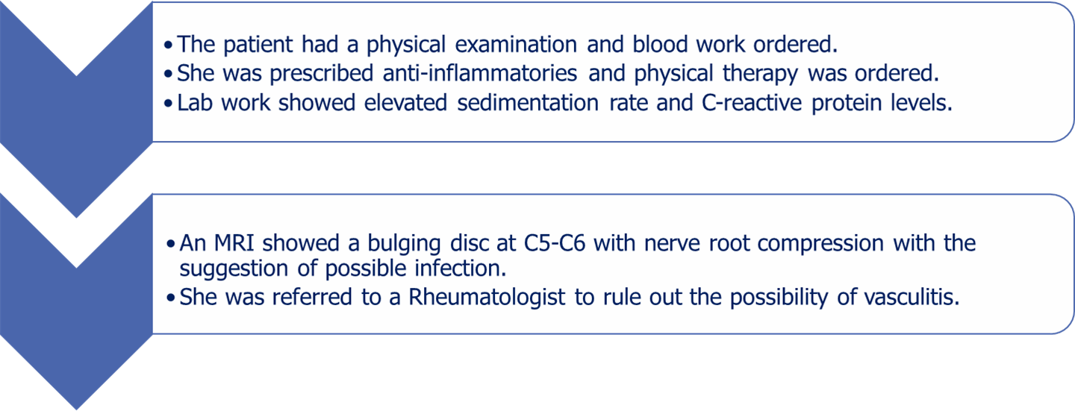
Case Study
A Missed Abscess
A 56-year-old woman presented to her primary care physician (who specialized in Internal Medicine) with a 3 month history of neck pain.

Slide 51
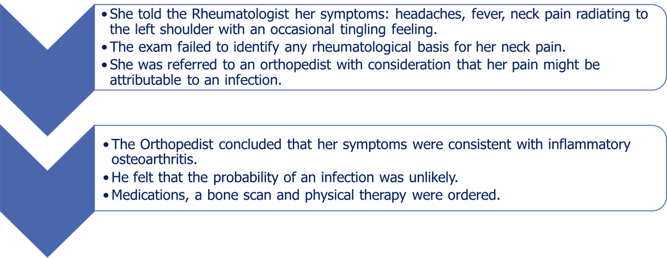
Case Study
A Missed Abscess
A 56-year-old woman presented to her primary care physician (who specialized in Internal Medicine) with a 3 month history of neck pain.

Slide 52
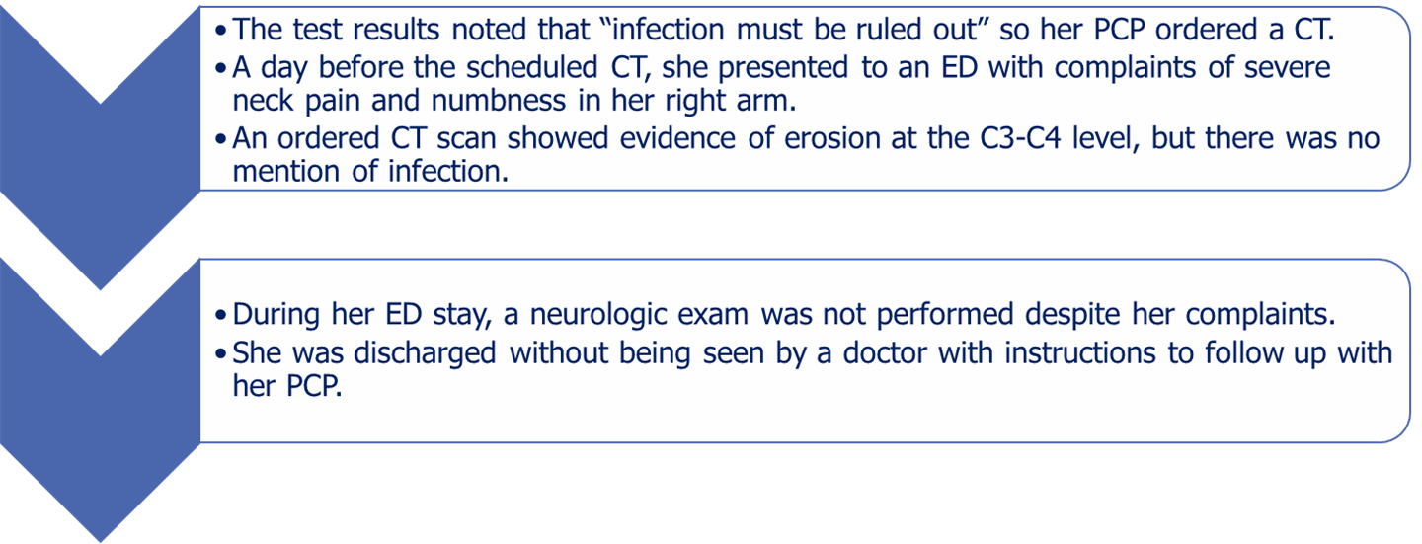
Case Study
A Missed Abscess
A 56-year-old woman presented to her primary care physician (who specialized in Internal Medicine) with a 3 month history of neck pain.

Slide 53
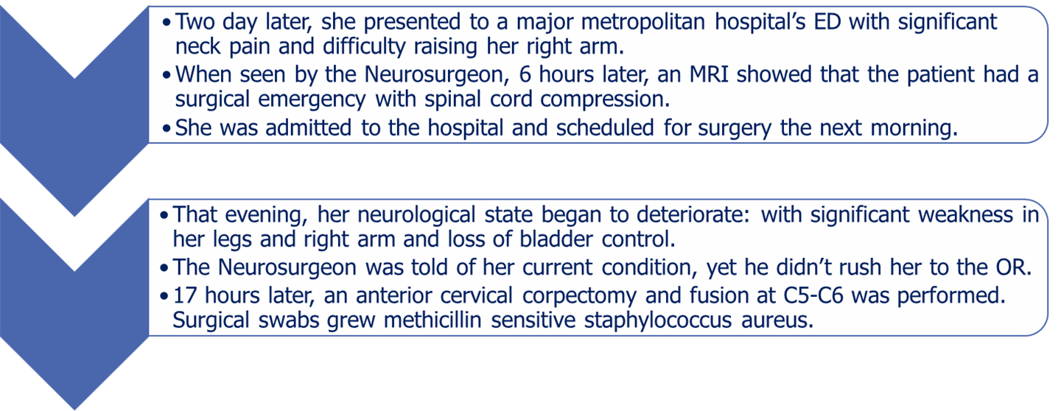
Case Study
A Missed Abscess
A 56-year-old woman presented to her primary care physician (who specialized in Internal Medicine) with a 3 month history of neck pain.

Slide 54
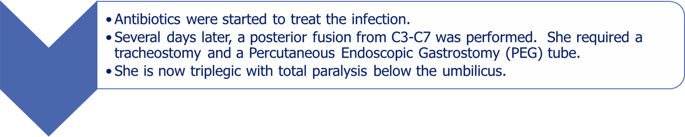
Case Study
A Missed Abscess
A 56-year-old woman presented to her primary care physician (who specialized in Internal Medicine) with a 3 month history of neck pain.

Slide 55
Case Study
A Missed Abscess
The lawsuit was brought forward that included nine named defendants.
Allegations included:
  a missed diagnosis of infection,
  inadequate communication among all specialists involved,
  a failure to follow-up on tests and lab results,
  ineffective coordination of care among providers, and
  deviation from the standard of care by failing to take the plaintiff to the operating room once a neurosurgical emergency had been declared.
Notes:
Case settled for 7.4M. MLMIC insured 4 physicians and the facility.
A failure of the original referring physician to provide all subsequent providers with critical important clinical information including the elevated SED rate and C reactive proteins as well as her history of fevers.

Slide 56
Diagnostic Error
Regardless of settlement amounts, an allegation of a diagnostic error is costly to defend.
Our review identified a diagnostic error resulting in death 34% of the time, followed by significant permanent injury 32% of the time.
Studies on diagnostic error have shown they are usually the result of process breakdowns during the physician-patient encounter, involving individual and system-related factors.
    (PSNet/AHRQ article posted 2.5.19)

Slide 57
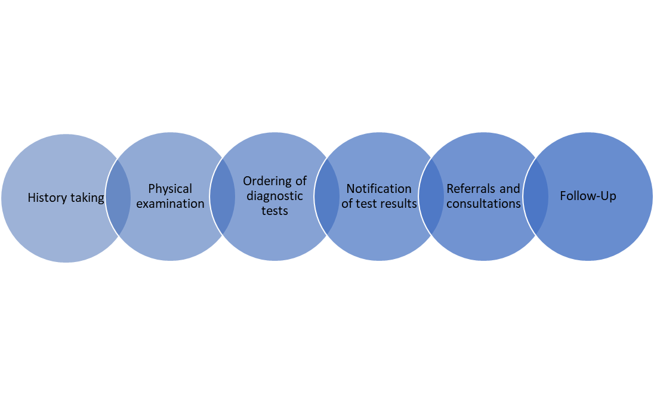
Diagnostic Error
Diagnostic errors are commonly associated with the following:

Slide 58
Diagnostic Error
Researchers have also focused on errors in cognitive thinking that arise in the diagnostic process and contribute to errors.
It has been shown that clinicians frequently use heuristics (mental shortcuts or “rules of thumb”) when making a provisional diagnosis, especially when a patient presents with common symptoms.
Notes:
While cognitive bias on the part of a physician plays a role in many diagnostic errors, system–related factors also contribute to missed and delayed diagnoses. Some of the leading issues include poor communication, inefficient coordination of care, ineffective follow-up systems and faulty diagnostic equipment. A number of human factors, such as distractions and excessive workloads, can also influence a physician’s ability to properly and correctly diagnose.

Slide 59
Bias | Definition
Affective | Also called visceral bias; emotional influences can induce thinking errors, including the feelings physicians have about their patients, both positive or negative.
Anchoring | Narrow focus on a single feature in a patient's presentation to support a diagnostic hypothesis, even if other concurrent features or subsequent information refutes the hypothesis.
Availability | The tendency to think that things that come to mind immediately are more likely or more common.
Blind obedience | Inappropriate deference to the recommendations of authority, either by direct superiors or by expert consultants, even in the absence of a sound rationale.
Confirmation | The tendency to search for evidence to support an initial diagnostic impression, and the tendency not to search for, or even to ignore, evidence that refutes it.

Slide 60
Bias | Definition
Diagnostic momentum | The tendency of a diagnostic label to become propagated by multiple intermediaries (patients, physicians, nurses, other team members) over time; what might have begun as a possible "working diagnosis" becomes "definite“.
Framing effect | The susceptibility of diagnosticians to be disproportionately influenced by how a problem is described, by whom it is described, or even the environment where an encounter takes place.
Hindsight bias | Knowing the outcome of an event influences the perception and memory of what actually might have occurred; in analyzing diagnostic errors, this can compromise learning by creating illusions of the participants' cognitive abilities, with potential for both underestimation and overestimation of what the participants knew (or could have known).
Overconfidence | The tendency to think one knows more than one does, especially in physicians who might place faith in opinions without gathering the necessary supporting evidence.
Premature closure | Making a diagnosis before it has been fully verified.

Slide 61
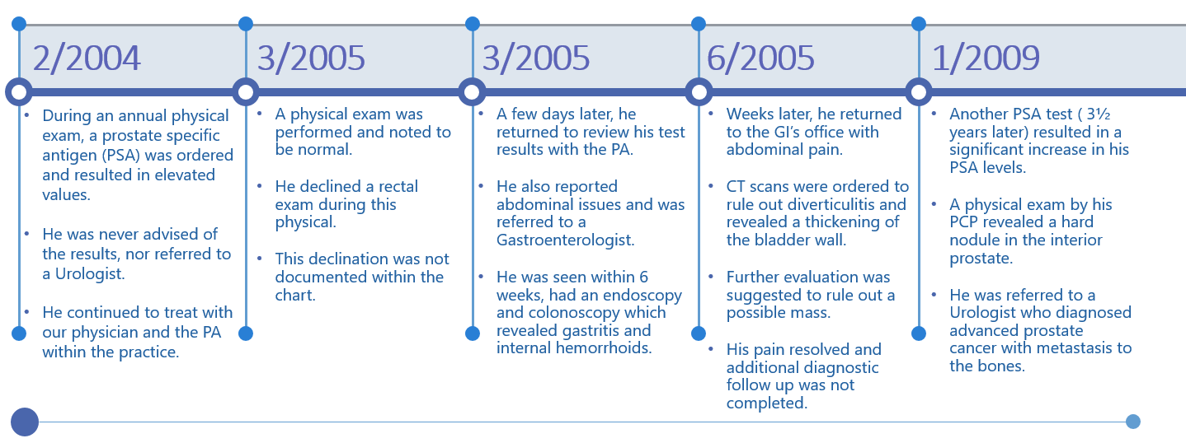
Case Study
Missed Cancer Diagnosis
A 58-year-old male smoker, who was an established patient and long-time friend of our Internal Medicine physician, was seen and treated for various complaints related to insulin dependent diabetes.

Slide 62
Case Study
Missed Cancer Diagnosis
A 58-year-old male smoker, who was an established patient and long-time friend of our Internal Medicine physician, was seen and treated for various complaints related to insulin dependent diabetes.
2/2004
  During an annual physical exam, a prostate specific antigen (PSA) was ordered and resulted in elevated values.
  He was never advised of the results, nor referred to a Urologist.
  He continued to be treated by the physician and the PA within the practice.

Slide 63
Case Study
Missed Cancer Diagnosis
A 58-year-old male smoker, who was an established patient and long-time friend of our Internal Medicine physician, was seen and treated for various complaints related to insulin dependent diabetes.
3/2005
  A physical exam was performed and noted to be normal.
  He declined a rectal exam during this physical.
  This declination was not documented within the chart.

Slide 64
Case Study
Missed Cancer Diagnosis
A 58-year-old male smoker, who was an established patient and long-time friend of our Internal Medicine physician, was seen and treated for various complaints related to insulin dependent diabetes.
3/2005
  A few days later, he returned to review his test results with the PA.
  He also reported abdominal issues and was referred to a Gastroenterologist.
  He was seen within 6 weeks, had an endoscopy and colonoscopy which revealed gastritis and internal hemorrhoids.

Slide 65
Case Study
Missed Cancer Diagnosis
A 58-year-old male smoker, who was an established patient and long-time friend of our Internal Medicine physician, was seen and treated for various complaints related to insulin dependent diabetes.
6/2005
  Weeks later, he returned to the GI’s office with abdominal pain.
  CT scans were ordered to rule out diverticulitis and revealed a thickening of the bladder wall.
  Further evaluation was suggested to rule out a possible mass.
  His pain resolved and additional diagnostic follow-up was not completed.

Slide 66
Case Study
Missed Cancer Diagnosis
A 58-year-old male smoker, who was an established patient and long-time friend of our Internal Medicine physician, was seen and treated for various complaints related to insulin dependent diabetes.
1/2009
  Another PSA test (3½ years later) resulted in a significant increase in his PSA levels.
  A physical exam by his PCP revealed a hard nodule in the interior prostate.
  He was referred to a Urologist who diagnosed advanced prostate cancer with metastasis to the bones.
Notes:
Expert reviewers opined that the treatment provided by our insured physician deviated from the standard of care as there was no follow-up on either the test results or the recommendation for further evaluation of the bladder to rule out a possible mass. In addition, our physician was criticized for the failure to discuss all test results with the patient and consider a urological consultation upon receipt of the first elevated PSA. As a result, the case was settled in excess of one million dollars.

Slide 67
Case Study
Missed Cancer Diagnosis
Physicians are often asked by close friends, relatives, or colleagues for medical advice, treatment, or prescriptions both inside and outside of the office.
Although the American Medical Association advises physicians not to treat immediate family members except in cases of emergency or when no one else is available, this practice continues to occur.
Notes:
This violates OPMC and Public Health Law 6530.

Slide 68
Case Study
Missed Cancer Diagnosis
At times, these “friends” may be seen as a courtesy and/or at no charge.
We have seen a number of lawsuits filed against physicians by close friends, as in this case study, colleagues, and even their own family members because of care provided by our insureds.
The defense of these suits is frequently hampered by the fact that there are often omissions, sparse or entirely non-existent medical records for the patient.
Notes:
This violates OPMC and Public Health Law 6530.

Slide 69
Case Study
Missed Cancer Diagnosis
All patient encounters for friends, relatives, and colleagues must be documented in the medical record.
Take a complete medical history when seeing friends, relatives, or colleagues as patients:
  This should include issues that may be uncomfortable to discuss, such as the use of psychotropic medications or sexual history.
Perform a thorough physical examination.
Sensitive portions of a physical examination should not be deferred when pertinent to the patient’s complaints:
  Consider a chaperone for those portions of the examination.

Slide 70
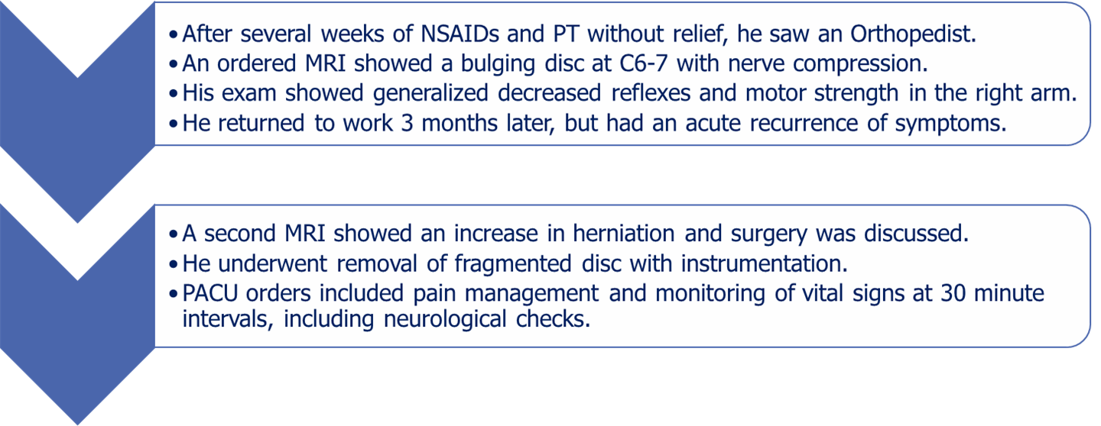
Case Study
Pain Management
A 41-year old laborer sustained a neck injury. Conservative therapy failed and he had cervical neck surgery with post-operative pain issues.

Slide 71
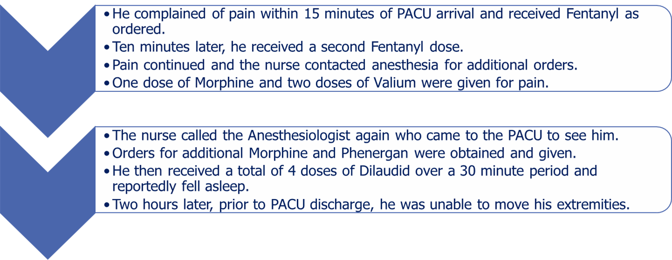
Case Study
Pain Management
A 41-year old laborer sustained a neck injury. Conservative therapy failed and he had cervical neck surgery with post-operative pain issues.

Slide 72
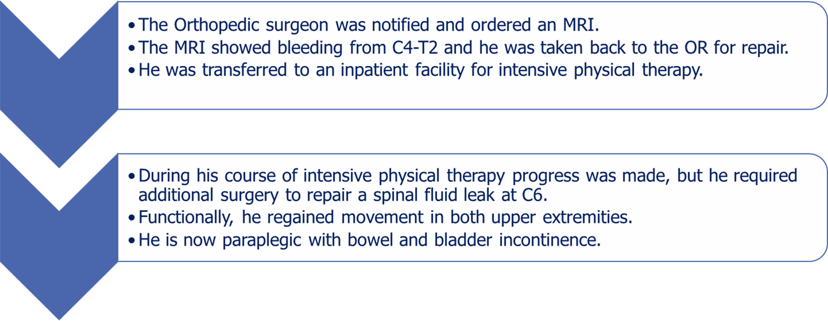
Case Study
Pain Management
A 41-year old laborer sustained a neck injury. Conservative therapy failed and he had cervical neck surgery with post-operative pain issues.

Slide 73
Case Study
Pain Management
The patient sued the Orthopedic surgeon, Anesthesiologist and hospital. As discovery unfolded, it was noted that:
  the Orthopedic surgeon was never contacted regarding the patient’s ongoing pain and agitation;
  the Anesthesiologist never contacted the Orthopedic surgeon when he came to the PACU to administer Morphine and Phenergan; and,
  the RN administered medications without proper orders.
Notes:
The plaintiff attorney made a demand of $12 million to settle the matter. The case eventually resolved for seven figures with more than 70% being paid on behalf of the RN.

Slide 74
Case Study
Pain Management
There were issues noted in the documentation, communication and care of this patient once he arrived into the PACU.
Leadership and staff must establish guidelines for patient care:
  In the preceding case study, the department of anesthesia provides all orders and care while in PACU.
Protocols should guide care coordination.
Notes:
This is especially critical in the setting of a PACU, where timing and flow are key.

Slide 75
Case Study
Pain Management
Verbal orders:
  During deposition, it was discovered that there were no orders written for the Valium and Dilaudid the patient received.
  The nurse practiced outside her scope when she administered these medications.
  10 NYCRR 405.10 specifically addresses telephone and verbal orders, stating that a hospital must implement policies and procedures regarding such orders.
    This should include the process for accepting, documenting and authenticating a verbal order.

Slide 76
Case Study
Pain Management
Timing of patient assessments:
  There were noted discrepancies with the documented physical findings in the medical record:
    not done at the ordered frequency, (at one-hour intervals and not every thirty minutes as per orders), and
    when the patient was found to be unable to move his extremities, the documentation in a different section of the electronic health record (EHR) at that approximate time noted no such change in condition.

Slide 77
Case Study
Pain Management
Care coordination:
  Our expert review noted that the Anesthesiologist could have considered a consulting phone call with the Orthopedic surgeon when the patient’s pain became to be an issue:
    Effective communication among members of the team can only enhance the quality of the care provided.
  While a healthcare provider may state that it is his/her usual and customary practice to make that call, a note should be entered into the record stating the time and content of the call.
Notes:
It is our experience that taking a few minutes to make that entry will save countless hours of time in the event that particular medical record and care become part of a claim or lawsuit.

Slide 78
Severity
Our analysis revealed that while death occurred in 30% of all claims reviewed, a significant permanent injury, which would include a loss of a limb or one kidney or lung, was the outcome in a little over 1 in 4 (27%) claims.
Notes:
Bear in mind, we are dealing with indemnity payments of one million dollars or more.

Slide 79
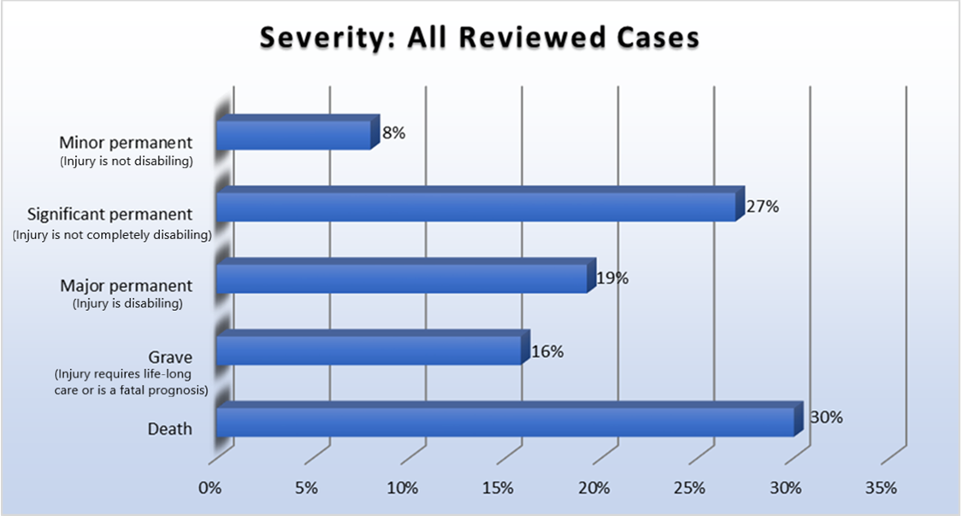
Severity
Notes:
Severity: Nine degrees of injury ranging from emotional to grave and death.
Emotional No physical damage occurred Fright
Insignificant No delay in recovery occurs Lacerations
Minor temp. Recovery is complete but delayed Infection
Major temp. Recovery is complete but delayed Burns
Minor perm. Injury is not disabling Loss of fingers
Signif. perm. Injury is not completely disabling Loss of limb
Major perm. Injury is disabling Paraplegia
Grave Requires life-long care or a fatal prognosis Quadriplegia
Death

Slide 80
Severity
When considering an associated chief medical factor of an error in a diagnosis of cancer, nearly 1 in 3 (30%) of these claims resulted in a significant permanent injury.
An improper performance allegation resulting in a significant permanent injury was identified in 1 in 4 Ob/Gyn claims at 25%.
Notes:
Associating chief medical factor with severity.

Slide 81
Specialty
Much like Ob/Gyn, Diagnostic Radiology is a high-risk specialty.
Our analysis found that female claimants suffered death at a younger age, compared to that of males, which is attributed to the 22% rate of an alleged missed diagnosis of breast cancer.
This, coupled with the emotional aspects of a cancer diagnosis, contributed to the claims experience for Ob/Gyn and Diagnostic Radiology.

Slide 82
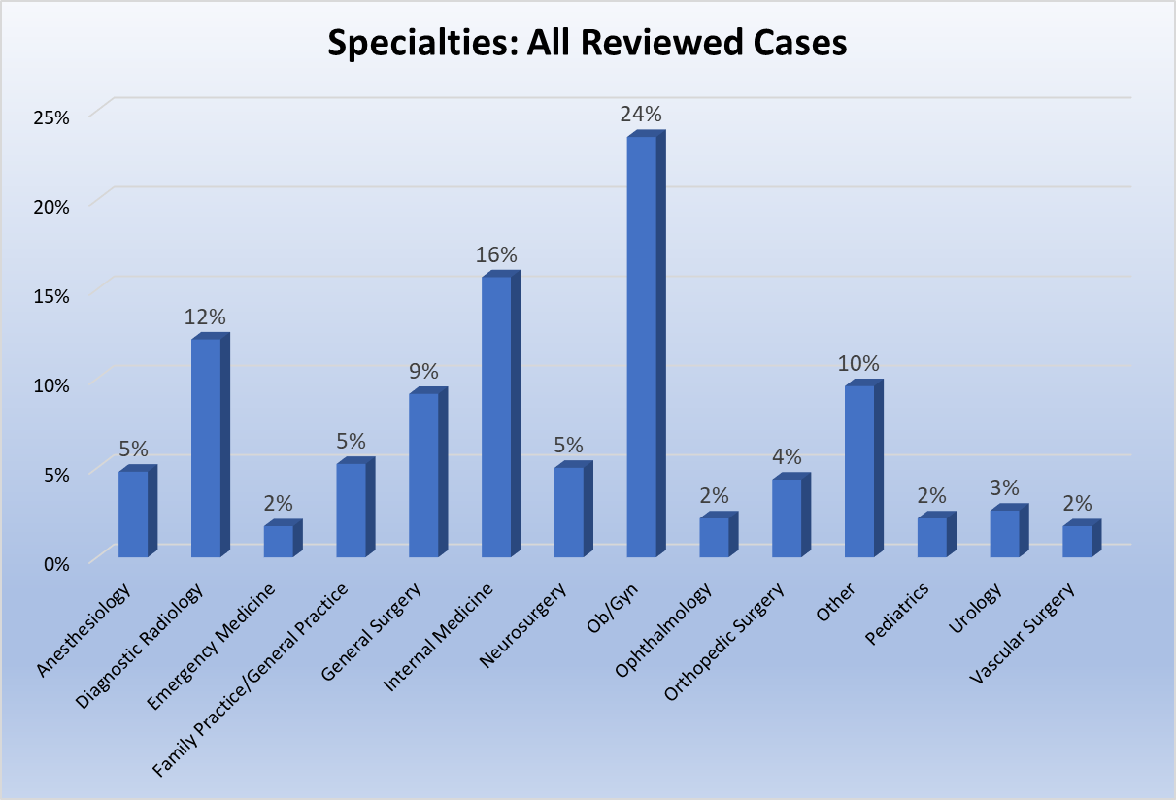
Specialty
Notes:
Much like Ob/Gyn, Diagnostic Radiology is a high-risk specialty. Our analysis found that female claimants suffered death at a younger age, compared to that of males, which is attributed to the 22% rate of an alleged missed diagnosis of breast cancer. This, coupled with the emotional aspects of a cancer diagnosis, contributed to the claims experience for Diagnostic Radiology.

Slide 83
Specialty
Our findings revealed that Ob/Gyn was most frequently associated with the claims we reviewed, having been identified in almost a quarter of all files (24%).
In the field of Obstetrics, physicians are caring for two patients —or more when it comes to multiple births:
  Damages are compounded by the likelihood of multiple claimants and jurors’ sympathy in such cases.

Slide 84
Specialty
Internal Medicine and Diagnostic Radiology were the specialties noted next in frequency at 16% and 12%, respectively, and most often connected to a diagnostic error.
General Surgery rounds out our top four with 9% of total claims, with the primary allegation of an improperly performed procedure.
Notes:
Given the skill set and expertise required to deliver care in each specialty, it was not unexpected that these four specialties were identified in our study as those claims or suits that generated indemnity payments of one million dollars or more.

Slide 85
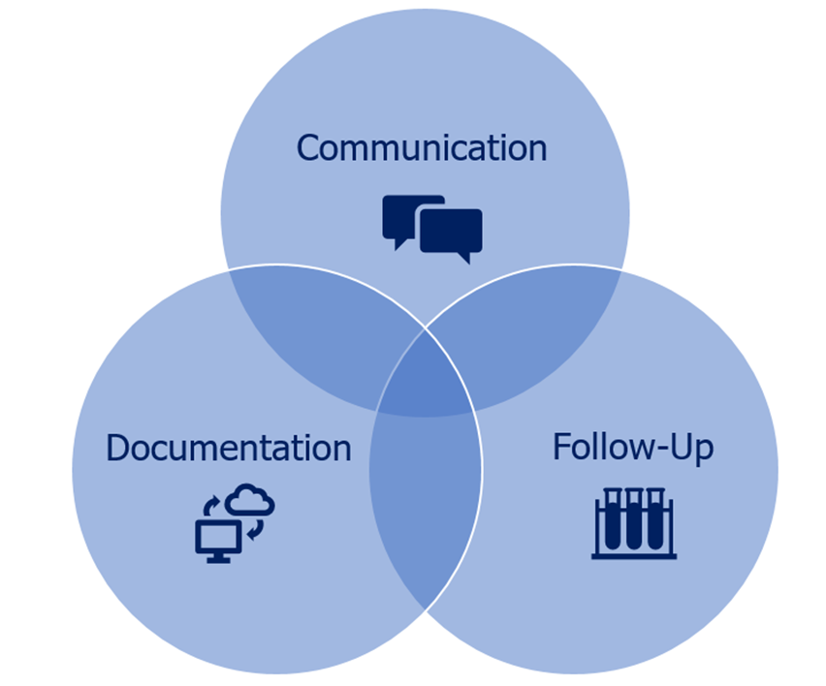
Risk Management Trifecta

Slide 86
Risk Management Trifecta
Throughout our 40+ years of experience, MLMIC has seen a significant number of claims that occurred due to lack of documentation, communication and follow-up, as illustrated by the case studies within this report.
To mitigate these three potential threats, we have included universal risk management strategies that can, and should, be employed by all healthcare providers:
  MLMIC Analytics® reports are individualized to target and evaluate vulnerabilities and offer strategies to reduce liability.

Slide 87
Risk Management Trifecta
Communication
Providers communicate on many levels with:
  patients,
  families,
  pharmacists,
  therapists,
  other healthcare providers, and/or
  payers.
At each level of interaction, effective communication is essential to developing and executing the best plan possible for optimum patient outcomes.

Slide 88
Risk Management Trifecta
Communication
Patients and family members:
  Acknowledge that their perception of your communication skills may impact the potential for allegations of malpractice.
  Promote open communication with patients to enhance their ability to reach an accurate diagnosis and develop an appropriate plan of care.

Slide 89
Risk Management Trifecta
Communication
Physicians and other healthcare providers:
  Recognize poor communication among providers can result in ineffective care coordination and increased liability.
  Develop systems to address and document calls from other provider offices.

Slide 90
Risk Management Trifecta
Communication
Physicians and other healthcare providers:
  When consulting with another specialist, the physician must do the following:
      Define the roles and responsibilities of all involved parties, including the patient.
      Delineate the steps to take when a patient fails to keep a follow-up appointment.

Slide 91
Risk Management Trifecta
Communication
Physicians and other healthcare providers:
  When consulting with another specialist, the physician must do the following:
      Implement a system for providing office notes and updates on care.
      Coordinate provider responsibilities for treatment and the follow-up of tests.
      Manage the transition of care back to the PCP when the consulting physician’s treatment plan is complete.

Slide 92
Risk Management Trifecta
Communication
Physicians and other healthcare providers:
  Provide prescription clarification for patients and pharmacists:
    E-prescribing, while dramatically reducing legibility issues, does generate telephone calls to address parts of the prescribing process, such as dosage, interactions, or availability issues.

Slide 93
Risk Management Trifecta
Communication
Physicians and other healthcare providers:
  Encourage clear and concise communication among health professionals will lead to safer and more effective care for the patient.
  Establish parameters for supervision, including but not limited to, patient care oversight, coordination of care and availability of a supervising physician for consultation.

Slide 94
Risk Management Trifecta
Documentation
The medical record is a legal document and the primary means of communication among members of the healthcare team.
The failure to maintain proper medical record documentation can be seen as both malpractice and professional misconduct.

Slide 95
Risk Management Trifecta
Documentation
In litigation, the medical record will be reviewed by both the plaintiff and defense counsel, as well as experts, to determine the merits of a case and prove or disprove liability.
Clear, timely and complete documentation can stop a plaintiff’s attorney from proceeding with a claim or a suit.
The information contained should tell the patient’s story, capture the care that was rendered and reflect the patient’s response to treatment.

Slide 96
Risk Management Trifecta
Documentation
Plan of care:
  Comprise a descriptive, clear and concise treatment plan for the patient, inclusive of the critical thinking process used to determine the current direction of care.
Care provided:
  Confirm there is a detailed written account of the care provided to the patient including his/her responses and treatment outcomes.
Notes:
Documentation at the time of care will always be more accurate and reliable than any recollection of events.

Slide 97
Risk Management Trifecta
Documentation
Incorporate notes regarding the patient, including but not limited to:
    family history,
    ordered tests and results,
    consultations,
    all telephone calls,
    notes from covering physicians, and
    changes in the patient’s condition.
Notes:
Documentation at the time of care will always be more accurate and reliable than any recollection of events.

Slide 98
Risk Management Trifecta
Follow-Up
Follow-up is an integral part of healthcare:
  medical appointments may be missed or forgotten,
  tests may not be completed, and/or
  results may be lost, overlooked, or not received.
Any one of these acts can contribute to a potential delay in diagnosis or misdiagnosis and subsequent liability exposure.

Slide 99
Risk Management Trifecta
Follow-Up
The following steps should be taken to ensure a seamless patient care plan:
  Educate patients and family members on the importance of complying with the plan of care.
  Use a system to track tests and consultations.
  Document all measures taken to contact the patient.
  Determine if the physician/patient relationship can continue if/when the plan of care is not followed/disrupted.

Slide 100
Risk Management Trifecta
Follow-Up
For Tests and Consultations:
  Document and track the dates:
    the test and/or referral was performed,
    the results and/or recommendation were received and reviewed, and
    the discussion of study results with the patient and any advice given.

Slide 101
Risk Management Trifecta
Follow-Up
For Missed Appointments:
  Advise the provider of all missed appointments.
  Adjust the care plan as needed.
  Explore the reasons for the missed appointment.
  Re-educate the patient on the rationale for keeping appointments.

Slide 102
The Jury’s Still Out…
As illustrated in this report, New York State’s reputation as a difficult litigation environment for the healthcare industry is well-earned.
In 2017, New York’s total payout for medical malpractice cases was nearly $618M:
  This is the highest amount in the nation despite NY ranking fourth in population.
  This total is also $275M higher than the second most-costly state, Pennsylvania.
There are measures taken nationwide which, if enacted, would balance the New York medical malpractice arena.
Notes:
The figures identified in this report must be viewed in the context of New York’s unique status as a highly litigious State for medical professional liability. For example, New York’s total payout for medical malpractice cases in 2017 was nearly $618 million. (Diedrich citation) This is the highest amount in the nation, despite New York ranking fourth in population. This total is also $275 million higher than the second most-costly state, Pennsylvania. New York is also only one of three states with total medical malpractice payouts exceeding $300 million in 2017. In fact, for 2017 over 15% of all medical malpractice payments in the country were generated out of New York State. (please verify my math is correct) From a litigation perspective, New York State is a hostile work environment for our healthcare providers.

Slide 103
The Jury’s Still Out…
Measures taken nationwide, but absent in NYS:
  Cap on non-economic damages:
    This measure, adopted in thirty other states, caps the reward on non-economic damages in medical malpractice cases at $250,000 (with a yearly update for inflation).
  Physician affidavit of merit:
    This would require plaintiff attorneys to submit a detailed affidavit from an identified physician when filing a medical malpractice suit.
    This would serve as a vetting of professional liability claims prior to commencing a legal action.
Notes:
NY has a certificate of merit signed by an attorney. This affidavit would be signed by a physician.

Slide 104
The Jury’s Still Out…
Measures taken nationwide, but absent in NYS:
  Full disclosure of medical experts:
    Identify all experts before trial.
    Afford the opportunity to depose all experts before trial.
  Quality protections for large physician groups:
    The same confidentiality and immunity protections afforded to Article 28 facilities in NYS would allow large physician groups to establish sophisticated peer review and quality initiatives to improve care.
  Statutory interest rate:
    Reducing the 9% statutory interest rate on judgments to the market rate would reduce the significant costs associated with medical malpractice claims.

Slide 105
Conclusion
Where we have been…
As New York State’s largest medical liability carrier for healthcare professionals, only MLMIC has the experience to provide such an in-depth analysis of the New York claims experience.
There are inherent high-exposure specialties and procedures in the field of healthcare, especially those that provide care of an urgent and complex nature:
  For this reason, our finding of Ob/Gyn as the most frequent specialty associated with this large loss review was not unexpected.

Slide 106
Conclusion
Where we have been…
As for chief medical factors, our top findings of improper performance and diagnostic error support the conclusions of similar studies made in the medical liability industry, including those published by the MPL Association and the ECRI.
Collectively, we have used these findings to direct our risk management programs and activities.

Slide 107
Conclusion
What we have learned…
All of medicine can be viewed through the prism of risks and benefits: they are weighed against evidence-based practice, expertise and experience.
Even with ideal circumstances, there are times when unanticipated outcomes are experienced.
While not every untoward occurrence becomes a claim or suit, New York State has a long-standing reputation of being a very litigious environment for professional liability claims.

Slide 108
Conclusion
What we have learned…
This report demonstrates that there is a correlation with distribution of both population and physician licenses, together with the incidence of court filings and the MLMIC claims experience, confirming that there is no true geographic boundary to where a large loss claim may occur.
Every event will have unique circumstances that will be investigated and analyzed by experts, in turn determining the direction and merit of the event.

Slide 109
Conclusion
What we have learned…
Remain focused on the Risk Management Trifecta:
  communication
  documentation
  follow-up
While there are no guarantees in medicine or, for that matter, medical liability, efforts to prioritize the Risk Management Trifecta will mitigate the risk of an event becoming a significant malpractice claim.

Slide 110
Conclusion
Where we are going…
Our review of cases that generated payments of one million dollars or more determined the specialties of Ob/Gyn, Internal Medicine, Diagnostic Radiology and General Surgery as those most frequently associated with large payments.
In subsequent reports, we will take a closer look at select specialties, chief medical factors, severity of injury and medical conditions that have contributed to the loss experience with a focus on identifying trends and providing strategies to mitigate future risk.

Slide 111



MLMIC.com fakslaw.com

