Slide 1
COVID-19 Pandemic
How ACP is supporting members and the internal medicine community during this public health crisis

Slide 2
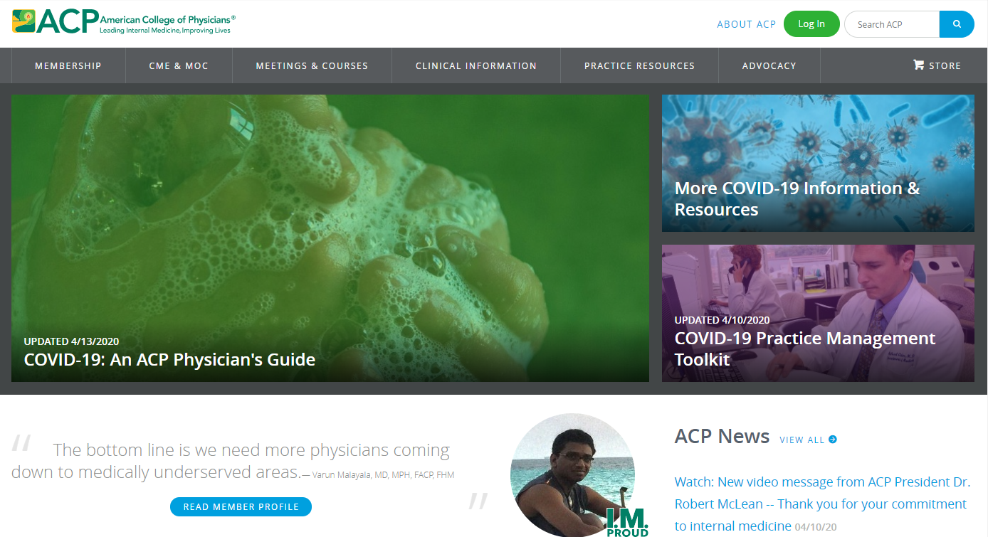
Supporting Internal Medicine During COVID-19 Pandemic
Created comprehensive COVID-19 Resource Hub: www.acponline.org/novel-coronavirus
Development and real-time updating of clinical, practical tools and information
Development of new ACP policies to address new situation and circumstances
Vigorously advocating to address ACP member and patient needs
Webinars: practical advice from front lines; implementing telehealth
Podcasts
Frequent publication of new Annals content
Member discussion forum
Weekly Update emails to ACP members

Slide 3
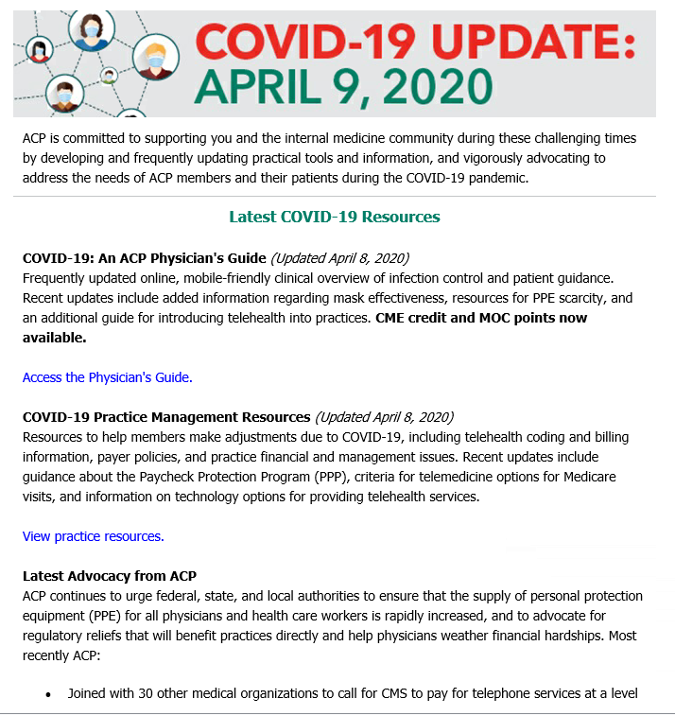
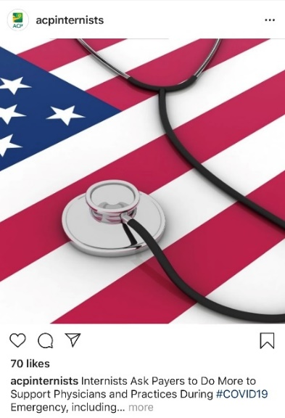
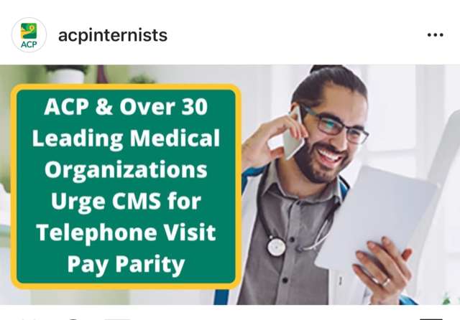
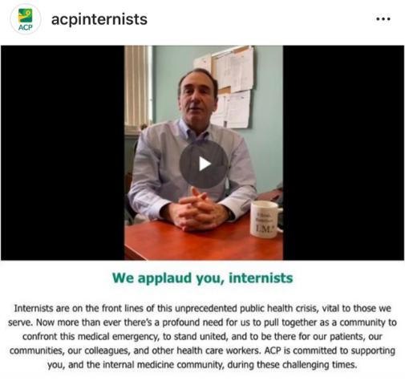
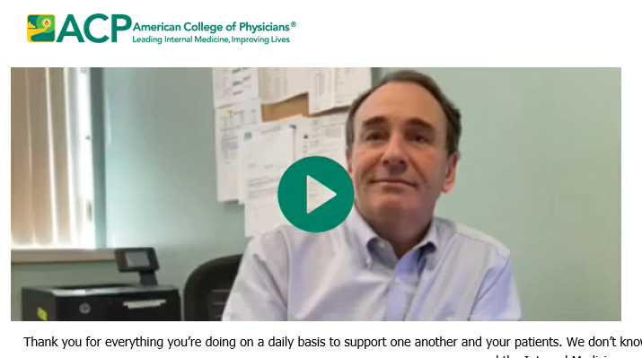
Getting the Word out to Members, Others
Weekly Update emails to ACP members
Video messages
E-newsletters: ACP Internist, ACP Hospitalist, ACP Advocate
Social Media
Press releases
ACP media interviews, news coverage

Slide 4
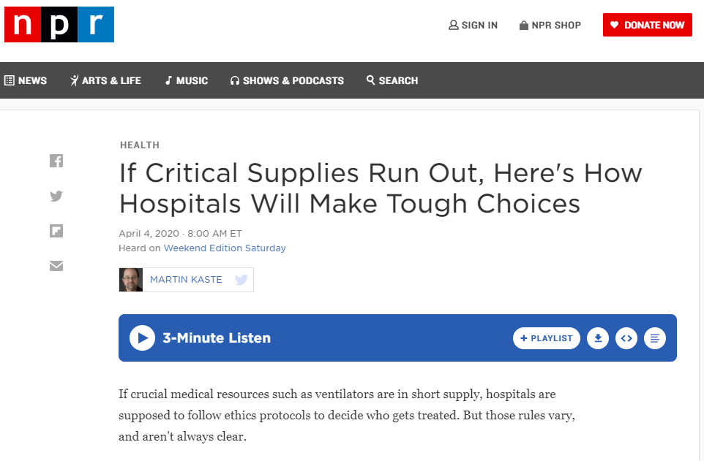
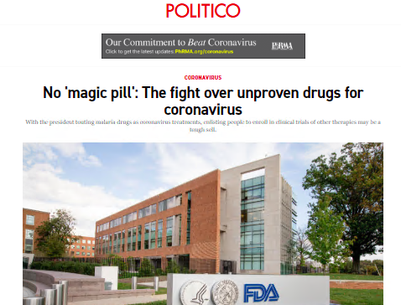
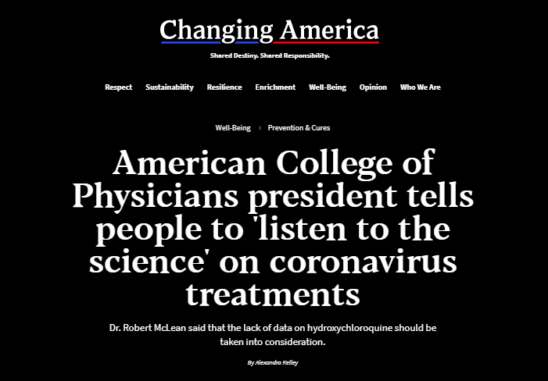
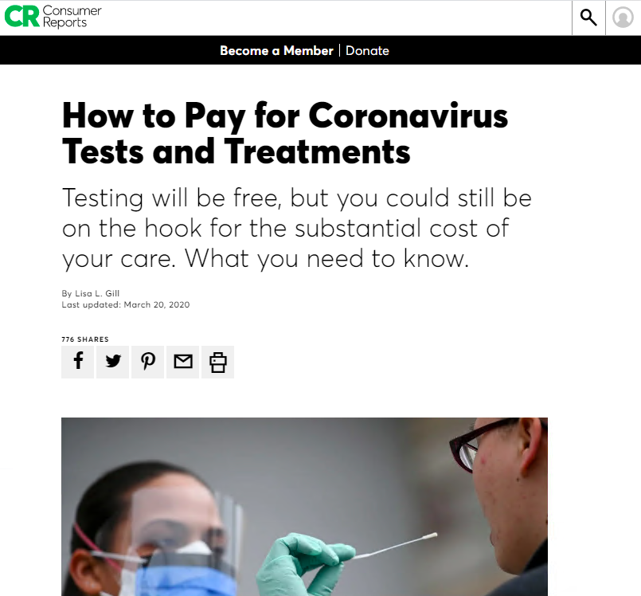
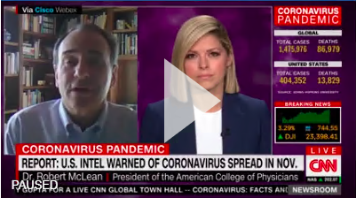
ACP in the News: COVID-19
ACP has been mentioned 945 total,
with an audience reach of 6.7 million.
Top tier outlet mentions include:
  The New York Times
  The Wall Street Journal
  The Washington Post
  Bloomberg News
  NPR
  The Hill
  POLITICO
  CNN

Slide 5
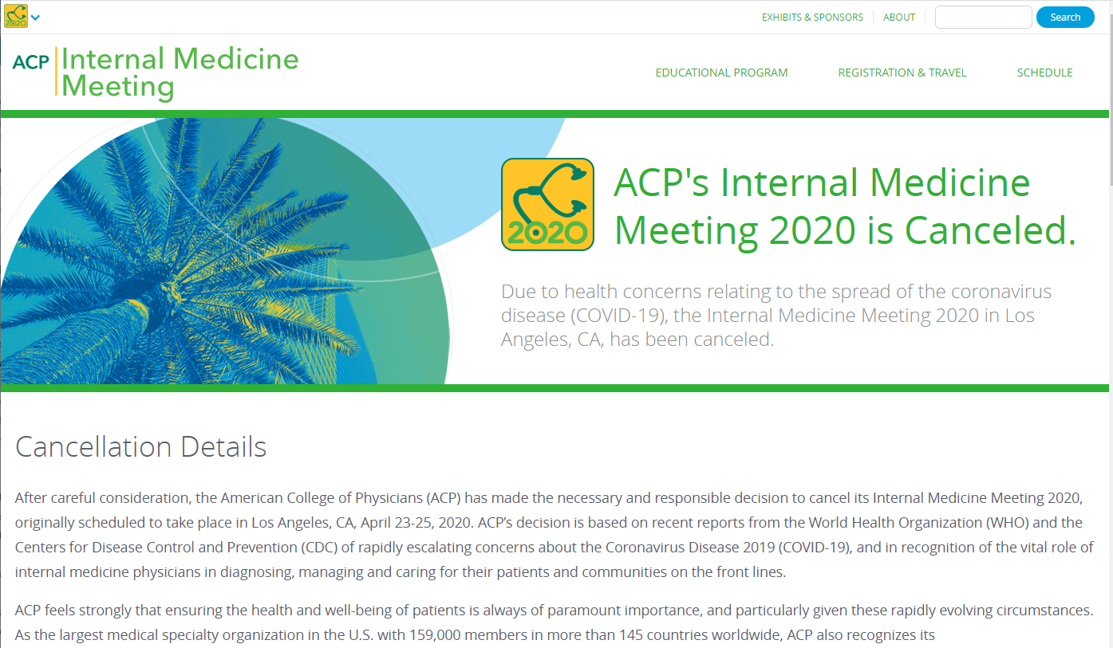
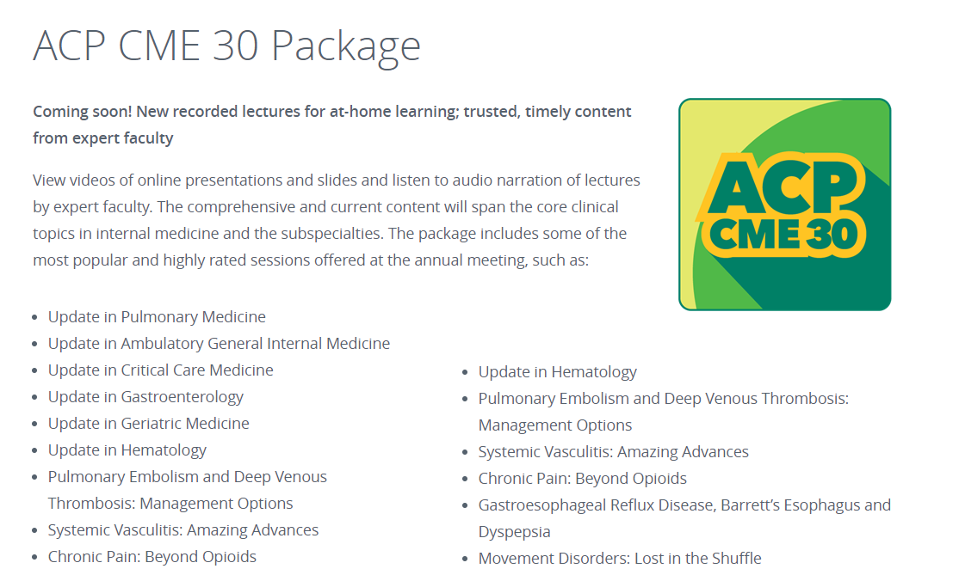
COVID-19 Pandemic: Internal Medicine 2020
Meeting cancellation communications to members, registered attendees, partners, exhibitors, vendors, and others
FAQs and information posted to meeting website
Refunds offered to everyone
CME 30 Package offered in lieu of refund
Rescheduled governance meetings

Slide 6
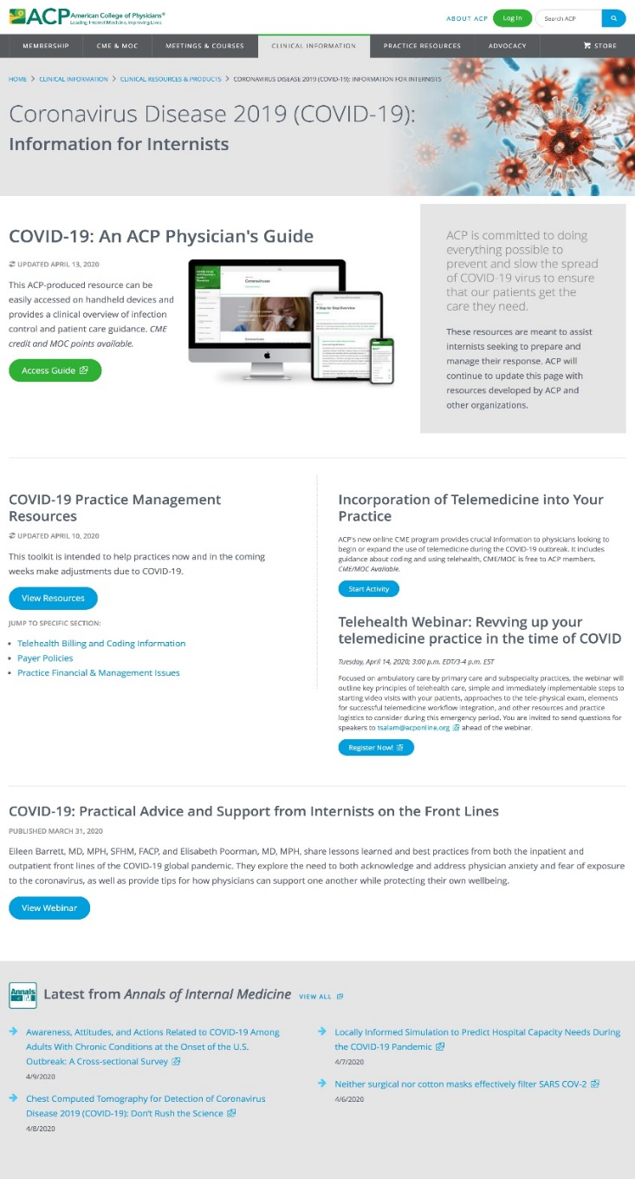
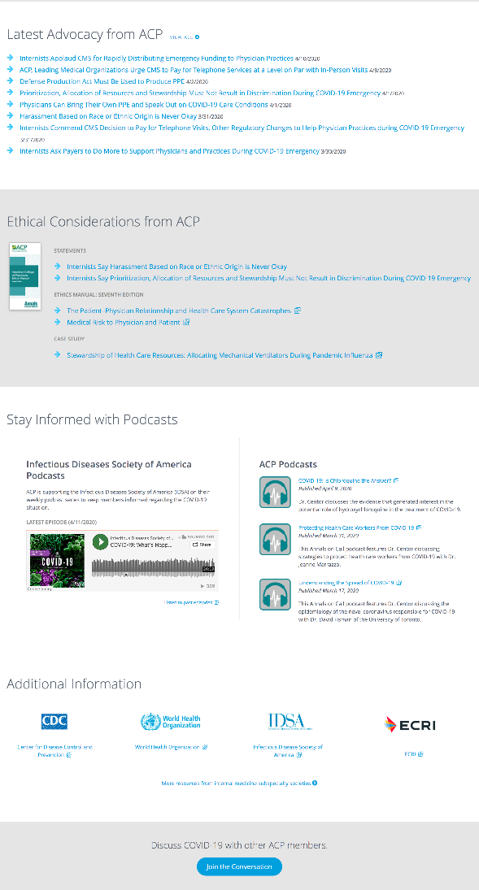
COVID-19 Resource Hub: A Collection of COVID-19 Resources

Slide 7
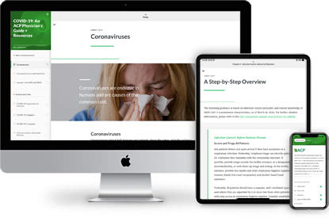
COVID-19: An ACP Physician’s Guide
Online, mobile-friendly clinical overview of infection control and patient management guidance that is updated frequently and continuously.

Slide 8
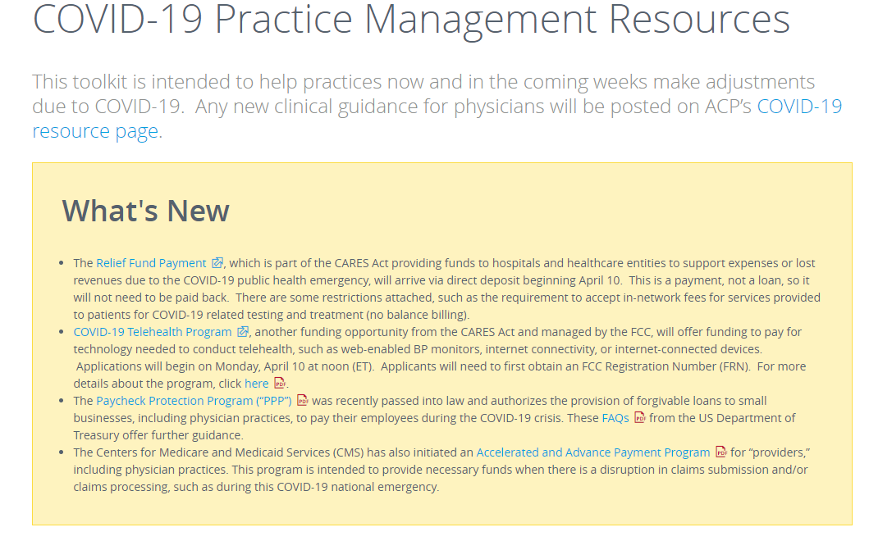
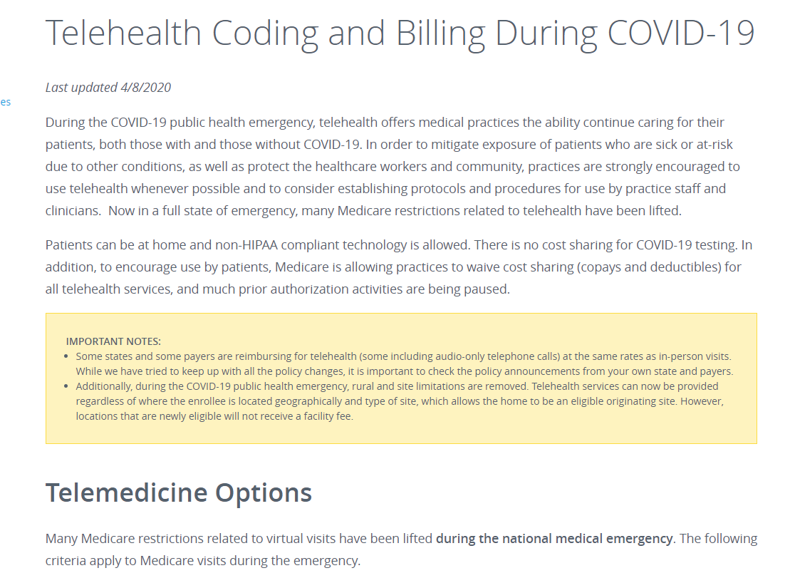
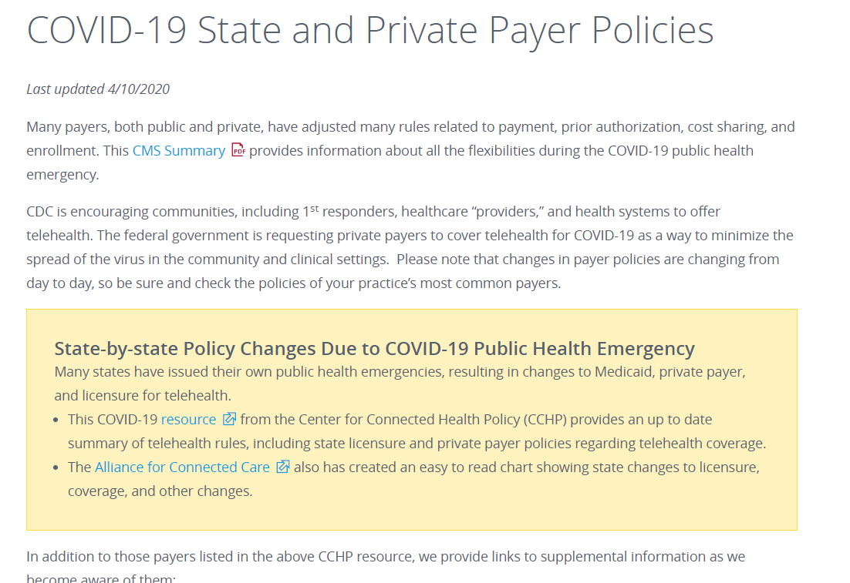
COVID-19 Practice Management Resources
New resources to support members and their practices, including:
  Coding and Billing for both Telehealth and Telephone Calls–guidelines for using CPT and ICD10 codes, modifiers, allowed technologies, testing, and more
  Payer Policies–information about payer and state-specific policy updates and flexibilities related to phone calls, testing, cost sharing, prescriptions, and enrollment
  Practice Financial & Management Issues–tips for accessing financial assistance, managing personnel shortages, and other issues

Slide 9
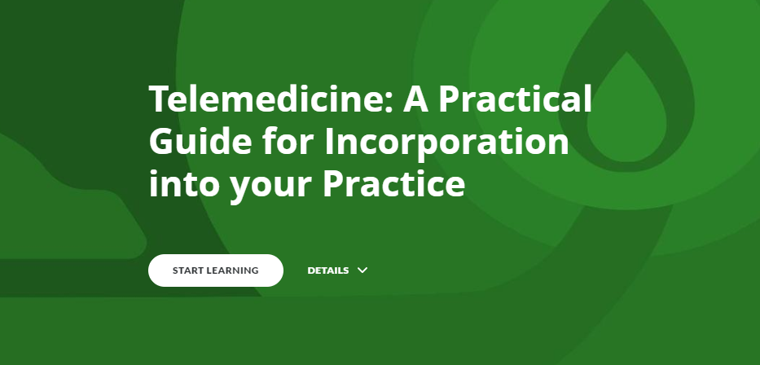
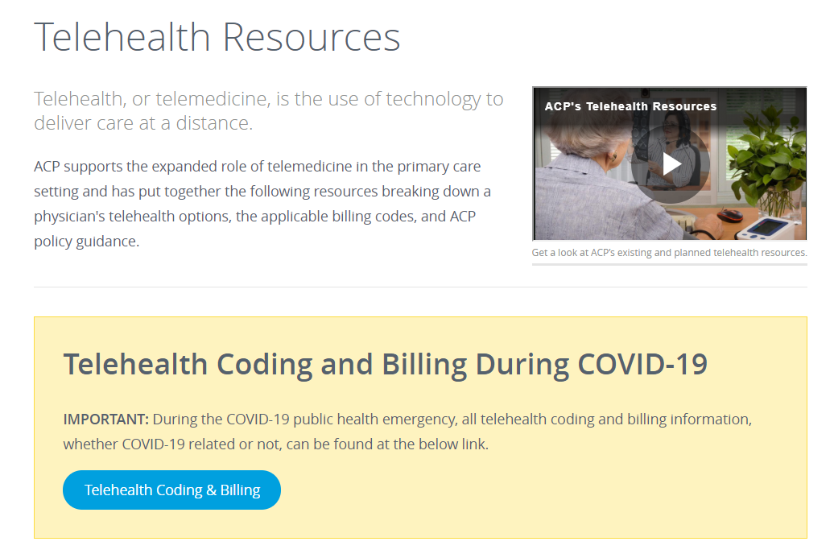
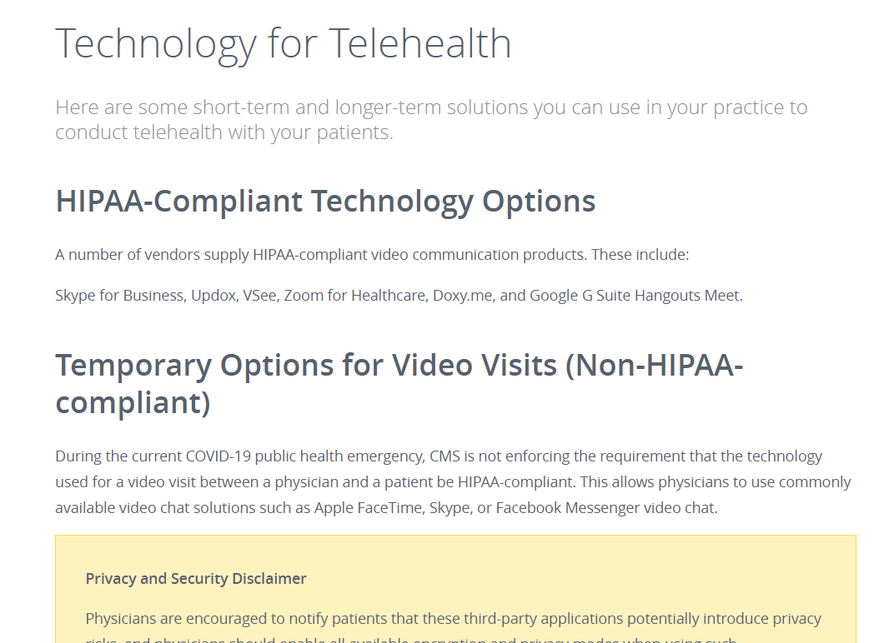
Telehealth & Telemedicine Resources
Online interactive CME program to help physicians implement telemedicine. Includes information about patient care during pandemics and public health crises.
Resources for telehealth coding and billing during COVID-19
Information on telehealth coverage rules, technology options for telehealth, and more

Slide 10
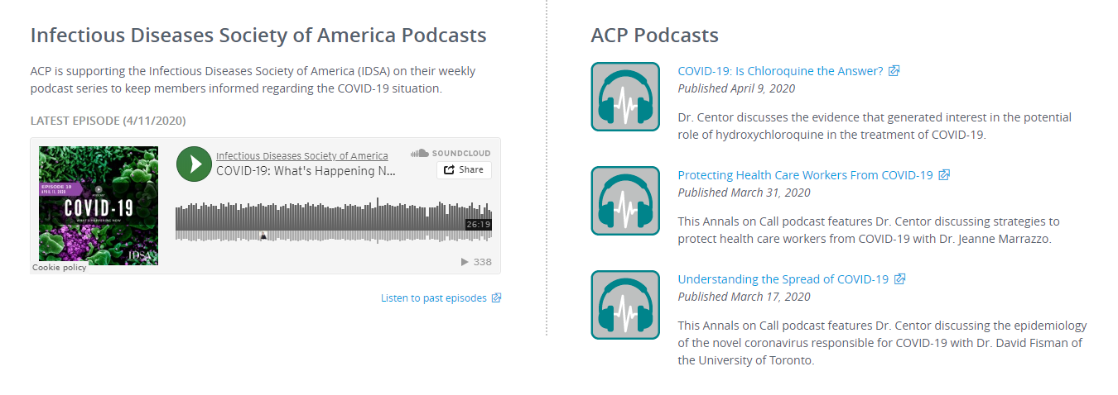
Podcasts
ACP and Annals Podcasts; Podcasts from the Infectious Diseases Society of America

Slide 11





New Clinical Policy: Living Practice Points on COVID-19
? | Question/Background: Ask a targeted question
 | Practice Points: Key take-ways to advise clinicians on what to do, based on the current evidence, and to highlight evidence gaps
 | Evidence Description: Graphic summary to describe current evidence base. E.g., How many studies? What types of studies? # of patients?
 | Evidence Summary: Bulleted synthesis of current evidence on benefits, harms, evidence gaps, and clinical considerations?
Rapid (“lightning”) development – 14 days from start of evidence review to journal submission
Concise overview of evidence and implications for practice
Maintained as living document – will monitor and assess new evidence every 1-2 weeks and update Practice Points as needed
2 questions currently underway Developed by Scientific Medical Policy Committee and based on rapid external systematic review Should Clinicians Use Chloroquine and Hydroxychloroquine Alone or In Combination with Azithromycin for the Prophylaxis or Treatment of COVID-19? (under review at Annals) What is the effectiveness of respirators vs. facemasks vs. cloth masks for prevention of COVID-19 in healthcare and community settings? (systematic review in progress)

Slide 12


COVID-19 Content collection in Annals of Internal Medicine
Annals is publishing a growing collection of research articles, commentaries, essays, podcasts, and graphic narratives related to COVID-19 is freely available to the public at the Annals of Internal Medicine website, www.annals.org.

Slide 13
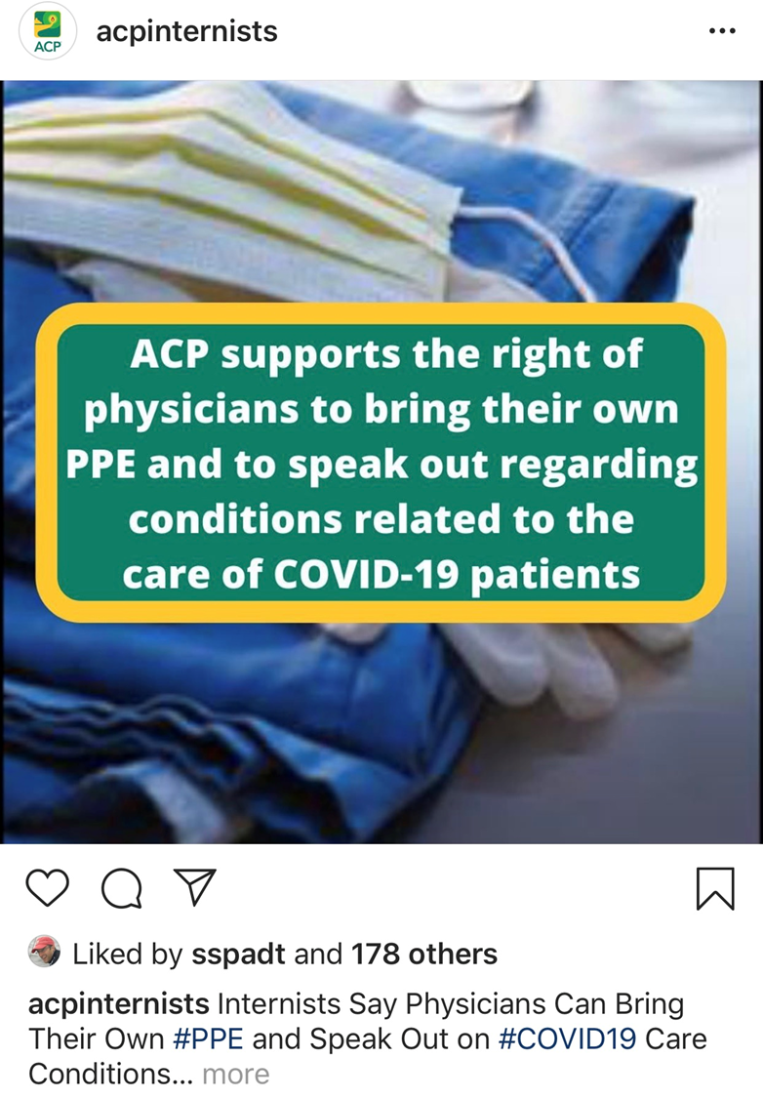

New ACP Policies Developed in response to COVID-19
Prioritization, Allocation of Resources and Stewardship Must Not Result in Discrimination
Harassment Based on Race or Ethnic Origin is Never Okay
Physicians Can Bring their Own PPE and Speak Out on COVID-19 Care Conditions
Social Distancing Recommendations to Help slow spread of COVID-19
Nonurgent In-person Medical Care – Transition In-office visits to Virtual Care

Slide 14
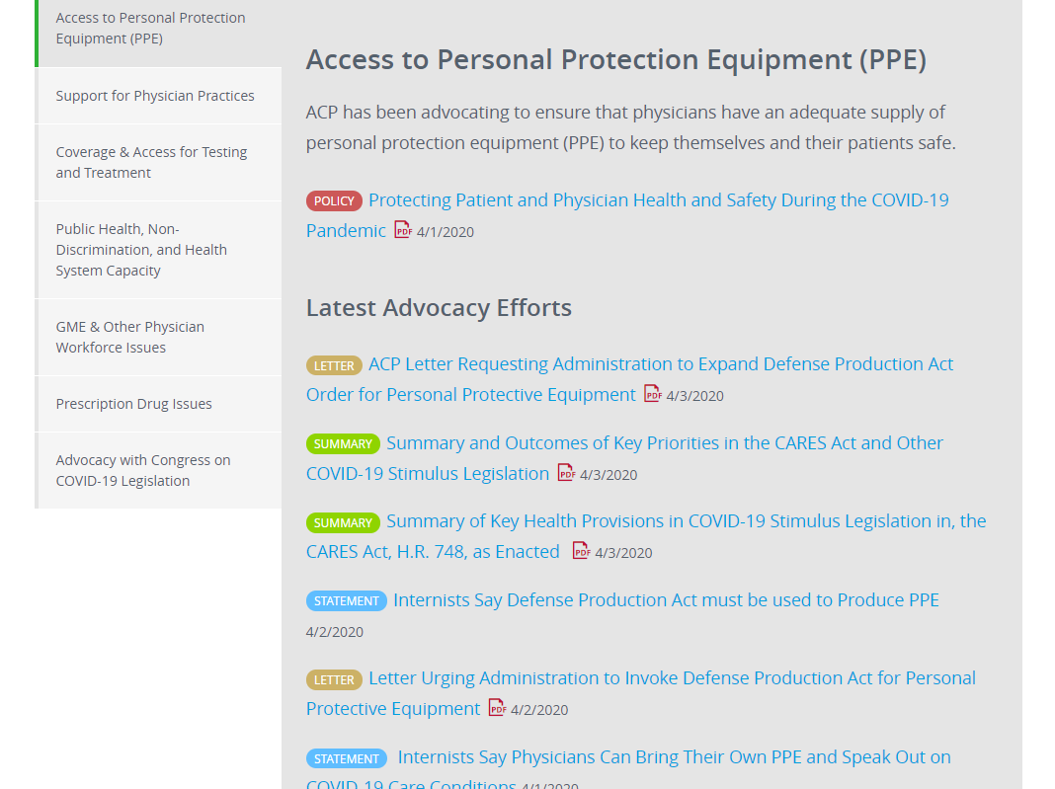
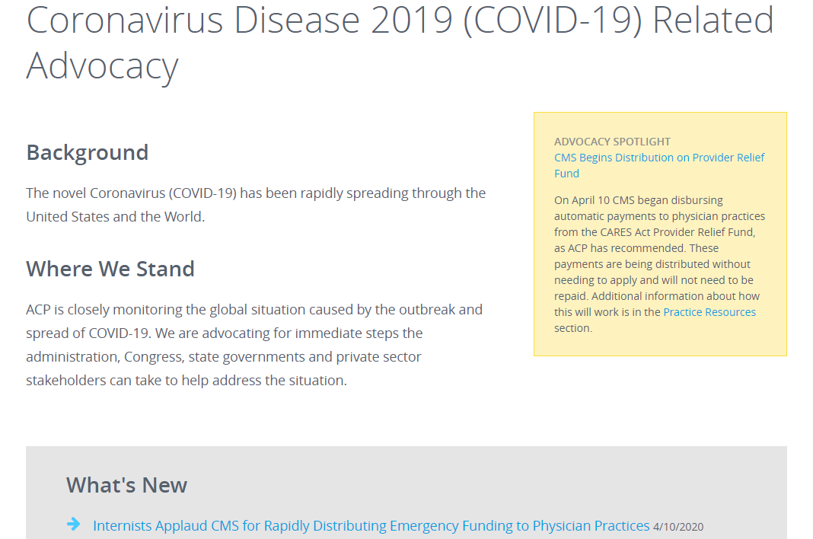
ACP COVID-19 Related Advocacy and Regulatory Activity
Vigorously advocating on federal, state and local levels for:
  Adequate supply and distribution of PPE
  Direct support and appropriate regulatory relief for members and their practices
  Payment for telehealth and telephone only call to be on par with in person visits
  Funding to help practices experiencing financial hardship, emergency grant programs
  Coverage and access for testing and treatment
  Suspension of elective procedures, prior authorization
  Collaborating with medical associations on provisions in CARES act
  Recommendations on stimulus legislation
  Enactment of Defense Production Act
  Opening of health insurance enrollment
  Expansion of Medicare, Medicaid
  Loan forgiveness for medical students and residents

Slide 15
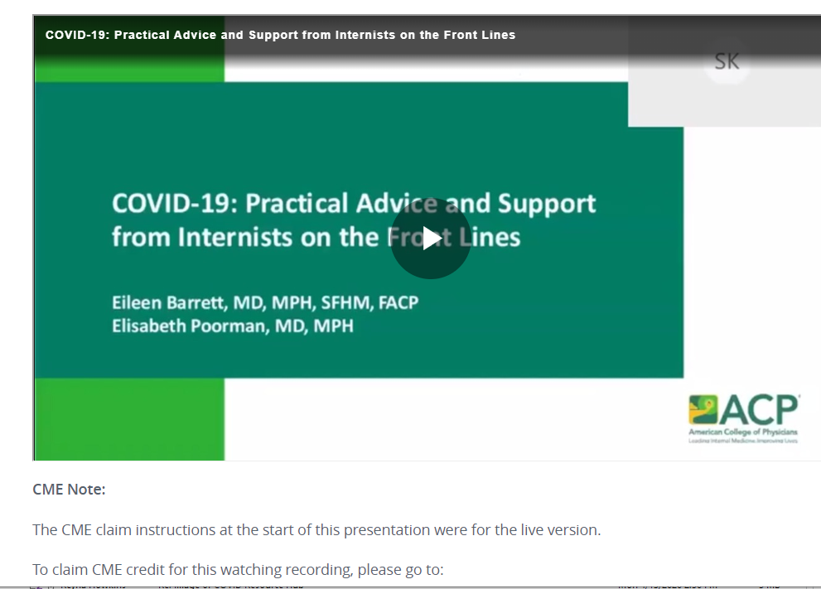
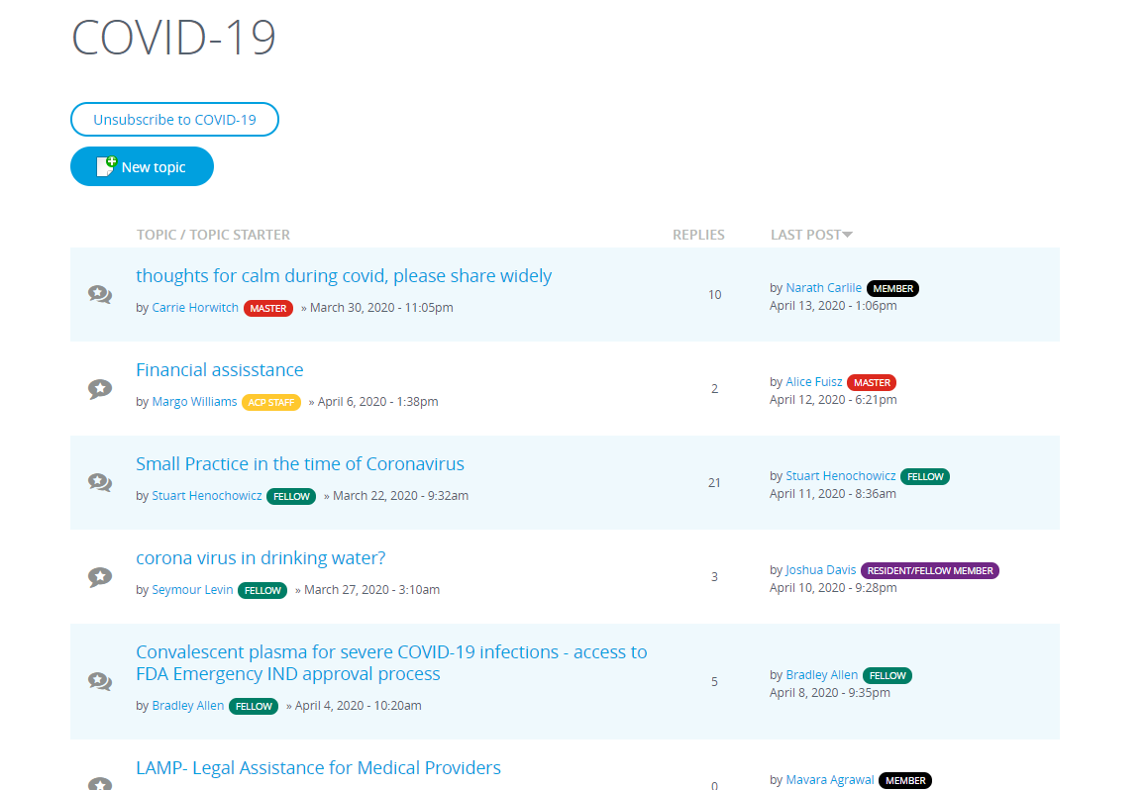

Webinars and Member Discussion Forum
Webinars on Telemedicine, Practical Advice and Support for Internists
COVID-19 Member Forum to Discuss COVID-10 with ACP Members

