Slide 1
Substance Use Disorders: Our Colleagues? Ourselves?
Presentation for the NYACP Wisdom and Well Being Series, 6/21/22
Kelly S. Ramsey, MD, MPH, MA, FACP, DFASAM
Chief of Medical Services

Slide 2

Disclosures
Dr. Ramsey does not have any financial relationships to disclose.

Slide 3
Case Scenario
A 34-year-old physician, H.M., is an established patient in my practice. H.M. presents for a follow-up visit after finishing inpatient treatment for opioid use disorder. Your patient shares that six weeks ago they were approached by their Medical Director to discuss concerns from the clinic staff about H.M.'s behavior, which included late arrivals to work, unexpected absences, mood swings, and weight loss. After the meeting, H.M. agreed to an evaluation by a Physician Health Program (PHP), and an opioid use disorder was diagnosed. Inpatient treatment was recommended, and H.M. is still on a medical leave of absence. H.M. is currently prescribed sertraline (Zoloft), 50 mg by mouth daily, and buprenorphine/naloxone (Suboxone), 8 mg/2 mg sublingually daily. H.M.'s aftercare plan includes attending community recovery meetings, focusing on self-care, and spending time with their spouse and children. H.M. reports “feeling better than I have in years” and states that they have had no cravings for opioids. The patient is attending cognitive behavior therapy sessions for treatment of depression and opioid use disorder and is enrolled in the NYS PHP.
As an internal medicine physician, what role do I play in supporting H.M.'s recovery from substance use disorder (SUD)?
Notes:
Source: https://www.aafp.org/pubs/afp/issues/2021/0301/p302.html#afp20210301p302-b3

Slide 4
Learning Objectives
Discuss vulnerabilities and risks for substance use and substance use disorder (SUD)
Discuss what physicians should know to take care of themselves
Discuss what physicians should know to take care of their peers
Discuss what physicians can do for their practice or organization

Slide 5
Vulnerabilities and Risks for Substance Use and SUD
Epidemiology of Substance Use in Physicians

Slide 6
Physicians and Substance Use
A few minutes after taking cocaine, one
experiences a sudden exhilaration and
feeling of lightness .... One senses an
increase of self-control and feels more
vigorous and more capable of work.
—Sigmund Freud, Über Coca (1884)
Notes:
Source: Impaired Physicians: Obliterating the Stigma A. Benjamin Srivastava, M.D. The American Journal of Psychiatry Residents’ Journal | March 2018

Slide 7
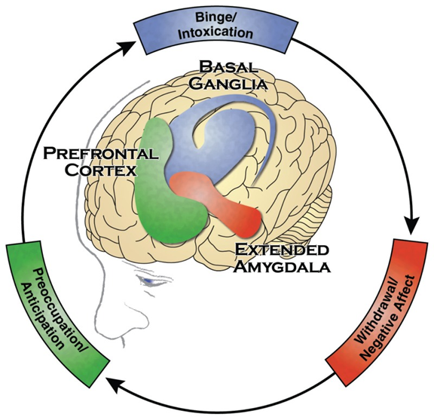
Pathophysiology of SUD
Notes:
Source: https://www.ncbi.nlm.nih.gov/books/NBK424849/

Slide 8
Diagnosis of SUD
DSM-5 Criteria: at least 2 criteria met within a 12-month period
Physiology:
  Tolerance: using more for the same effect or less effect with the same amount
  Withdrawal: characteristic withdrawal syndrome or similar substance taken to avoid withdrawal symptoms
The Core Problem of SUD:
  Knowledge of adverse consequences, yet continued use
Internal Preoccupation:
  Desire to cut down on use or unsuccessful attempts to stop using
  Time: a lot of time spent acquiring, using, and recovering from use
  Larger quantities used over a longer period of time than intended
  Craving or a strong desire to use
External Consequences:
  Activities reduced or given up because of use
  Role obligations neglected
  Social or interpersonal problems
  Recurrent use in situations that are physically hazardous
Severity: Mild: 2-3 sx; Moderate: 4-5 sx; Severe: >6 sx
Notes:
Source: P. Levounis, Academic Psychiatry, 2015, based on the DSM-5 Criteria

Slide 9
Vulnerabilities for Developing SUD in the General Population
Genetic predisposition (40-60% of risk)
Concomitant mental health diagnoses: bipolar disorder, anxiety (panic disorder, PTSD, social anxiety), major depression, ADHD, personality disorders (borderline, antisocial), antisocial conduct disorder (especially in adolescence); whether undiagnosed or undertreated or untreated or treated inappropriately
History of trauma and/or abuse: preadolescent sexual trauma (especially females), victim/witness to violence (males/females)
Poor coping mechanisms; escapism
Impulsivity: plays a role in the initiation of substance use
Sensation/novelty seeking play a role in the initiation of substance use
Environmental triggers/sensory cues: triggers to use/resume use
Lack of homeostatic reward regulation; reward “deficiency”: orientation towards pleasurable rewards, priming of the brain by early substance use
Section Title – Arial Bold

Slide 10
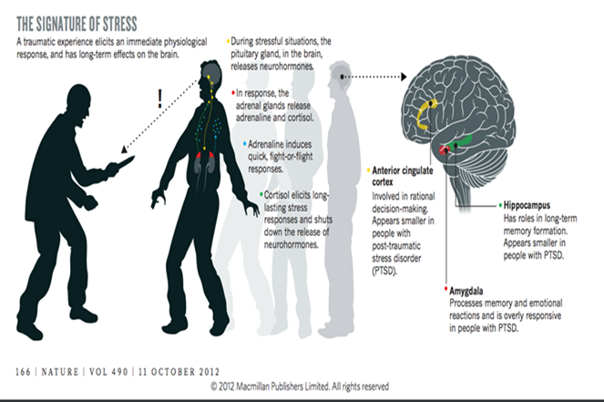
What Is Trauma?
What Is Trauma?
From Violence to Trauma
Exposure to actual or threatened death, serious injury, or sexual violence in one or more of four ways:
-directly experiencing the event
-witnessing, in person, the event occurring to others
-learning that such an event happened to a close family member or friend
-experiencing repeated or extreme exposure to aversive details of such events (i.e., first responders)
Section Title – Arial Bold
Notes:
Sources: American Psychiatric Association. (2013). Diagnostic and statistical manual of mental disorders (5th ed.). Washington, DC and “The Roots of Resilience”, Virginia Hughes 11 OCTOBER 2012 | VOL 490 | NATURE | 165, https://www.nature.com/news/polopoly_fs/1.11570!/menu/main/topColumns/topLeftColumn/pdf/490165a.pdf

Slide 11
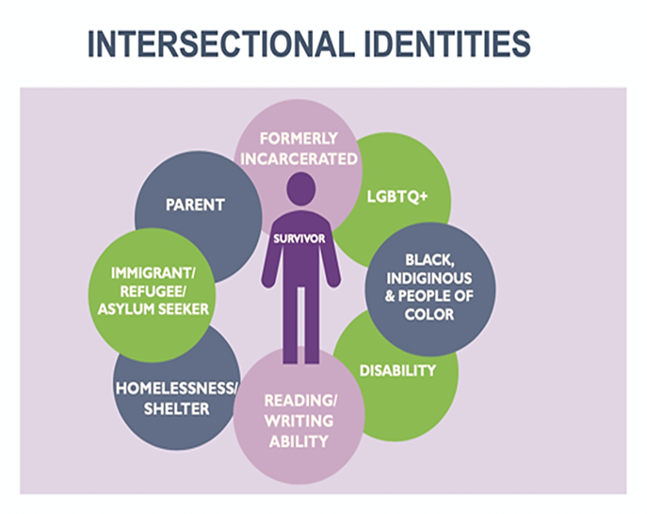
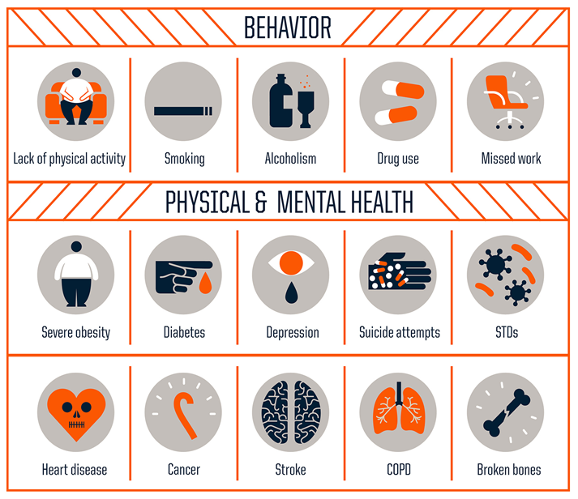
Trauma’s Effects
Its Effects
Section Title – Arial Bold
Notes:
Sources: Centers for Disease Control and Prevention, Robert Wood Johnson Foundation: https://www.npr.org/sections/health-shots/2015/03/02/387007941/take-the-ace-quiz-and-learn-what-it-does-and-doesnt-mean and thanks to Anita Ravi, MD for her slides

Slide 12
Trauma and Addiction
There is a well-established link between trauma and addiction
The experience of addiction may be traumatic in and of itself as it can put individuals in dangerous situations and affect health status
Individuals with substance use disorder often experience additional trauma
Section Title – Arial Bold
Notes:
Source: University of Buffalo School of Social Work/NYS OASAS slides
https://pubmed.ncbi.nlm.nih.gov/24592664/
http://lib.adai.uw.edu/pubs/addictmessenger/am2011_14_5.pdf

Slide 13
Stigma and People Who Use Drugs (PWUD)
Stigma in Healthcare Settings
Consider the Relationship of Stigma and Trauma
Stigma includes attitudes, beliefs, behaviors, and structures at multiple levels (e.g., individuals, groups, organizations, systems) and can lead to prejudice or discrimination against people with mental health diagnoses and substance use disorders
Perpetuates stereotypes and assigns labels like dangerous, noncompliant or incapable of managing treatment, dirty, at fault, etc.
Can be internalized to make people feel they are not deserving of being treated with dignity and respect
  Fear, shame, and isolation
  Feeling unwelcome, judged, or unworthy of seeking or receiving services
Limits a person’s ability or desire to access services
Ultimately, stigma contributes to suboptimal (and sometimes traumatic) healthcare experiences and health outcomes
Realize that most people have experienced trauma
  Personal and/or generational/historical trauma
  People with a substance use disorder (SUD) are more likely to have experienced trauma, including trauma in healthcare or pharmacy settings
Recognize how trauma affects people
  Trauma impacts physical health; neurobiology; and cognitive, social, and emotional functioning
  Perceived “high-risk behaviors” can be a way of coping with trauma
Consider how past histories of trauma, violence, layers of disadvantage and stigma
  Consider how this may affect the way a person engages with providers and pharmacists
Commit to not repeating trauma or creating more trauma (re-traumatizing)
Section Title – Arial Bold
Notes:
Sources:
https://harmreduction.org/issues/harm-reduction-basics/undoing-stigma-facts/
https://www.drugabuse.gov/nidamed-medical-health-professionals/health-professions-education/words-matter-terms-to-use-avoid-when-talking-about-addiction and https://www.ncbi.nlm.nih.gov/pmc/articles/PMC3181836/#:~:text=Brain%20areas%20implicated%20in%20the,norepinephrine%20responses%20to%20subsequent%20stressors.
https://store.samhsa.gov/product/TIP-57-Trauma-Informed-Care-in-Behavioral-Health-Services/SMA14-4816
https://traumainformedoregon.org/resource/foundations-trauma-informed-care/

Slide 14
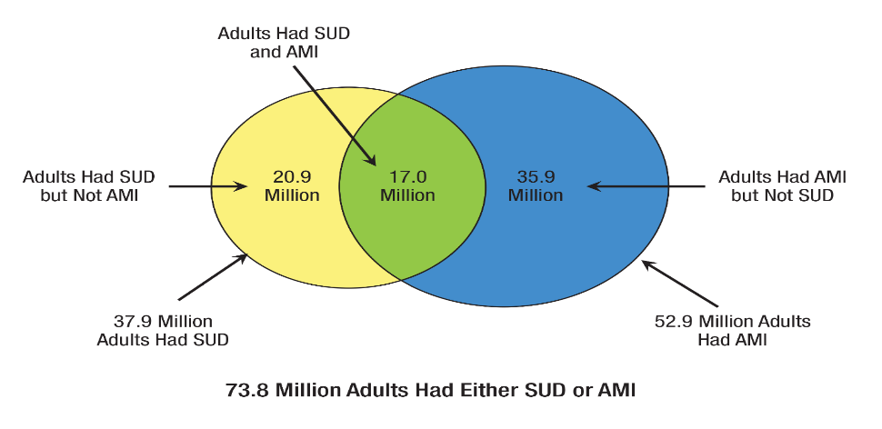
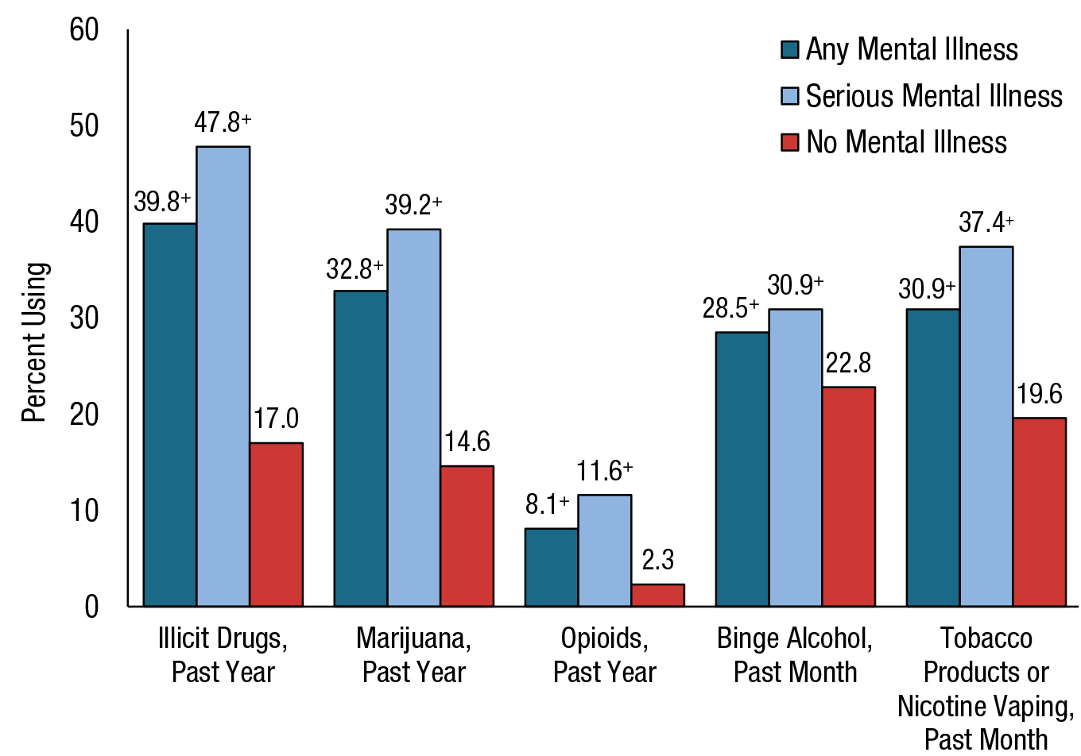
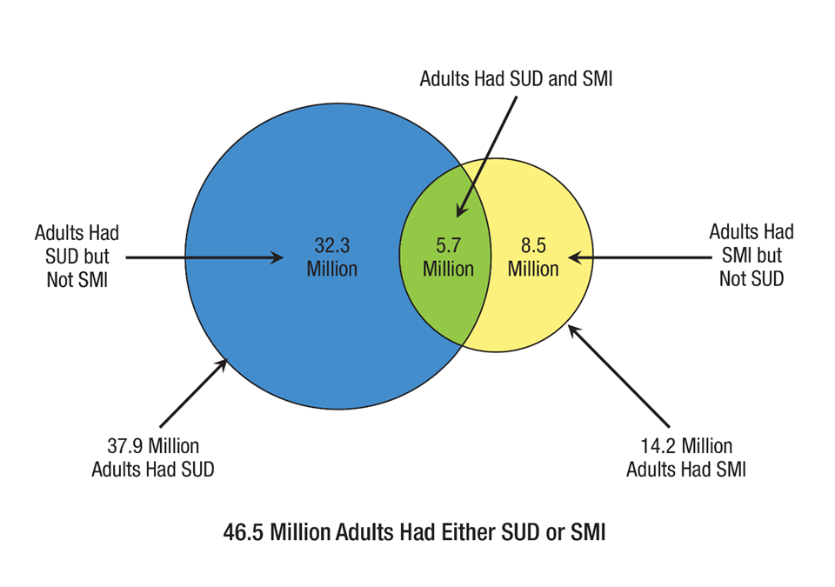
NSDUH 2020: SUD and Mental Health Comorbidity
Notes:
Source: NSDUH 2020, https://www.samhsa.gov/data/release/2020-national-survey-drug-use-and-health-nsduh-releases

Slide 15
Additional Vulnerabilities for Developing SUD in Physicians
Same vulnerabilities listed on the slide for the general population PLUS
Vulnerabilities unique to physicians, including:
  Greater access to prescription medications than non-physicians and ability to write prescriptions
  High work stress
  A culture of medical care and behaviors modeled in physician training have been faulted for promoting attributes that can interfere with physician wellness or obtaining clinical care for oneself as a physician
    Early assumption of responsibility (may be associated with poor communication and/or coping skills)
    Trained to be self-reliant and self-sufficient (may lead to self-treatment)
    Confidence in understanding medications may lead to self-medication
    The ability to perform under stress and despite personal difficulties is a hallmark of the profession
    Physicians often have sophisticated denial with elaborate justification and rationalization, making intervention more difficult; physicians may be better at concealing use
    Professional arrogance (overconfidence) can lead to difficulty taking directions or input from others
    Gender may be an issue; research studies suggest that female physicians with a substance use disorder (SUD) are not referred for treatment as frequently as male physicians; also telescoping effect in women (quicker progression to unhealthy use and consequences due to use)
Section Title – Arial Bold
Notes:
Source: https://www.uptodate.com/contents/substance-use-disorders-in-physicians-epidemiology-clinical-manifestations-identification-and-engagement#H1
Merlo LJ, Trejo-Lopez J, Conwell T, Rivenbark J. Patterns of substance use initiation among healthcare professionals in recovery. Am J Addict 2013; 22:605.
Merlo LJ, Singhakant S, Cummings SM, Cottler LB. Reasons for misuse of prescription medication among physicians undergoing monitoring by a physician health program. J Addict Med 2013; 7:349.
Lutsky I, Hopwood M, Abram SE, et al. Psychoactive substance use among American anesthesiologists: a 30-year retrospective study. Can J Anaesth 1993; 40:915.
Harms BA, Heise CP, Gould JC, Starling JR. A 25-year single institution analysis of health, practice, and fate of general surgeons. Ann Surg 2005; 242:520.
Boisaubin EV, Levine RE. Identifying and assisting the impaired physician. Am J Med Sci 2001; 322:31.
Szymczak JE, Smathers S, Hoegg C, et al. Reasons Why Physicians and Advanced Practice Clinicians Work While Sick: A Mixed-Methods Analysis. JAMA Pediatr 2015; 169:815.
Merlo LJ, Cummings SM, Cottler LB. Recovering substance-impaired pharmacists' views regarding occupational risks for addiction. J Am Pharm Assoc (2003) 2012; 52:480.
Wunsch MJ, Knisely JS, Cropsey KL, et al. Women physicians and addiction. J Addict Dis 2007; 26:35.
Frank E, Brogan D, Schiffman M. Prevalence and correlates of harassment among US women physicians. Arch Intern Med 1998; 158:352.
Hughes PH, Brandenburg N, Baldwin DC Jr, et al. Prevalence of substance use among US physicians. JAMA 1992; 267:2333.

Slide 16
Prevalence of SUD Among Physicians
A 2012 study involving 7197 American surgeons (28.7 percent response rate) found that 15.4 percent had a score on the Alcohol Use Disorders Identification Test (AUDIT-C) suggesting the presence of an alcohol use disorder.
A 2015 study of 7206 American physicians of various specialties (26.7 percent response rate) showed that 21.4 percent had a likely substance use disorder (alcohol and/or other substances), based on screening with the AUDIT-C and World Health Organization Alcohol, Smoking, and Substance Involvement Screening Test measures.
Alcohol has been found to be the most frequently misused substance in several United States samples of physicians with SUDs; prescription opioids have typically been found to be the second most frequently misused substance.
Physicians have been found to have higher rates of prescription drug misuse, notably benzodiazepines and opioids, compared with the general population. Prescription drugs misused by physicians are frequently self-prescribed or otherwise obtained through the physician’s professional access.
Section Title – Arial Bold
Notes:
Source: https://www.uptodate.com/contents/substance-use-disorders-in-physicians-epidemiology-clinical-manifestations-identification-and-engagement#H1
Oreskovich MR, Kaups KL, Balch CM, et al. Prevalence of alcohol use disorders among American surgeons. Arch Surg 2012; 147:168.
Oreskovich MR, Shanafelt T, Dyrbye LN, et al. The prevalence of substance use disorders in American physicians. Am J Addict 2015; 24:30.
Hughes PH, Brandenburg N, Baldwin DC Jr, et al. Prevalence of substance use among US physicians. JAMA 1992; 267:2333.
McAuliffe WE, Rohman M, Breer P, et al. Alcohol use and abuse in random samples of physicians and medical students. Am J Public Health 1991; 81:177.
McAuliffe WE, Rohman M, Santangelo S, et al. Psychoactive drug use among practicing physicians and medical students. N Engl J Med 1986; 315:805.
Kenna GA, Wood MD. Alcohol use by healthcare professionals. Drug Alcohol Depend 2004; 75:107.
Professional Resource Network, Florida PHP, participant survey December 2007, personal communication.
McAuliffe PF, Gold MS, Bajpai L, et al. Second-hand exposure to aerosolized intravenous anesthetics propofol and fentanyl may cause sensitization and subsequent opiate addiction among anesthesiologists and surgeons. Med Hypotheses 2006; 66:874.
Hughes PH, Storr C, Baldwin DC Jr, et al. Patterns of substance use in the medical profession. Md Med J 1992; 41:311.
Cummings SM, Merlo L, Cottler L. Mechanisms of prescription drug diversion among impaired physicians. J Addict Dis 2011; 30:195.

Slide 17
Prevalence of SUD Among Physicians
Substances of choice
Trends over time
As an example of types of substances used, a retrospective study of physician health program (PHP) medical records of 3604 physicians monitored between 1980 and 2002 reported “drug of choice,” as follows:
●Alcohol – 25 percent ●Opioids – 25 percent
●Marijuana – 12 percent ●Cocaine – 11 percent
●Sedatives – 10 percent ●Amphetamines – 4 percent
●Inhalants – 1 percent ●Other – 8 percent
Though published data are not available, clinical experience suggests that the number of physicians assessed and treated for an SUD has increased significantly in recent years.
Enhanced awareness of the problem and an increased emphasis on risk management may have contributed to this increase.
Section Title – Arial Bold
Notes:
Source: https://www.uptodate.com/contents/substance-use-disorders-in-physicians-epidemiology-clinical-manifestations-identification-and-engagement#H1
Hughes PH, Brandenburg N, Baldwin DC Jr, et al. Prevalence of substance use among US physicians. JAMA 1992; 267:2333.

Slide 18
The Prevalence of Substance Use Disorders in American Physicians
Background: There have been few studies on the prevalence of substance use disorders (SUDS) in the physician population at large nor have any studies compared the prevalence of SUDS in American physicians by specialty.
Methods: We conducted a national study of SUDS in a large sample of U.S. physicians from all specialty disciplines using the AMA Physician Masterfile. Substance Use Disorders (SUDS) were measured using validated instruments.
Results: Of the 27,276 physicians who received an invitation to participate, 7,288 (26.7%) completed surveys. 12.9% of male physicians and 21.4% of female physicians met diagnostic criteria for alcohol abuse or dependence [DSM-IV criteria, pre-DSM-5]. Abuse of prescription drugs and use of illicit drugs was rare. Factors independently associated with alcohol abuse or dependence were age (OR 0.985; p < .0001), hours worked (OR 0.994; p = 0.0094), male gender (OR 0.597; p < .0001), being married (OR 1.296; p =0.0424) or partnered (OR 1.989; p =0.0003), having children (OR 0.745; p -0.0049), and being in any specialty other than internal medicine (OR 1.757; p =0..0060). Specialty choice was strongly associated with alcohol abuse or dependence (p =0..0011). Alcohol abuse or dependence was associated with burnout (p < .0001), depression (p < .0001), suicidal ideation (p =0.0004), lower quality of life (p < .0001), lower career satisfaction (p =0.0036), and recent medical errors (p =0.0011).
Conclusion: Alcohol abuse or dependence is a significant problem among American physicians. Since prognosis for recovery of physicians from chemical dependency is exceptionally high, organizational approaches for the early identification of problematic alcohol consumption in physicians followed by intervention and treatment where indicated should be strongly supported.
(Am J Addict 2015;24:30–38)
Section Title – Arial Bold
Notes:
Source: The American Journal on Addictions, 24: 30–38, 2015 Copyright © American Academy of Addiction Psychiatry
ISSN: 1055-0496 print / 1521-0391 online DOI: 10.1111/ajad.12173

Slide 19
SUD Among Physicians: Comorbidities
The prevalence of co-occurring mental disorders in physicians with an SUD is high, with estimates from 25 to 75 percent.
A study of 99 physicians who completed a PHP diagnostic evaluation by the Florida PHP found high rates of co-occurring mental disorders:
  Major depressive disorder – 30.3 percent
  Bipolar disorder – 11.4 percent
  Antisocial personality disorder – 7.2 percent
  Generalized anxiety disorder – 7.1 percent
  Social phobia – 5.1 percent
A study of 157 physicians referred to the Virginia PHP found that 39 percent were referred for an uncomplicated SUD, 39 percent for a mental disorder without an SUD, and 21 percent had a dual diagnosis of a SUD with a co-occurring a mental disorder. The most prevalent comorbid disorders among the physicians with an SUD were:
  Bipolar disorder – 33 percent
  Depression – 24 percent
  Antisocial personality disorder – 9 percent
  Generalized anxiety disorder – 9 percent
The presence of a coexisting psychiatric disorder was associated with higher risk of SUD relapse among 292 health care professionals enrolled in the Washington PHP.
Section Title – Arial Bold
Notes:
Source: https://www.uptodate.com/contents/substance-use-disorders-in-physicians-epidemiology-clinical-manifestations-identification-and-engagement#H1
McGovern MP, Angres DH, Leon S. Characteristics of physicians presenting for assessment at a behavioral health center. J Addict Dis 2000; 19:59.
Angres DH, McGovern MP, Shaw MF, Rawal P. Psychiatric comorbidity and physicians with substance use disorders: a comparison between the 1980s and 1990s. J Addict Dis 2003; 22:79.
Frank E, Dingle AD. Self-reported depression and suicide attempts among U.S. women physicians. Am J Psychiatry 1999; 156:1887.
Wijesinghe CP, Dunne F. Substance use and other psychiatric disorders in impaired practitioners. Psychiatr Q 2001; 72:181.
Cottler LB, Ajinkya S, Merlo LJ, et al. Lifetime psychiatric and substance use disorders among impaired physicians in a physicians health program: comparison to a general treatment population: psychopathology of impaired physicians. J Addict Med 2013; 7:108.
Wijesinghe CP, Dunne F. Substance use and other psychiatric disorders in impaired practitioners. Psychiatr Q 2001; 72:181.
Domino KB, Hornbein TF, Polissar NL, et al. Risk factors for relapse in health care professionals with substance use disorders. JAMA 2005; 293:1453.

Slide 20
SUD Among Physicians: Clinical Specialties
Addiction is seen in physicians across medical specialties but appears to occur at a higher rate among physicians in anesthesiology, emergency medicine, psychiatry, and family practice. Multiple studies suggest that pediatricians have the lowest rate of addiction.
Research suggests that use of specific substance classes may vary across medical specialties. Emergency medicine residents reported higher rates of current cocaine use compared with other specialties; rates of marijuana use were higher among physicians in emergency medicine, family practice, anesthesiology, and psychiatry. Psychiatrists have been reported to have a higher rate of benzodiazepine misuse; female surgeons have been reported to have a higher rate of alcohol use compared with other female physicians.
Anesthesiologists have been found to be more likely than other physicians to use drugs intravenously, and to misuse opioids and propofol. Anesthesiologists have greater proximity and access to these medications. There is also the possibility that people with a predisposition toward substance use are more likely to pursue anesthesiology as a specialty.
Section Title – Arial Bold
Notes:
Source: https://www.uptodate.com/contents/substance-use-disorders-in-physicians-epidemiology-clinical-manifestations-identification-and-engagement#H1
McGovern MP, Angres DH, Leon S. Characteristics of physicians presenting for assessment at a behavioral health center. J Addict Dis 2000; 19:59.
McAuliffe WE, Rohman M, Santangelo S, et al. Psychoactive drug use among practicing physicians and medical students. N Engl J Med 1986; 315:805.
Hughes PH, Storr CL, Brandenburg NA, et al. Physician substance use by medical specialty. J Addict Dis 1999; 18:23.
Pelton C, Ikeda RM. The California Physicians Diversion Program's experience with recovering anesthesiologists. J Psychoactive Drugs 1991; 23:427.
Winter RO, Birnberg B. Working with impaired residents: trials, tribulations, and successes. Fam Med 2002; 34:190.
Talbott GD, Gallegos KV, Wilson PO, Porter TL. The Medical Association of Georgia's Impaired Physicians Program. Review of the first 1000 physicians: analysis of specialty. JAMA 1987; 257:2927.
Bissell L, Jones RW. The alcoholic physician: a survey. Am J Psychiatry 1976; 133:1142.
Myers T, Weiss E. Substance use by internes and residents: an analysis of personal, social and professional differences. Br J Addict 1987; 82:1091.
Shore JH. The Oregon experience with impaired physicians on probation. An eight-year follow-up. JAMA 1987; 257:2931.
Morrison J, Wickersham P. Physicians disciplined by a state medical board. JAMA 1998; 279:1889.
Knight JR, Sanchez LT, Sherritt L, et al. Outcomes of a monitoring program for physicians with mental and behavioral health problems. J Psychiatr Pract 2007; 13:25.
Milling TJ. Drug and alcohol use in emergency medicine residency: an impaired resident's perspective. Ann Emerg Med 2005; 46:148.
Rosta J, Aasland OG. Female surgeons' alcohol use: a study of a national sample of norwegian doctors. Alcohol Alcohol 2005; 40:436.
Gallegos KV, Browne CH, Veit FW, Talbott GD. Addiction in anesthesiologists: drug access and patterns of substance abuse. QRB Qual Rev Bull 1988; 14:116.
Wischmeyer PE, Johnson BR, Wilson JE, et al. A survey of propofol abuse in academic anesthesia programs. Anesth Analg 2007; 105:1066.
Merlo LJ, Gold MS. Prescription opioid abuse and dependence among physicians: hypotheses and treatment. Harv Rev Psychiatry 2008; 16:181.

Slide 21
SUD Among Physicians: Clinical Specialties: Substance Use Disorder
in Physicians after Completion of Training in Anesthesiology in the
United States from 1977 to 2013
Background: Substance use disorder among physicians can expose both physicians and their patients to significant risk. Data regarding the epidemiology and outcomes of physician substance use disorder are scarce but could guide policy formulation and individual treatment decisions. This article describes the incidence and outcomes of substance use disorder that resulted in either a report to a certifying body or death in physicians after the completion of anesthesiology training.
Methods: Physicians who completed training in U.S. anesthesiology residency programs from 1977 to 2013 and maintained at least one active medical license were included in this retrospective cohort study (n = 44,736). Substance use disorder cases were ascertained through records of the American Board of Anesthesiology and the National Death Index.
Results: Six hundred and one physicians had evidence of substance use disorder after completion of training, with an overall incidence of 0.75 per 1,000 physician-years (95% CI, 0.71 to 0.80; 0.84 [0.78 to 0.90] in men, 0.43 [0.35 to 0.52] in women). The highest incidence rate occurred in 1992 (1.79 per 1,000 physician-years [95% CI, 1.12 to 2.59]). The cumulative percentage expected to develop substance use disorder within 30 yr estimated by Kaplan–Meier analysis equaled 1.6% (95% CI, 1.4 to 1.7%). The most common substances used by 353 individuals for whom information was available were opioids (193 [55%]), alcohol (141 [40%]), and anesthetics/hypnotics (69 [20%]). Based on a median of 11.1 (interquartile range, 4.4 to 19.8) yr of follow-up, the cumulative proportion of survivors estimated to experience at least one relapse within 30 yr was 38% (95% CI, 31 to 43%). Of the 601 physicians with substance use disorder, 114 (19%) were dead from a substance use disorder–related cause at last follow-up.
Conclusions: A substantial proportion of anesthesiologists who develop substance use disorder after the completion of training die of this condition, and the risk of relapse is high in those who survive.
(ANESTHESIOLOGY 2020; 133:342–9)
Section Title – Arial Bold
Notes:
Source: David O. Warner, M.D., Keith Berge, M.D., Huaping Sun, Ph.D., Ann Harman, Ph.D., Ting Wang, Ph.D. Anesthesiology 2020; 133:342–9

Slide 22
SUD Among Physicians: Clinical Manifestations
Changes in mood/affect – eg, mood swings, depression, blunted affect, irritability, appearing overwhelmed, denial
Decreased productivity – eg, tardiness, absenteeism, frequent breaks, missed appointments
Increased mistakes – eg, medical errors, charting errors, forgetfulness, impaired judgment
Inconsistent hours – eg, rounding at variable times, unexplained disappearances, taking extra shifts, especially at night
Complaints from patients, colleagues, supervisors, or lawsuits
Evidence of diversion – eg, missing/broken vials, failure to document appropriately, extra attention to patients receiving misusable medications, inappropriate prescribing
Deterioration in appearance – eg, disheveled, poor hygiene, wearing long sleeves in hot weather
Deterioration in physical health – eg, flu like symptoms, appearance of oversedation, bloodshot/watery eyes, weight loss/gain, lack of coordination or tremors
Changes in social interaction – eg, social withdrawal, increased conflicts, excessive drinking at events, inappropriate behavior
Legal issues - eg, arrests, DUIs
Suicidality - eg, overdose, SI, suicide attempts; suicide rates among physicians are higher than in the general population; rates among female physicians are particularly concerning: in one meta-analysis, rates of suicide were 70 percent higher in age-matched males and 250 to 400 percent higher in age-matched females compared with the general population.
Section Title – Arial Bold
Notes:
Source: https://www.uptodate.com/contents/substance-use-disorders-in-physicians-epidemiology-clinical-manifestations-identification-and-engagement#H1
Merlo LJ, Gold MS. Successful treatment of physicians with addictions. Psychiatric Times 2009; 26 http://www.psychiatrictimes.com/display/article/10168/1444802# (Accessed on September 22, 2014).
Eells MA. Interventions with alcoholics and their families. Nurs Clin North Am 1986; 21:493.
Schernhammer E. Taking their own lives -- the high rate of physician suicide. N Engl J Med 2005; 352:2473.
Schernhammer ES, Colditz GA. Suicide rates among physicians: a quantitative and gender assessment (meta-analysis). Am J Psychiatry 2004; 161:2295.
McLellan AT, Skipper GS, Campbell M, DuPont RL. Five year outcomes in a cohort study of physicians treated for substance use disorders in the United States. BMJ 2008; 337:a2038.
Menk EJ, Baumgarten RK, Kingsley CP, et al. Success of reentry into anesthesiology training programs by residents with a history of substance abuse. JAMA 1990; 263:3060.
GMC. Doctors who commit suicide while under GMC fitness to practise investigation. 2014. www.gmc-uk.org/Internal_review_into_suicide_in_FTP_processes.pdf_59088696.pdf (Accessed on February 19, 2016).
Brooks E, Gendel MH, Parry AL, et al. Challenging cognitive cases among physician populations: case vignettes and recommendations. Occup Med (Lond) 2017; 67:68.

Slide 23
SUD Among Physicians: Course
The course of SUD in physicians has not been found to differ from the general population, but the length of time before recognition of an active SUD in physicians may vary by the substance used.
Physicians who develop SUD often begin to use alcohol excessively and/or use illicit substances prior to medical school. Research involving a survey of 105 health care professionals (51 percent physicians) participating in a physician health program (PHP) found high rates of regular use before medical (or other professional) school for: Tobacco – 73 percent, Alcohol – 90.4 percent, and Other substances – 64.4 percent
Occupational risk factors for developing an SUD are evident as early as medical school, likely due to increased access and higher levels of stress. As an example, an anonymous survey study of 4402 United States medical students found that:: 34.5 percent believed it was acceptable to self-prescribe antibiotics; 57.7 percent believed it was acceptable to prescribe for a spouse; students suffering from burnout were more likely to find these prescribing behaviors acceptable and less likely to believe that they have a responsibility to report impaired colleagues; and medical students with AUDIT-C scores suggesting an alcohol use disorder (32.4 percent) were less likely to believe they had a responsibility to report a colleague impaired by alcohol/other substances
Section Title – Arial Bold
Notes:
Source: https://www.uptodate.com/contents/substance-use-disorders-in-physicians-epidemiology-clinical-manifestations-identification-and-engagement#H1
Merlo LJ, Trejo-Lopez J, Conwell T, Rivenbark J. Patterns of substance use initiation among healthcare professionals in recovery. Am J Addict 2013; 22:605.
Baldwin DC Jr, Hughes PH, Conard SE, et al. Substance use among senior medical students. A survey of 23 medical schools. JAMA 1991; 265:2074.
Conard S, Hughes P, Baldwin DC Jr, et al. Substance use by fourth-year students at 13 U.S. medical schools. J Med Educ 1988; 63:747.
Conard SE, Hughes P, Baldwin D, et al. Substance use and the resident physician: a national study. Res Med Educ 1988; 27:256.
Dyrbye LN, West CP, Satele D, et al. A national study of medical students' attitudes toward self-prescribing and responsibility to report impaired colleagues. Acad Med 2015; 90:485.

Slide 24
Risk Factors for Relapse in Health Care Professionals With Substance Use Disorders
Context: Substance use disorders among physicians are important and persistent problems. Considerable debate exists over whether use of major opioids, especially among anesthesiologists, is associated with a higher relapse rate compared with alcohol and nonopioids. Moreover, the risk factors for relapse with current treatment and monitoring strategies are unknown.
Objective: To test the hypothesis that chemically dependent health care professionals using a major opioid (eg, fentanyl, sufentanil, morphine, meperidine) as drug of choice are at higher risk of relapse.
Design, Setting, and Participants: Retrospective cohort study of 292 health care professionals enrolled in the Washington Physicians Health Program, an independent post treatment monitoring program, followed up between January 1, 1991, and December 31, 2001.
Main Outcome Measure: Factors associated with relapse, defined as the resumption of substance use after initial diagnosis and completion of primary treatment for chemical dependency.
Results: Twenty-five percent (74 of 292 individuals) had at least 1 relapse. A family history of a substance use disorder increased the risk of relapse (hazard ratio [HR], 2.29; 95% confidence interval [CI], 1.44-3.64). The use of a major opioid increased the risk of relapse significantly in the presence of a coexisting psychiatric disorder (HR, 5.79; 95% CI, 2.89-11.42) but not in the absence of a coexisting psychiatric disorder (HR, 0.85; 95% CI, 0.33-2.17). The presence of all 3 factors—major opioid use, dual diagnosis, and family history—markedly increased the risk of relapse (HR, 13.25; 95% CI, 5.22-33.59). The risk of subsequent relapses increased after the first relapse (HR, 1.69; 95% CI, 1.13-2.53).
Conclusions: The risk of relapse with substance use was increased in health care professionals who used a major opioid or had a coexisting psychiatric illness or a family history of a substance use disorder. The presence of more than 1 of these risk factors and previous relapse further increased the likelihood of relapse. These observations should be considered in monitoring the recovery of health care professionals.
Section Title – Arial Bold
Notes:
Source: JAMA. 2005;293:1453-1460 www.jama.com

Slide 25
Physicians and nurses with substance use disorders
Background. The literature addressing substance use patterns among medical professionals suggests that specialty, gender, age, familial substance abuse, and access/familiarity with prescription drugs are associated with particular chemical dependencies. These studies have rarely compared nurses and physicians directly, thereby making if difficult to tailor interventions to the potentially unique needs of each group.
Aim. This paper reports a study to compare the initial clinical presentations, service utilization patterns, and post-treatment functioning of nurses and physicians who received services in an addiction treatment programme.
Method. This exploratory study combined data collected through retrospective record reviews and prospective questionnaires. There were three types of dependent variables: initial clinical characteristics, treatment utilization patterns, and posttreatment functioning. The independent variable was membership of either professional group. Time both in treatment and between discharge and follow-up were covariates.
Results. Nurses and physicians showed comparable results in most domains. Among the statistically significant differences between groups, a subset was particularly noteworthy. Prior to participating in the programme nurses showed significantly less personality disturbance than physicians, although they tended to work and live in environments with more triggers to relapse, such as other substance users. After the index hospitalization, nurses received less primary treatment, worked longer hours, and were more symptomatic than physicians. Furthermore, nurses reported more frequent and severe work-related sanctions as a consequence of their behavioural disorders.
Conclusion. In most areas of study, nurses and physicians demonstrated comparable results; however, a series of statistically significant differences suggest that these groups may have unique clinical needs. The policy implications of these findings are discussed.
Section Title – Arial Bold
Notes:
Source: Shaw, et al. Journal of Advanced Nursing, 2004 (Submitted for publication 2 June 2003, Accepted for publication 21 December 2003)

Slide 26
Impact of the COVID-19 Pandemic
On Mental Health and
Substance Use

Slide 27
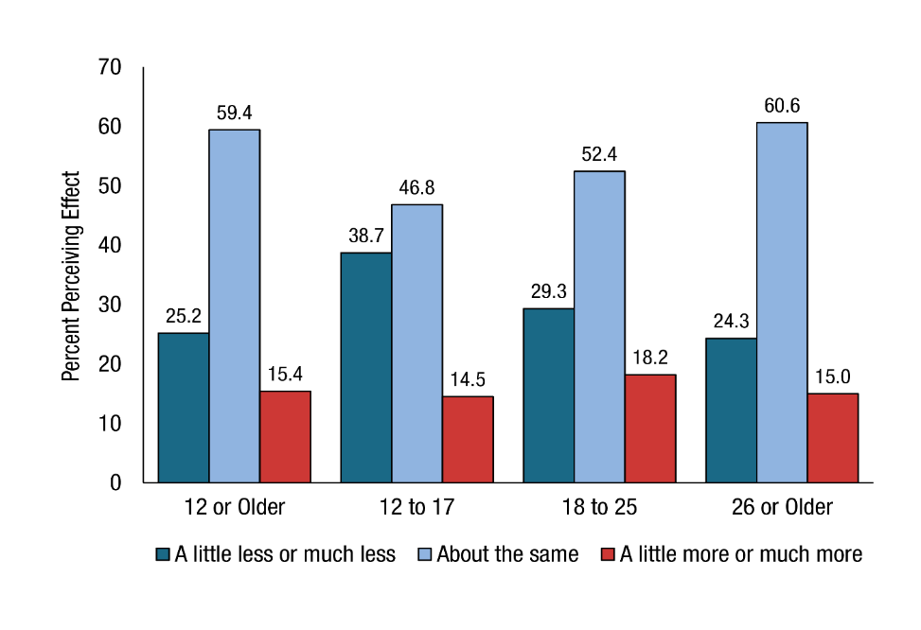
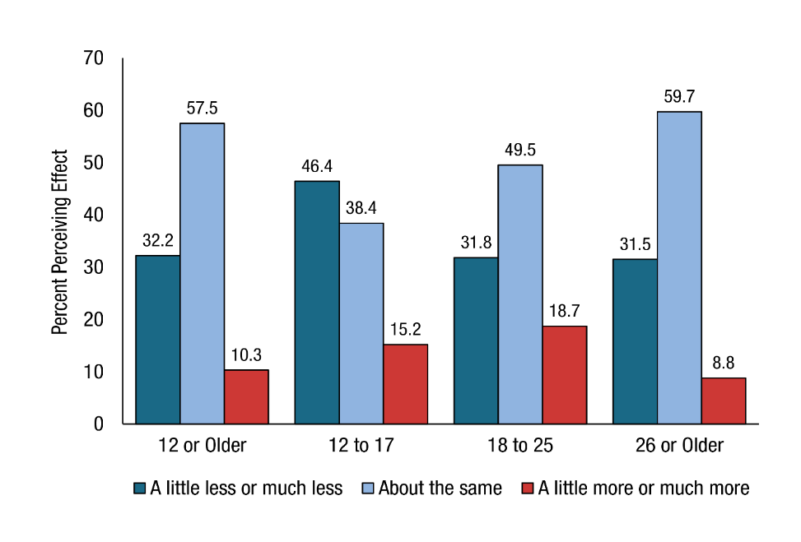
NSDUH 2020: Perceived COVID-19 Pandemic Effect
On Alcohol Use
On Substance Use (other than alcohol)
Notes:
Source: NSDUH 2020, https://www.samhsa.gov/data/release/2020-national-survey-drug-use-and-health-nsduh-releases

Slide 28
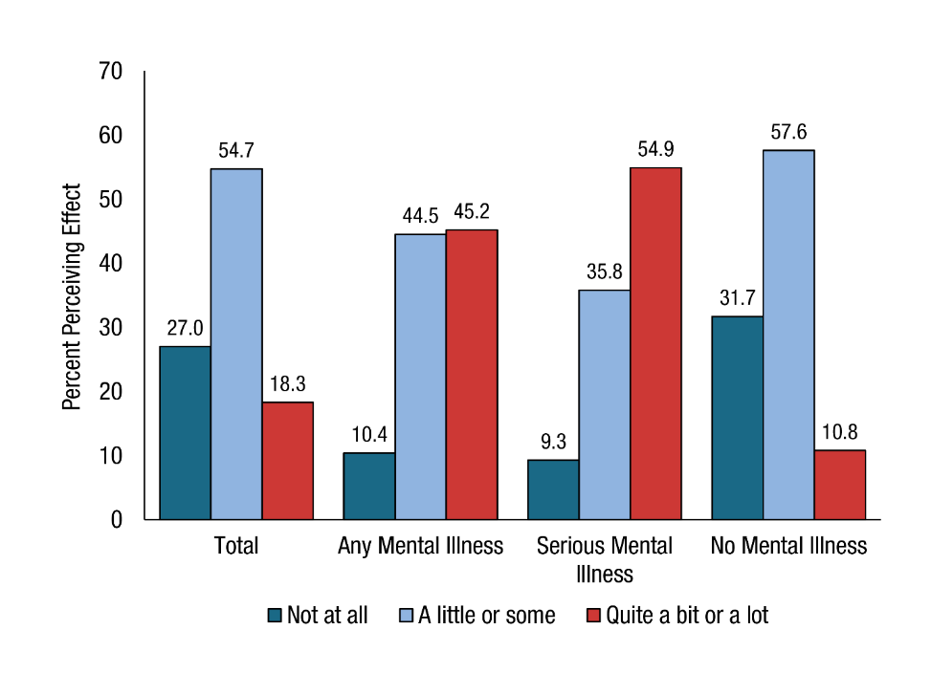
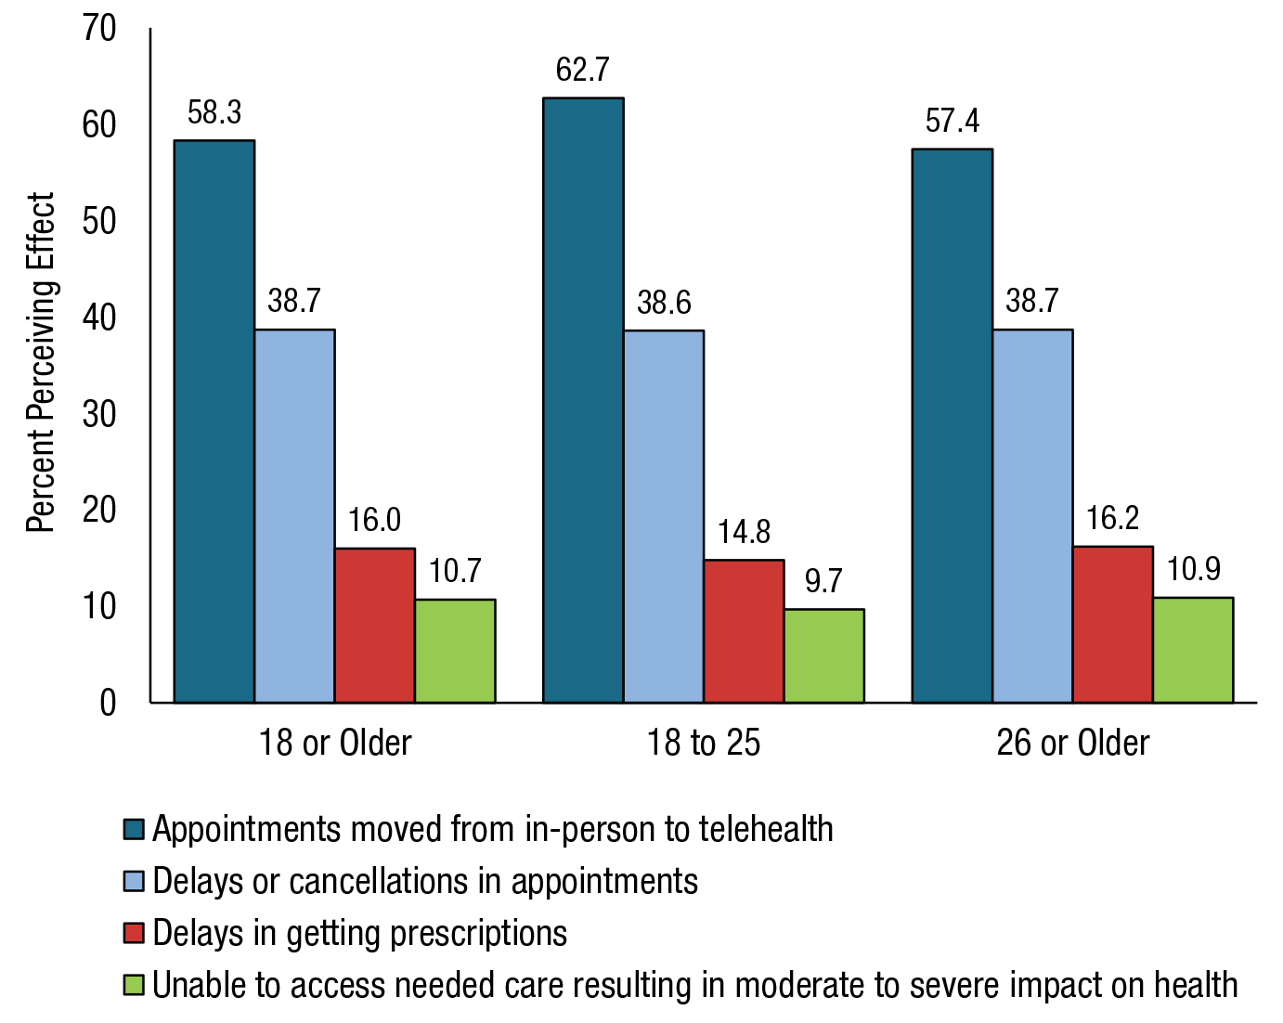
NSDUH 2020: Perceived COVID-19 Pandemic Effect
Negative Effect on Emotional or Mental Health, Among Adults 18 or Older, by Past Year MI Status, 4th Quarter 2020
Negative Effect on Mental Health Services, Among Adults 18 or Older, Who Received Services, 4th Quarter 2020
Notes:
Source: NSDUH 2020, https://www.samhsa.gov/data/release/2020-national-survey-drug-use-and-health-nsduh-releases

Slide 29
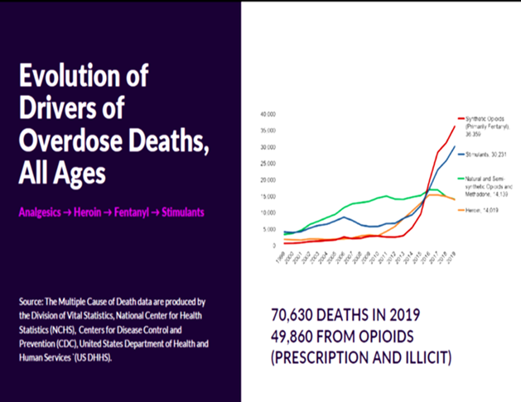
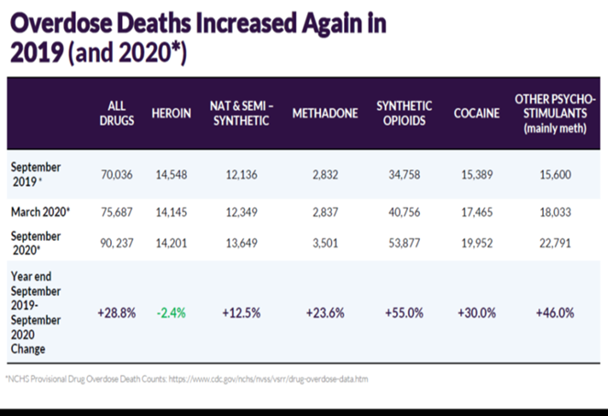
Fentanyl Related Overdose Deaths in the US
Overdose Deaths Pre-COVID-19
Overdose Deaths During COVID-19
Notes:
Source: slides from Dr. Volkow at Virtual ASAM 4/2021

Slide 30
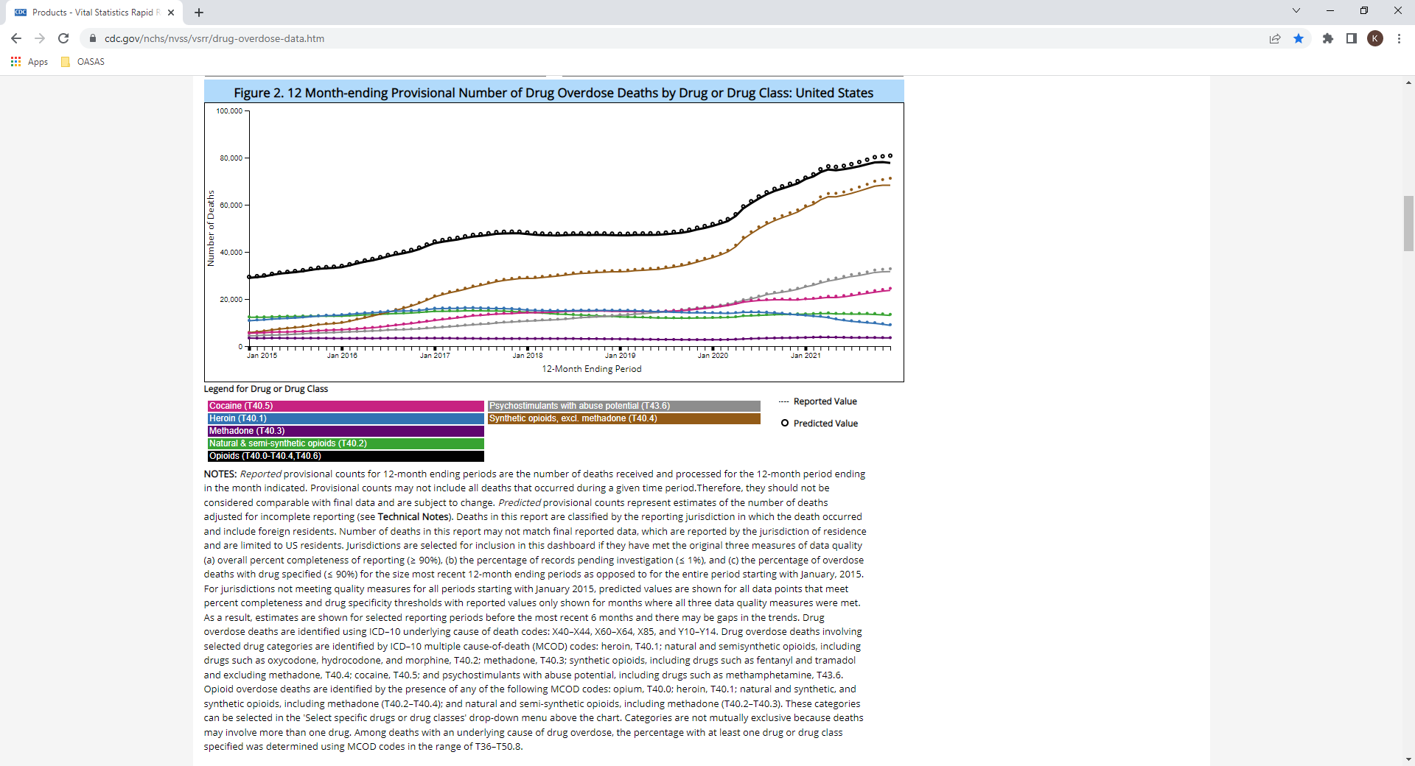
CDC Provisional Drug Overdose Death Counts 2021
Overdose by Substance Through December 2021
Total Estimated Overdose Deaths Through December 2021
Annual drug overdose deaths have reached another record high in the United States, as deaths from fentanyl and its analogues surge to unprecedented levels.
An estimated 107,622 people died of a drug overdose in the 12-month period ending December 2021, according to provisional data published 5/11/2022 by the US Centers for Disease Control and Prevention's National Center for Health Statistics.
An overall 15% increase in deaths compared with 2020. About two-thirds of those deaths involved synthetic opioids such as fentanyl and its analogues. There were significant deaths due to methamphetamine use as well.
Notes:
Source: https://www.cdc.gov/nchs/nvss/vsrr/drug-overdose-data.htm and https://www.whitehouse.gov/ondcp/briefing-room/2022/05/11/statement-from-dr-rahul-gupta-on-todays-cdc-overdose-death-data-4/

Slide 31
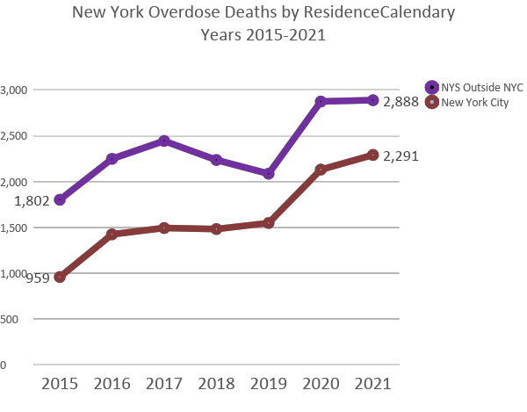
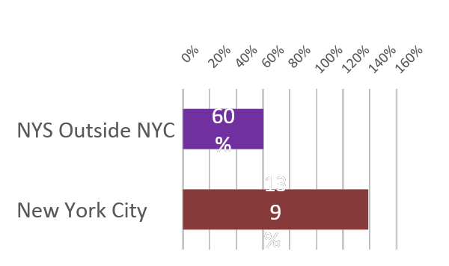
New York State Overdose Death Data
Notes:
Source: https://www.cdc.gov/nchs/nvss/vsrr/drug-overdose-data.htm and thanks to Andrew Heck, OASAS, for his analysis of the data

Slide 32
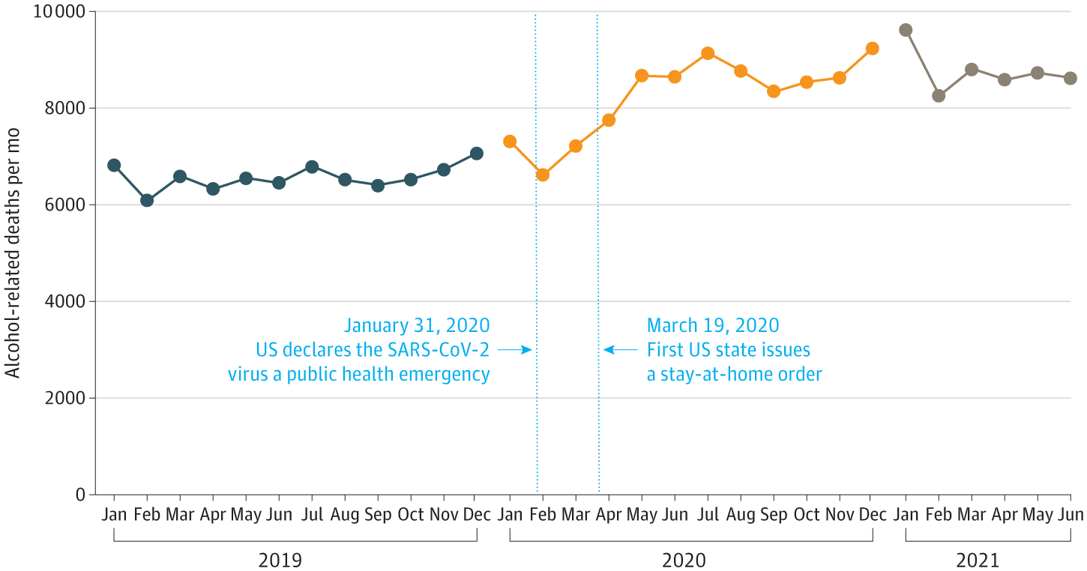
Alcohol-Related Deaths During the COVID-19 Pandemic
The number of deaths involving alcohol increased between 2019 and 2020, from 78,927 to 99,017 [relative change, 25.5%], as did the age-adjusted rate, from 27.3 to 34.4 per 100 000 [relative change, 25.9%].
The number of deaths with an underlying cause of alcohol-associated liver diseases increased from 24,106 to 29,504 (22.4%) and the number of deaths with an underlying cause of alcohol-related mental health and behavioral disorders increased from 11,261 to 15,211 (35.1%). Opioid overdose deaths involving alcohol as a contributing cause increased from 8,503 to 11,969 (40.8%). Deaths in which alcohol contributed to overdoses specifically on synthetic opioids other than methadone (e.g., fentanyl and fentanyl analogues) increased from 6,302 to 10,032 (59.2%).
Alcohol-related deaths accounted for 2.8% of all deaths in 2019 and 3.0% in 2020.
Figure. Monthly Alcohol-Related Deaths Among People 16 Years and Older
Notes:
Source: https://cdn.jamanetwork.com/ama/content_public/journal/jama/0/jld220016f1_1647557636.3336.png?Expires=1650673226&Signature=dQn4aXAer~N~yh3GrfXvf9hy0pg-Eej9qf4CJFKZiH1xXAbundrcvC8rMB1zsQMvBev5bPkUeMihjOeMl6C69H0PJPOjkPpYzFiTYv7Y3bPfcGqbpPikEG89UCQW1Bp1pa9vFfQUSFHgMmpJEEpwEWrtwLnAaTLmKW7d8xgkd594HT5DACvxkAaiyINE3algCw1P9Ui1gjV74ukl8Sqgc1AOUQxlTHQ8YzF-M7y5RyouilaWFkh5Wwl5fcOi5Ue0hvwhJy9AxEisu4sqPJSJ8w-iVOClyCnPVPIzutugwgwVA-ZEQUNfbC-cFQP-qGJC07FgP4Aki337Ot9afdUFzA__&Key-Pair-Id=APKAIE5G5CRDK6RD3PGA and Alcohol-Related Deaths During the COVID-19 Pandemic
Aaron M. White, PhD¹; I-Jen P. Castle, PhD¹; Patricia A. Powell, PhD¹; et alRalph W. Hingson, ScD¹; George F. Koob, PhD¹
Author Affiliations Article Information
JAMA. Published online March 18, 2022. doi:10.1001/jama.2022.4308

Slide 33
Mental Health Impacts of the COVID-19 Pandemic
Research highlights increases in anxiety, depression, and traumatic stress, as well as stress and loneliness, in the US
Overall Mental Health: The APA’s annual survey on stress and mental health, conducted in August 2020, included 3,409 adults and 1,026 teens. 19% of adults described their mental health as worse in 2020, compared with 2019.
Stress: 78% of adult respondents reported the COVID-19 pandemic as a significant source of stress in their lives, 67% of adults reported increased stress during the pandemic, 49% of adults reported negative effects of increased stress (increased bodily tension 21%, being very quick to anger 20%, unexpected mood swings 20%, screaming or yelling at a loved one 19%)
Anxiety: Studies have found more individuals meeting criteria for generalized anxiety disorder (GAD) during the COVID-19 pandemic; in a survey of adults in June 2020, 26% of respondents were symptomatic for GAD (3x the % of persons in 2019); in the UK, 24.3% of adults surveyed met criteria for GAD, compared with 5% in 2019.
Depression: In June 2020, researchers found that 24.3% of adult respondents were symptomatic for depression (4x the % of persons in 2019); in another study in March-April 2020, prevalence of symptoms of depression increased in every severity category, and more than tripled in the study population, from before to during the pandemic
Notes:
Source: https://www.samhsa.gov/sites/default/files/dtac/mental-health-substance-use-effects-covid-pandemic-srb.pdf

Slide 34
Disparate Impacts of the COVID-19 Pandemic on Special Populations
Increased vulnerability for mental health symptoms, substance use, and suicidality in:
  Youth (especially 18-24 years old): increased anxiety (45.4%), anxiety and depression (62.9%), pandemic-related trauma (PTSD) (31.8%), serious psychological distress (24%), loneliness (63%), substance use (24.7%), serious consideration of suicide (24.7%)
  Women: more likely to be exposed to stressors and to appraise events as more stressful, increased alcohol consumption; pregnant and parenting persons: increased anxiety (36.3%) and depression (43.4%)
  Healthcare workers: increased job-related anxiety (increase from 1%->27%), increased GAD (15.8%), depression (14%), and PTSD (23.1%)
  Racial/ethnic minoritized communities: disproportionate COVID-19 deaths, substance use, serious consideration of suicide, depression, anxiety, serious psychological distress, and PTSD compared with their non-BIPOC counterparts
Increased vulnerability for mental health symptoms, substance use, and suicidality in:
  Individuals with lower incomes and less money in savings: increased serious psychological distress (those with a household income of < $35,000/year and < $5000 in savings)
  Individuals who are homeless: (18-25 yo): increased anxiety (44%), hopelessness (48%), loneliness (38%), depression (36%), sleep problems (34%); pregnant persons/IPV (intimate partner violence) survivors: IPV as a risk factor for depression, PTSD, and suicidality and childhood sexual abuse, sex and human trafficking, and sexual assault are often precursors for women and pregnant persons who are homeless
  Older adults: increased serious psychological stress (though reported less frequently than in younger adults), negative health impacts, feeling very lonely, and a negative impact on relationships
Notes:
Source: https://www.samhsa.gov/sites/default/files/dtac/mental-health-substance-use-effects-covid-pandemic-srb.pdf

Slide 35
Substance Use-Related Impacts of the COVID-19 Pandemic
Increases in Substance Use: On a survey in June 2020, 13% of adult respondents reported they had begun, or increased substance use to cope with stress or emotions due to COVID-19. Research has found increases specifically in alcohol use (documented in separate slides).
Changes in Substance Use Disorder Treatment: Rapid transition to telehealth (audio/video and audio only) in March 2020; loosening of federal and state regulations to allow for expanded use of telehealth during the PHE; benefits and drawbacks of telehealth noted by providers and patients
Notes:
Source: https://www.samhsa.gov/sites/default/files/dtac/mental-health-substance-use-effects-covid-pandemic-srb.pdf

Slide 36
The Impact of COVID-19 on Physician Burnout Globally: A Review
Background: The current pandemic, COVID-19, has added to the already high levels of stress that medical professionals face globally. While most health professionals have had to shoulder the burden, physicians are not often recognized as being vulnerable and hence little attention is paid to morbidity and mortality within this group.
Objective: To analyse and summarise the current knowledge on factors/potential factors contributing to burnout amongst healthcare professionals amidst the pandemic. This review also makes a few recommendations on how best to prepare intervention programmes for physicians.
Methods: In August 2020, a systematic review was performed using the database Medline and Embase (OVID) to search for relevant papers on the impact of COVID-19 on physician burnout–the database was searched for terms such as “COVID-19 OR pandemic” AND “burnout” AND “healthcare professional OR physician”. A manual search was done for other relevant studies included in this review.
Results: Five primary studies met the inclusion criteria. A further nine studies were included which evaluated the impact of occupational factors (n = 2), gender differences (n = 4) and increased workload/sleep deprivation (n = 3) on burnout prior to the pandemic. Additionally, five reviews were analysed to support our recommendations. Results from the studies generally showed that the introduction of COVID-19 has heightened existing challenges that physicians face such as increasing workload, which is directly correlated with increased burnout. However, exposure to COVID-19 does not necessarily correlate with increased burnout and is an area for more research.
Conclusions: There is some evidence showing that techniques such as mindfulness may help relieve burnout. However, given the small number of studies focusing on physician burnout amidst a pandemic, conclusions should be taken with caution. More studies are needed to support these findings.
Notes:
Source: Healthcare 2020, 8, 421; doi:10.3390/healthcare8040421

Slide 37
The changing face of medical professionalism and the impact of COVID-19
Morale among doctors is generally declining—eg, a survey in the UK showed 54% of physicians reported morale as low or very low —and burnout is rising (prevalence about 66–80%). There is a crisis in staff retention in some countries with up to 48% doctors considering leaving the profession.
The COVID-19 pandemic has changed how health professionals work, how we behave and interact within our teams and organisations, our understandings of personal health and risk, inequalities between doctors with different risk factors, and wellbeing and mental health. Globally more than 300000 health-care workers have been infected with COVID-19 in 79 countries, over 7000 have died, and many more have suffered as a result of stress, burnout, and moral injury.
Andrew F Goddard, MD and Mumtaz Patel, MD
London, February 2021
Notes:
Source: Goddard and Patel, The Lancet, Volume 397, March 13, 2021 (Published Online February 23, 2021 https://doi.org/10.1016/S0140-6736(21)00436-0)

Slide 38
The Impact of Physicians’ COVID-19 Pandemic Occupational Experiences on Mental Health
Objective: To examine the association between a number of negative COVID-19 occupational experiences and probable anxiety, depression, and PTSD among physicians.
Methods: Cross-sectional examination of longitudinal registry data consisting of physician personal and occupational well-being. Multivariable logistic regressions were performed to determine the association between negative COVID-19 experiences and outcomes.
Results: Of the 620 eligible physicians, approximately half were female (49%), and 71% white with a mean age of 46.51 (SD 13.28). A one-point increase in negative experience score was associated with a 23% increase in probable anxiety (OR 1.23, 95% CI: 1.14–1.34), a 23% increase in probable depression (OR 1.23, 95% CI: 1.13–1.33), and a 41% increase in probable PTSD (OR 1.41, 95% CI: 1.30–1.52).
Conclusions: Negative pandemic experiences were strongly associated with adverse mental health outcomes while greater resilience was protective.
Notes:
Source: Schwartz, RM, et al. JOEM Volume 64, Number 2, February 2022

Slide 39
COVID-19 crisis impact on the next generation of physicians: a survey of 800 medical students
Background: Many initiatives have emerged worldwide to handle the surge of hospitalizations during the SARS-CoV-2 pandemic. In France, the University of Paris North called on its medical students, whose status makes them integral members of the healthcare staff, to volunteer in their capacity of medical students and/or as nurses/nursing aids in understaffed intensive care units and other Covid-19 services. We attempted to evaluate their commitment, whether the pandemic affected their certainty for the medical profession and career choices, and how they scored their sadness and anxiety levels.
Methods: The University of Paris North took a weekly official census of the involvement of 1205 4th–6th year medical students during the first lockdown in France. Six weeks after the lockdown began (May 4th), an e-questionnaire was sent to 2145 2nd-6th year medical students. The survey lasted 4 weeks and documented volunteering by medical students, the association between the pandemic and certainty for their profession, their choice of medical specialty and factors that influenced sadness and anxiety scores.
Results: 82% of 4th–6th year medical students volunteered to continue their internship or be reassigned to COVID-19 units. Of 802 2nd-6th year students who completed the e-questionnaire, 742 (93%) volunteered in Covid-19 units, of which half acted as nurses. This engagement reinforced the commitment of 92% of volunteers to become physicians. However, at the peak of the outbreak, 17% had doubts about their ability to be physicians, while 12% reconsidered their choice of future specialty. Finally, 38% of students reported a score of 7/10 or more on the sadness scale, and 43% a score of 7/10 or more for anxiety. Neither study year nor service influenced sadness or anxiety scores. However, gender influenced both, with women scoring significantly higher than men (p < 0.0001).
Conclusion: Medical students of the University of Paris North who made an early and unconditional commitment to help hospital staff handle the pandemic constituted a powerful healthcare reserve force during the crisis. Although the vast majority remained convinced that they want to become physicians, this experience came at a significant psychological cost, especially for women. Alleviating this cost would improve future crisis responses.
Notes:
Source: Passemard et al. BMC Medical Education (2021) 21:529 https://doi.org/10.1186/s12909-021-02955-7

Slide 40
The prevalence of sleep disturbances among physicians and nurses facing the
COVID-19 patients: a systematic review and meta-analysis
Background: In all epidemics, healthcare staff are at the centre of risks and damages caused by pathogens. Today, nurses and physicians are faced with unprecedented work pressures in the face of the COVID-19 pandemic, resulting in several psychological disorders such as stress, anxiety and sleep disturbances. The aim of this study is to investigate the prevalence of sleep disturbances in hospital nurses and physicians facing the COVID-19 patients.
Method: A systematic review and metanalysis was conducted in accordance with the PRISMA criteria. The PubMed, Scopus, Science direct, Web of science, CINHAL, Medline, and Google Scholar databases were searched with no lower time-limit and until 24 June 2020. The heterogeneity of the studies was measured using I2 test and the publication bias was assessed by the Egger’s test at the significance level of 0.05.
Results: The I2 test was used to evaluate the heterogeneity of the selected studies, based on the results of I2 test, the prevalence of sleep disturbances in nurses and physicians is I2: 97.4% and I2: 97.3% respectively. After following the systematic review processes, 7 cross-sectional studies were selected for meta-analysis. Six studies with the sample size of 3745 nurses were examined in and the prevalence of sleep disturbances was approximated to be 34.8% (95% CI: 24.8-46.4%). The prevalence of sleep disturbances in physicians was also measured in 5 studies with the sample size of 2123 physicians. According to the results, the prevalence of sleep disturbances in physicians caring for the COVID-19 patients was reported to be 41.6% (95% CI: 27.7-57%).
Conclusion: Healthcare workers, as the front line of the fight against COVID-19, are more vulnerable to the harmful effects of this disease than other groups in society. Increasing workplace stress increases sleep disturbances in the medical staff, especially nurses and physicians. In other words, increased stress due to the exposure to COVID-19 increases the prevalence of sleep disturbances in nurses and physicians. Therefore, it is important for health policymakers to provide solutions and interventions to reduce the workplace stress and pressures on medical staff.
Notes:
Source: Salari et al. BMC, Globalization and Health (2020) 16:92 https://doi.org/10.1186/s12992-020-00620-0

Slide 41
Impact of the COVID-19 Pandemic on Physicians
Depression, anxiety, stress levels of physicians and associated factors in COVID-19 pandemics
Insomnia and stress of physicians during COVID-19 outbreak
Aim: To investigate anxiety, stress, and depression levels of physicians during the COVID-19 outbreak and explored associated factors in both clinical and general site.
Methods: An online survey is conducted to assess psychological responses of healthcare workers and related factors during the COVID-19 outbreak. It is consisted of three subsections covering the following areas:
1) sociodemographic data 2) information on individuals` working conditions 3) Depression Anxiety and Stress Scale-21 (DAS-21).
Results: Of all 442 participants, 286 (64.7%) had symptoms of depression, 224 (51.6%) anxiety, and 182 (41.2%) stress. Being female, young, and single, having less work experience, and working in frontline settings were associated with higher scores, whereas having a child was associated with lower scores in each subscale. Factors found to be associated with higher DAS-21 total scores in frontline workers were as follows: increased weekly working hours, increased number of COVID-19 patients cared for, lower level of support from peers and supervisors, lower logistic support, and lower feelings of competence during COVID-19 related tasks.
Conclusions: Our findings highlight the factors which need to be taken into consideration to protect the mental wellbeing of physicians while fighting with a disaster that has major impacts on society worldwide.
Background: Healthcare workers are at high risk of developing sleep disorders during an outbreak.
This study aimed to measure severity of sleep difficulty and its correlation with duration of deal with
suspected/confirmed cases of novel coronavirus (COVID-19) in physicians.
Methods: In this cross-sectional study, 268 physicians from different medical settings were included
during the COVID-19 outbreak.
Results: The mean age and experience of physicians were 35.06 (33-70 years) and 10.13 years. The
median duration of dealing with suspected/confirmed cases of COVID-19 was 1.0 (0-30 days). The mean
sleep score and stress of physicians were 8.43 of 24.0 and 4.20 of 10, respectively. More than two-thirds
of the physicians were sleepless (68.3%) and majority had stress (93.7%). The study did not find a sig-
nificant difference in sleep score of physicians with different specialties (P 1⁄4 0.059). However, most
physicians were sleepless; including anesthesia and intensive care (77.8%); general physicians (80.8%),
and obstetrics and gynecology (80.0%). They were sleepless in morning (58.7%); evening (77.8%); night
(100%); and multi-shift (70.9%). The physicians who dealt with suspected or confirmed cases of COVID-19 or with stress had more escalated sleep compared to those who did not deal with patients or without stress (9.39 vs. 7.17 and 8.78 vs. 2.69 P < 0.001). The sleep of physicians was escalated with increasing stress (r 1⁄4 0.558; P < 0.001) and a number of days that physicians dealt with suspected/confirmed cases of COVID-19 (r 1⁄4 0.210; P 1⁄4 0.001), respectively.
Conclusion: The study confirmed that working with COVID-19 patients has a negative effect on the sleep of physicians.
Notes:
Source: https://doi.org/10.1016/j.psychres.2020.113130 (Turkey, May 2020) and https://doi.org/10.1016/j.sleepx.2020.100017 (Iraq, 2020)

Slide 42
Impact of the COVID-19 Pandemic on Physicians
Physician Burnout
Physicians’ Practices and Their Patients
8% of physicians said their practices closed as a result of COVID-19—approximately 16,000 practices.
4% plan to close their practices in the next 12 months.
43% of physicians reduced staff due to COVID-19.
72% of physicians experienced a reduction in income due to COVID-19.
12% of physicians – approximately 100,000 – switched to a primarily telemedicine practice as a result of COVID-19.
52% of physicians plan to increase use of telemedicine in their practices.
72% of physicians indicated that COVID-19 will have serious consequences for patient health in their communities because many patients delayed getting care they needed during the pandemic.
58% of physicians often have feelings of burnout, compared to 40 percent in 2018
22% of physicians know a physician who has committed suicide.
13% have sought medical attention for a mental health problem caused COVID-19’s effects on their practice or employment situation.
37% of physicians would like to retire in the next year.
Notes:
Source: https://physiciansfoundation.org/physician-leadership/physician-and-patient-surveys/ (2020 and 2021)

Slide 43
Impact of the COVID-19 Pandemic on Physicians: Burnout and Posttraumatic Stress Disorder in the Coronavirus Disease 2019 (COVID-19) Pandemic: Intersection, Impact, and Interventions
Notes:
Source: https://doi.org/10.1016/j.jacr.2020.05.021 (July 2020)

Slide 44
What Physicians Should Know
To Take Care of Themselves

Slide 45
If you think you may have an issue with alcohol or other substances, ask yourself, am I…
❑ Spending less time on activities that were once important
❑ Using more alcohol or other substances than intended
❑ Having strong desire to drink or use substances
❑ Unsuccessfully attempting to stop using alcohol or other substances
❑ Experiencing problems that are caused or worsened by alcohol or other substances
❑ Continuing to drink or use other substances despite experiencing problems
❑ Experiencing a change in tolerance
❑ Using substances in dangerous situations (such as while driving a vehicle)
❑ Failing to fulfill obligations at home, work, or school
❑ Experiencing withdrawal symptoms when substance use is cut down or stopped
❑ Spending a great deal of time getting, using, or recovering from the effects of substances
Section Title – Arial Bold
Notes:
Source: WELL Toolkit (2020), https://gmewellness.upmc.com/

Slide 46
What Physicians Should Know
To Take Care of Their Peers

Slide 47
Physicians and Substance Use: Physicians as Patients
“The onus cannot fall only on impaired physicians to heal themselves—physician colleagues and supervisors need to reach out to them.”
WELL Toolkit (2020), https://gmewellness.upmc.com/
Notes:
Source: Samet JH, Liebschutz J. Beyond “Heal Thyself”: Physicians as Patients—An Uneasy Role. Ann Intern Med. 2019;170:893–894. WELL Toolkit (2020), https://gmewellness.upmc.com/

Slide 48
Case Scenario Commentary
Physicians are not impervious to SUDs. Studies have suggested that the prevalence of SUDs among physicians is 10% to 15%, similar to the general population.
Alcohol use disorder is the most common type of SUD in physicians, and a national survey of U.S. physicians for all specialties found that female physicians reported alcohol use disorder at a higher rate than male physicians.
In addition, some medical specialists, such as anesthesiologists, may experience higher rates of a nonalcohol SUD because of occupational exposure and access to medications in the workplace. There are limited published data on this topic, and reporting bias is likely because of the sensitivity around an SUD diagnosis for practicing physicians; therefore, the true prevalence of SUD among physicians is unknown.
Physicians experience several risk factors for the development of SUDs, including high levels of work-related stress; exposure to illness, trauma, and death; and untreated depression or other mental illness.
With evidence-based treatment and peer and professional support, physicians who have an SUD can recover their health and continue meaningful careers in medicine.
Notes:
Source: https://www.aafp.org/pubs/afp/issues/2021/0301/p302.html#afp20210301p302-b3 (Am Fam Physician. 2021;103(5):302-304)
Baldisseri MR. Impaired healthcare professional. Crit Care Med. 2007;35(2 suppl):S106-S116.
Oreskovich MR, Shanafelt T, Dyrbye LN, et al.; The prevalence of substance use disorders in American physicians. Am J Addict. 2015;24(1):30-38.
Booth JV, Grossman D, Moore J, et al.; Substance abuse among physicians: a survey of academic anesthesiology programs. Anesth Analg. 2002;95(4):1024-1030.
Merlo LJ, Trejo-Lopez J, Conwell T, et al.; Patterns of substance use initiation among healthcare professionals in recovery. Am J Addict. 2013;22(6):605-612.

Slide 49
SUD Among Physicians: Identification and Engagement
Recognition
  Colleagues play a primary role in identification of physicians with an active SUD. Reports to physician health programs (PHP) come from many sources, including patients, families, hospital staff, coworkers, peers, and the legal system.
  Colleagues who suspect that a physician is misusing substances should not attempt to establish or confirm a diagnosis, which should be left to a professional evaluator. It is important to note and document the behaviors and events that indicate possible substance misuse.
Responsibilities of colleagues
  Reporting a colleague or friend with a suspected SUD to a PHP or medical board can be difficult. Research suggests that many physicians are reluctant to report a colleague, even one they suspect is impaired or incompetent.. One may wish to avoid confrontation or may fear that he or she is harming the physician's career and reputation.
  This “conspiracy of silence” has the potential to cause harm by allowing a physician to continue practicing while impaired. Physicians share a duty to patients, their affected colleague or friend, and their profession to address promptly substance misuse in a fellow physician. Specific potential ramifications of not intervening include:
    Putting the physician’s patients at risk of harm
    Subjecting themselves to potential professional or legal sanctions
    Denying the physician an opportunity for treatment
    The long-term impact of the SUD on the physician’s family and career
Section Title – Arial Bold
Notes:
Source: https://www.uptodate.com/contents/substance-use-disorders-in-physicians-epidemiology-clinical-manifestations-identification-and-engagement#H1
Farber NJ, Gilibert SG, Aboff BM, et al. Physicians' willingness to report impaired colleagues. Soc Sci Med 2005; 61:1772.
DesRoches CM, Rao SR, Fromson JA, et al. Physicians' perceptions, preparedness for reporting, and experiences related to impaired and incompetent colleagues. JAMA 2010; 304:187.
Berge KH, Seppala MD, Schipper AM. Chemical dependency and the physician. Mayo Clin Proc 2009; 84:625.

Slide 50
Understanding Reporting Requirements in NYS
Who Files Complaints? ( https://www.health.ny.gov/publications/1445/ and https://www.health.ny.gov/professionals/doctors/conduct/laws.htm)
  All licensed health professionals, including physicians, physician assistants, and specialist assistants, are required by state law to report colleagues whom they suspect may be guilty of misconduct. Failure to report suspected instances of misconduct is, in itself, misconduct. If you believe a colleague's actions may constitute misconduct, contact OPMC.
  Practitioners suspected of having problems with alcohol, substances, or mental health, but whose ability to practice is not impaired, may be reported to the Committee on Physicians' Health (CHP) of the Medical Society of the State of New York (MSSNY). All calls are confidential. CHP dentifies, refers to treatment, and monitors impaired physicians. The program is voluntary and participation is confidential. The names of physicians participating in the program are not shared with OPMC without a participant's approval unless there is a failure to comply with treatment recommendations. If you believe, however, that a colleague's medical performance may be impaired, you must contact OPMC. The law does not exempt physicians from their duty to report colleagues practicing with a suspected impairment to OPMC because they have reported to CHP. However, this requirement does not apply if compliance would violate a physician-patient relationship.
What Does the Law Say in NYS? (http://www.op.nysed.gov/prof/med/article131-a.htm)
  Article 131-A, Definitions of Professional Misconduct Applicable to Physicians, Physician's Assistants and Specialist's Assistants
    §6530. Definitions of professional misconduct. | §6531. Additional definition of professional misconduct, limited application. | §6532. Enforcement, administration and interpretation of this article.
    “Practicing the profession while impaired by alcohol, drugs, physical disability, or mental disability;”
    “Being a habitual abuser of alcohol, or being dependent on or a habitual user of narcotics, barbiturates, amphetamines, hallucinogens, or other drugs having similar effects, except for a licensee who is maintained on an approved therapeutic regimen which does not impair the ability to practice, or having a psychiatric condition which impairs the licensee's ability to practice;”
Section Title – Arial Bold
Notes:
Source: https://www.health.ny.gov/publications/1445/
https://www.health.ny.gov/professionals/doctors/conduct/laws.htm
http://www.op.nysed.gov/prof/med/article131-a.htm

Slide 51
SUD Among Physicians: Reporting Potentially Impaired Physicians in NYS
Committee for Physician Health (CHP) (https://www.mssny.org/MSSNY/CPH/Referrals/MSSNY/Physician_Advocacy/CPH-Physician_Health/Referrals.aspx?hkey=393fe21c-cfa6-4e75-9b9e-19cc94ad92a7)
  Referral Process:
    Anyone can make a referral to CPH. Most referrals (75%) come from colleagues or physicians seeking help for themselves, nurses, other healthcare professionals, workers, friends, and family members concerned enough to help also initiate referrals.
    If you call CPH about a colleague, your phone call will be held in the strictest confidence. The identity of a referral source is never revealed unless the caller agrees. Once a referral is made, program staff members gather information to better define the extent of the disease. The CPH Medical Director and/or local physicians may meet with the referred physician to candidly discuss reports of unusual behavior and determine if a problems exits. Denial is a significant part of the disease and often the initial response. However, when approached by concerned and caring colleagues, most physicians will candidly admit a need for help and will agree to participate in the program.
  Confidentiality:
    The confidentiality of the CPH program participants, referral sources, and CPH records are protected by New York State and Federal laws. Anyone who makes a referral or volunteers to work with CPH participants shall not be liable for actions taken in good faith and without malice.
    CPH does not refer physicians to the New York State Department of Health's Office of Professional Medical Conduct as long as the physician agrees to participate, stays with the program, is helped by treatment, and does not present an imminent danger to the public.
NYS DOH Office of Professional Medical Conduct (OPMC) (https://www.health.ny.gov/professionals/doctors/conduct/file_a_complaint.htm)
  If you wish to file a complaint, please review How to Choose the Right Physician - How to Tell Us if You Don't before printing and filling out a complaint form.
  The OPMC reviews all complaints of professional medical misconduct against licensed physicians, physician assistants, and specialist assistants, including complaints of sexual harassment and assault.
Section Title – Arial Bold
Notes:
Source: https://www.mssny.org/MSSNY/CPH/Referrals/MSSNY/Physician_Advocacy/CPH-Physician_Health/Referrals.aspx?hkey=393fe21c-cfa6-4e75-9b9e-19cc94ad92a7
https://www.health.ny.gov/professionals/doctors/conduct/file_a_complaint.htm

Slide 52
Barriers to seeking help for physicians with substance use disorder: A review
Background: Substance use disorders (SUD) might concern as many as 8–15% of physicians. Previous studies suggest that self-diagnosis and self-medication are common practices among physicians. The aim of this review was to identify if barriers to seeking help and medical care for impaired physicians exist. We also aimed at characterizing the nature of these barriers.
Methods: The review included scientific papers published on the MEDLINE and PsychINFO databases between January 2000 and September 2018. The inclusion criteria were: (i) articles that focused on SUD in physicians. The exclusion criteria were: (i) no mention of SUD; (ii) no mention of barriers to seeking help; (iii) articles focused on burn-out and work-related stress; (iv) articles focused on risk factors or treatments for SUD; (v) articles focused on psychiatric comorbidities and (vi) those focused on other professionals.
Results: Potential barriers to seeking help that were identified for impaired physicians with SUD included denial of the disease and of loss of performance, fear of stigma, psychiatric comorbidities, fear of familial/social/professional and economic consequences and a lack of knowledge.
Conclusions: Different barriers to seeking help could be identified. Priority should be given to educating medical students to ameliorate this. Increased awareness should reduce the stigma, which, even nowadays, still prevents some physicians from seeking help.
Section Title – Arial Bold
Notes:
Source: https://doi.org/10.1016/j.drugalcdep.2019.04.004 (April 2019)

Slide 53
SUD Among Physicians: Evaluating the Efficacy of PHPs (Physician Health Programs)
Five year outcomes in a cohort study of physicians treated for substance use disorders in the United States
Objective: To evaluate the effectiveness of US state physician health programmes in treating physicians with
substance use disorders.
Design: Five year, longitudinal, cohort study.
Setting: Purposive sample of 16 state physician health programmes in the United States.
Participants: 904 physicians consecutively admitted to one of the 16 programmes from September 1995 to September 2001.
Main outcome measures: Completion of the programme, continued alcohol and drug misuse (regular urine tests),
and occupational status at five years.
Results: 155 of 802 physicians (19.3%) with known outcomes failed the programme, usually early during treatment. Of the 647 (80.7%) who completed treatment and resumed practice under supervision and monitoring, alcohol or drug misuse was detected by urine testing in 126 (19%) over five years; 33 (26%) of these had a repeat positive test result. At five-year follow-up, 631 (78.7%) physicians were licensed and working, 87 (10.8%) had their licences revoked, 28 (3.5%) had retired, 30 (3.7%) had died, and 26 (3.2%) had unknown status.
Conclusion: About three quarters of US physicians with substance use disorders managed in this subset of physician health programmes had favourable outcomes at five years. Such programmes seem to provide an appropriate combination of treatment, support, and sanctions to manage addiction among physicians effectively.
Section Title – Arial Bold
Notes:
Source: J Subst Abuse Treat. 2009 Mar;36(2):159-71. doi: 10.1016/j.jsat.2008.01.004 (https://pubmed.ncbi.nlm.nih.gov/19161896/)
Cite this as: BMJ 2008;337:a2038 doi:10.1136/bmj.a2038 (August 2008)

Slide 54
What Physicians Can Do
For Their Practice or Organization

Slide 55
Physicians and Substance Use: “The Sick Physician”
The misuse of drugs and alcohol by physicians is compounded by their critical role as caregivers. Historically, ‘addicted’ physicians either went unnoticed or were treated punitively. In 1973, the American Medical Association
recommended, in a landmark report entitled "The Sick Physician," that state medical societies establish programs to identify and treat impaired physicians. Since that time, every state has established a program or committee for that
purpose.
Stephen Ross, MD
Notes:
Source: Virtual Mentor. December 2003, Volume 5, Number 12. doi: 10.1001/virtualmentor.2003.5.12.cprl1-0312
The Sick Physician: Impairment by Psychiatric Disorders, Including Alcoholism and Drug Dependence. JAMA. 1973;223(6):684–687. doi:10.1001/jama.1973.03220060058020

Slide 56
ACP Position Paper: Physician Impairment and Rehabilitation: Reintegration Into Medical Practice While Ensuring Patient Safety
  POSITIONS:
    The professional duties of competence and self-regulation require physicians to recognize and address physician illness and impairment.
    The distinction between functional impairment and potentially impairing illness should guide identification of and assistance for the impaired physician.
    Best practices for physician health programs (PHPs) should be developed systematically, informed by available evidence and further research.
    PHPs should meet the goals of physician rehabilitation and reintegration in the context of established standards of ethics and with safeguards for both patient safety and physician rights.
    Maintenance of physician wellness with the goal of well-being must be a professional priority of the health care community promoted among colleagues and learners
    Published June 18, 2019
Notes:
Source: https://www.acpjournals.org/doi/10.7326/M18-3605

Slide 57
CPH: Committee for Physician Health (MSSNY)
The Physician Health Program for New York State,The Committee for Physician Health (CPH), founded in 1974, is a division of the Medical Society of the State of New York (MSSNY). CPH provides non-disciplinary, confidential assistance to physicians, residents, medical students, and physician assistants experiencing problems from stress and difficult adjustment to emotional, substance abuse (sic. substance use) and other psychiatric disorders, including psychiatric problems that may arise as a result of medical illness.
CPH provides support and referrals to those participating in the program, but also to those calling in with concerns about physicians, including healthcare coworkers, colleagues, and family members. We recommend evaluation, treatment, and/or other assistance to our participants, and monitor for progress in recovery from illness. In this way, we can also provide strong advocacy on behalf of the participant to continue their practice as a physician or physician-in-training.
We provide education to the medical community as well as other communities on recognition of stress, burnout, and illness in physicians, options for prevention or reduction[of symptoms], and outreach to physician groups on our services. Importantly, we instill hope in the lives of our clients, that recognition and treatment for stress and illness is desirable, helpful, and can route the person back to optimum health as an individual and as a physician.
Notes:
Source: http://www.mssny.org/cph/

Slide 58
PAP: Professional Assistance Program
The Professional Assistance Program (PAP) assists professionals* who have substance abuse problems (sic. substance use issues), but who have not harmed patients or clients. Such professionals may voluntarily surrender their licenses while receiving treatment rather than face charges of professional misconduct. All applications to the program are confidential.
A three-member panel of the Committee for Professional Assistance interviews applicants for admission to PAP and considers petitions for license restoration. A member of the State Board for the profession of the licensee whose case is being considered is also present to help address issues which may be specific to that profession. The meetings are informal and confidential, and no transcript is made.
The criteria for admission to the PAP include:
total abstinence from all mood-altering substances including alcohol;
temporary, voluntary surrender of the professional license;
participation in treatment at an agency approved by the PAP; and
an agreement to be monitored by the PAP for at least two years after reinstatement of the license.
Monitoring includes toxicology reports, work-site reports, and random observed drug screens at specified frequencies. Other conditions may apply as appropriate to the individual situation and the recommendations of the treatment provider.
*Includes nurses and nurse practitioners, as well as many other licensed professionals.
Notes:
Source: http://www.op.nysed.gov/prof/pap.htm

Slide 59
ASAM Policy Statement:
Physicians and Other Healthcare Professionals with Addiction
Physicians and other healthcare professionals, like all people, are susceptible to developing addiction. In some, but not all cases, addiction may impair a healthcare professional’s ability to practice and present a risk to patient safety. The Federation of State Medical Boards (FSMB) defines impairment as the “inability of a licensee to practice medicine with reasonable skill and safety as a result of: (a) mental disorder… or (b) physical illness or condition… or (c) substance-related disorders…” Importantly, the FSMB definition goes on to clarify that:
  Impairment is a functional classification which exists dynamically on a continuum of severity and can change over time rather than being a static phenomenon. Illness, per se, does not constitute impairment. When functional impairment exists, it is often the result of an illness in need of treatment. Therefore, with appropriate treatment, the issue of potential impairment may be resolved while the diagnosis of illness may remain.i
Depending on the stage of their illness, many healthcare professionals who develop addiction are able to function effectively, but if their illness progresses to cause impairment, available evidence for physicians indicates that treatment usually results in remission of disease and restoration of functioning, particularly if appropriate monitoring and continuing care is put in place.ii
The public, policymakers, regulatory agencies, and professional associations expect and deserve safe and competent care from all healthcare professionals. All parties involved should be assured that healthcare professionals with addiction have been appropriately evaluated, adequately treated, and have received or are receiving evidence-based continuing care and monitoring to ensure they are in sustained remission and unimpaired in practice.
State laws and regulations vary in how they address potentially impaired healthcare professionals. Most states mandate that healthcare professionals report fellow healthcare professionals who are impaired by illness. In some states, clinicians who have knowledge of a fellow clinician’s impairment because they are treating the impaired clinician may be exempt from such reporting. Some states have statutes or rules that satisfy reporting requirements if a referral is made to a state’s Physician Health Program (PHP) in lieu of reporting to the regulatory agency (i.e., licensing board).
  Adoption Date: 2/6/2020
Notes:
Source: https://www.asam.org/advocacy/public-policy-statements/details/public-policy-statements/2020/02/05/physicians-and-other-healthcare-professionals-with-addiction
i. Federation of State Medical Boards (FSMB). “Policy on Physician Impairment.” April 2011. Available at: http://www.fsmb.org/siteassets/advocacy/policies/physician-impairment.pdf
ii. McLellan AT, Skipper GS, Campbell M, DuPont RL. Five year outcomes in a cohort study of physicians treated for substance use disorders in the United States. BMJ. 2008;337:a2038.

Slide 60
ASAM Policy Statement Recommendations (excerpted):
Physicians and Other Healthcare Professionals with Addiction
1. All relevant entities with an interest in healthcare professionals with addiction should recognize that while addiction is a potentially impairing illness, “impairment” is a functional classification and illness per se does not constitute impairment.
2. The public health, safety and welfare are best served when an otherwise competent healthcare professional with a potentially impairing illness is identified early and receives appropriate evaluation and indicated treatment and, when ready, returned to the safe, monitored practice of their profession.
3. Although specialized treatment programs for professionals may provide the benefit of extensive staff experience in working with this population, treatment for healthcare professionals should be individualized to the needs of each professional as well as to the available resources.
4. Healthcare professionals should be offered the full range of evidence-based treatments, including medication for addiction, in whatever setting they receive treatment.
5. Relapse, or a recurrence of symptoms, is a recognized characteristic of addiction.
6. Diversion of controlled substances for personal use is not uncommon in healthcare professionals who develop addiction…disciplinary responses to drug diversion should be proportionate to the harm caused by the episode of diversion.
  Adoption Date: 2/6/2020
7. Healthcare professionals should have the same rights of privacy and confidentiality of personal health information as other persons.
8. Whenever possible, the reporting of healthcare professionals with potentially impairing conditions should result in efforts to restore health rather than disciplinary action.
9. Physicians and other health care professionals should not be discriminated against in the areas of professional licensure, clinical privileges, specialty certification or inclusion in managed care or health maintenance organization provider panels, solely due to a past diagnosis of addiction when that professional has demonstrated the disease is in sustained remission.
10. Barring other substantive issues, successful completion by a healthcare professional of a regulatory agency’s administrative requirements and associated re-licensure - with or without license restrictions - should suffice for specialty boards and professional societies to affirm certification, eligibility for recertification, and/or membership.
11. PHPs need further study to see if positive outcomes are replicated in more rigorous, prospective studies and to determine which factors are most important for producing good outcomes, whether such outcomes are sustained after PHP monitoring ends, and whether the PHP model of treatment and monitoring is feasible and effective for non-physician healthcare professionals.
12. Healthcare professionals should be educated about occupational risk factors for addiction given healthcare professionals’ unique access to controlled substances and legal authority to write prescriptions. They should also receive training in healthy self-care and stress management practices to promote health and prevent unhealthy use of medication or drugs such as alcohol. Healthcare professionals should be able to recognize signs of addiction in colleagues and know how to help colleagues connect with non-disciplinary assistance.
Notes:
Source: https://www.asam.org/advocacy/public-policy-statements/details/public-policy-statements/2020/02/05/physicians-and-other-healthcare-professionals-with-addiction
i. Federation of State Medical Boards (FSMB). “Policy on Physician Impairment.” April 2011. Available at: http://www.fsmb.org/siteassets/advocacy/policies/physician-impairment.pdf
ii. McLellan AT, Skipper GS, Campbell M, DuPont RL. Five year outcomes in a cohort study of physicians treated for substance use disorders in the United States. BMJ. 2008;337:a2038.

Slide 61
Impact of the COVID-19 Pandemic on Physicians: Burnout and Posttraumatic Stress Disorder in the Coronavirus Disease 2019 (COVID-19) Pandemic: Intersection, Impact, and Interventions
Notes:
Source: https://doi.org/10.1016/j.jacr.2020.05.021 (July 2020)

Slide 62
Doing the Work and the Experience of Trauma
Notes:
Source: University of Buffalo School of Social Work/NYS OASAS slides
https://www.researchgate.net/publication/318871843_Solution-Focused_Trauma-Informed_Care_SF-TIC_An_Integration_of_Models

Slide 63
Doing the Work and the Experience of Trauma: Changing the Narrative
Notes:
Source: University of Buffalo School of Social Work/NYS OASAS slides

Slide 64
Changing the Narrative: Building Resilience and Growth
Notes:
Source: University of Buffalo School of Social Work/NYS OASAS slides
https://www.researchgate.net/publication/234155094_Postive_Changes_Following_Adversity
https://www.researchgate.net/publication/13857323_Resilience_and_Thriving_in_Response_to_Challenge_An_Opportunity_for_a_Paradigm_Shift_in_Women's_Health

Slide 65
Changing the Narrative: What Can you Do in Your Practice or Organization?
Notes:
Source: University of Buffalo School of Social Work/NYS OASAS slides
https://melissainstitute.org/scientific-articles/meichenbaum-d/

Slide 66
SUD Among Physicians: Summary and Recommendations
Physician impairment refers to the inability to practice according to accepted standards as a result of a medical or psychiatric issue, most prominently due to substance use and/or a substance use disorder (SUD).
At least in the United States, physicians have similar rates of SUD as the general population in the United States, but higher rates of prescription drug misuse. Alcohol is the most frequently misused substance among physicians treated in physician health programs (PHPs). Anesthesiologists have higher reported rates of opioid misuse compared with other clinical specialties.
Clinical manifestations of SUD in physicians include changes in mood/affect; decreased productivity; increased mistakes; inconsistent hours; complaints from patients, colleagues, or supervisors; lawsuits; evidence of diversion; and deterioration in the physician’s appearance and physical health.
Reports identifying physicians with active SUD to a PHP or medical board come from many sources, including patients, families, hospital staff, coworkers, peers, and the legal system. Physicians have a duty to patients and to their profession to report impaired physicians and to assist those with active SUD who are not yet impaired. In the United States, nearly all states (47 states and the District of Columbia) in the United States have legal requirements that physicians report impaired colleagues.
Stigma towards substance use, SUD, people who use drugs (PWUD), and substances themselves contributes to the stigma towards physicians with substance use or SUD and their ability and willingness to seek care.
Trauma due to COVID-19 has contributed to an increase in mental health symptoms, substance use, and burnout among physicians. We have a responsibility to promote and support wellbeing, resilience, and growth.
Section Title – Arial Bold
Notes:
Source: https://www.uptodate.com/contents/substance-use-disorders-in-physicians-epidemiology-clinical-manifestations-identification-and-engagement#H1

Slide 67
Questions?
Kelly.Ramsey@oasas.ny.gov

